Slide 1
European Maritime Single Window environment
Overview and introduction

Slide 2
Key definitions
(6) ‘port call’ means the arrival of a ship at, the stay of a ship in, and the departure from a maritime port in a Member State;
(11) ‘declarant’ means any natural or legal person who is subject to reporting obligations or any duly authorised natural or legal person acting on that person's behalf within the scope of the relevant reporting obligation;
(5) ‘reporting obligation’ means the information required by the Union and international legal acts listed in the Annex, as well as national legislation and requirements referred to in the Annex which has to be provided in connection with a port call;
(7) ‘data element’ means the smallest unit of information which has a unique definition and precise technical characteristics such as format, length and character type;

Slide 3
Key definitions
(3) 'maritime National Single Window’ means a nationally established and operated technical platform for receiving, exchanging and forwarding electronically information to fulfil reporting obligations, which includes commonly defined management of access rights, a harmonised reporting interface module and a graphical user interface for communication with declarants, as well as links with the relevant authorities’ systems and databases at national and at Union level, which enables messages or acknowledgments covering the widest range of decisions taken by all of the participating relevant authorities to be communicated to declarants, and which could also allow, where applicable, for the connection with other reporting means;

Slide 4
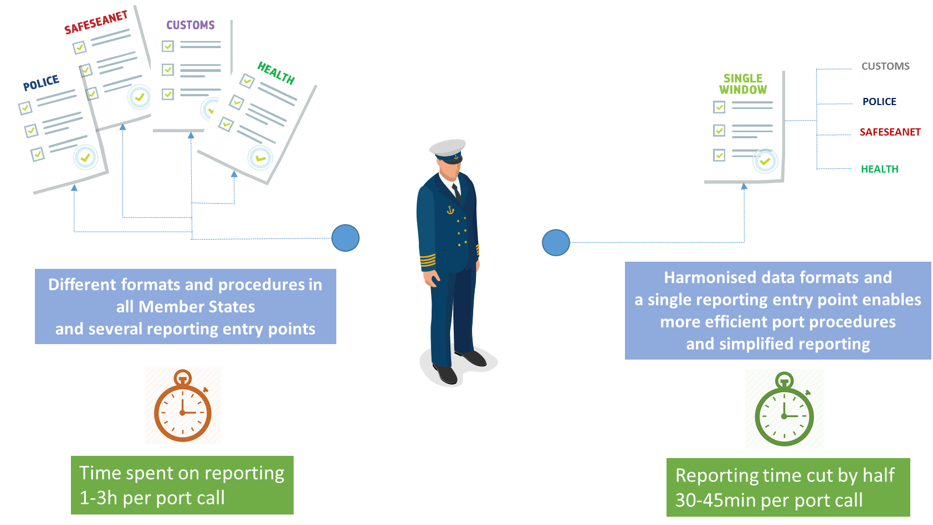
Past -> Directive 2010/65/EU -> Regulation 2019/1239/EU
  To facilitate maritime transport and further reduce administrative burden for shippers, to improve the competitiveness and efficiency of the sector and improve the working conditions for ship masters, through further simplification and harmonisation of information transmission procedures

Slide 5
Evaluation of the EU
Directive on Reporting Formalities
The Directive 2010/65/EU on Reporting Formalities adopted in 2010 has failed to reduce sufficiently administrative burden due to lack of harmonisation between the EU Member States. Total of 2.5 mi hours could be saved annually with more efficient reporting procedures.
Problems:
  Diverse interfaces: All National Single Windows have different interfaces, data formats and procedures
  Diverse reporting requirements: The Directive covers only 14 international and EU formalities
  Data requirements not harmonised: data not efficiently re-used = reporting duplication

Slide 6
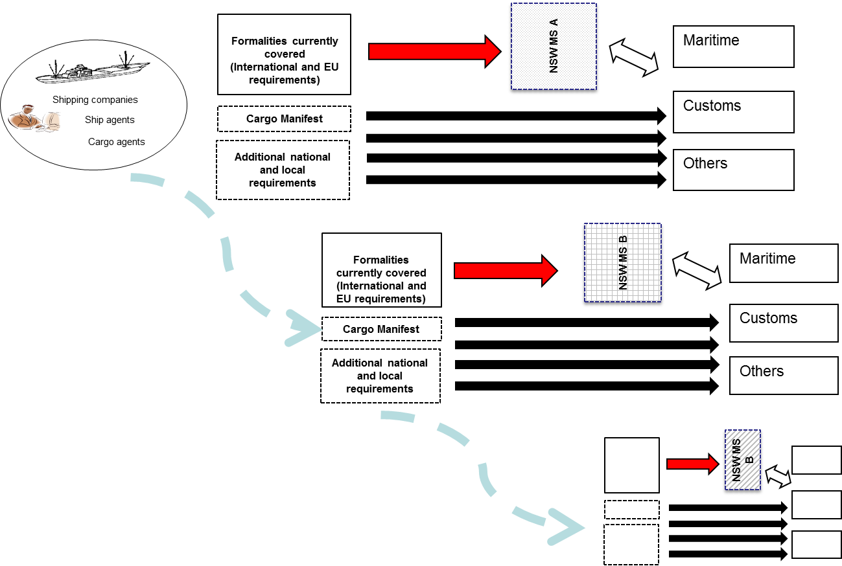
The problem (older schema)

Slide 7
EMSWe subject matter and scope
This Regulation establishes a framework for a technologically neutral and interoperable European Maritime Single Window environment (‘EMSWe’) with harmonised interfaces, in order to facilitate the electronic transmission of information in relation to reporting obligations for ships arriving at, staying in and departing from a Union port.

Slide 8
Provisions of EMSWe
A decentralised network of Maritime National Single Windows with:
A harmonised common data set
Comprehensive reporting – all reporting formalities, including customs and national and local reporting
Harmonised interfaces for manual reporting and system-to-system with harmonised internet addresses
A common user registry and access management system
Common databases for ship identification, locations codes and information on dangerous and polluting goods
Publication of arrival and departure times of ships calling in EU ports

Slide 9
Involved parties around EMSWe
Declarant
Any natural or legal person who is subject to reporting obligations or any duly authorised natural or legal person acting on that person’s behalf within the limits of the relevant reporting obligation
MS’s competent national authorities and customs
Authorities that require data to be submitted when ships makes a port call in EU port
Industry, Member States, Commission and EMSA
Parties involved in establishing the EMSWe
Authorities responsible for customs formalities
Data service providers
Who provides ICT service for the declarant in order to connect to the interfaces and exchange information with the MNSWs.

Slide 10
Main components of EMSWe
Maritime National Single Window
Graphical User Interface
Common Addressing Service*
Common databases
EMSWe ship database*
Common location database*
Common Hazmat Database*
Common Ship Sanitation Database*
User registry and access management system*
Reporting Interface Module*
Notes:
* IT components with Commission responsibilities

Slide 11
EMSWe Architecture components
Commission responsibilities deriving from the Regulation
RIM- Harmonised Reporting Interface Module (specifications, development, maintenance, information for integration) (Article 6 (1,2))
Common functionalities for GUIs - graphical user interfaces of MNSW (Article 6 (4))
Common user registry and access management system (Article 12 (1))
Common databases (ship, location, hazmat, sanitation) (Article 14-17)
CAS - Common addressing service(Article 13(1))

Slide 12
EMSWe architecture components
Member State responsibilities deriving from the Regulation
MNSW - Maritime National Single Window (Article 5(1))
GUI – Graphical User Interface of the MNSW, adherence to the common functionalities (Article 5 (3.a))
Compatibility of the MNSW with the harmonised reporting module(Article 5 (3.a))
Connections with the relevant systems of the competent authorities(Article 5(3.c), 4)

Slide 13
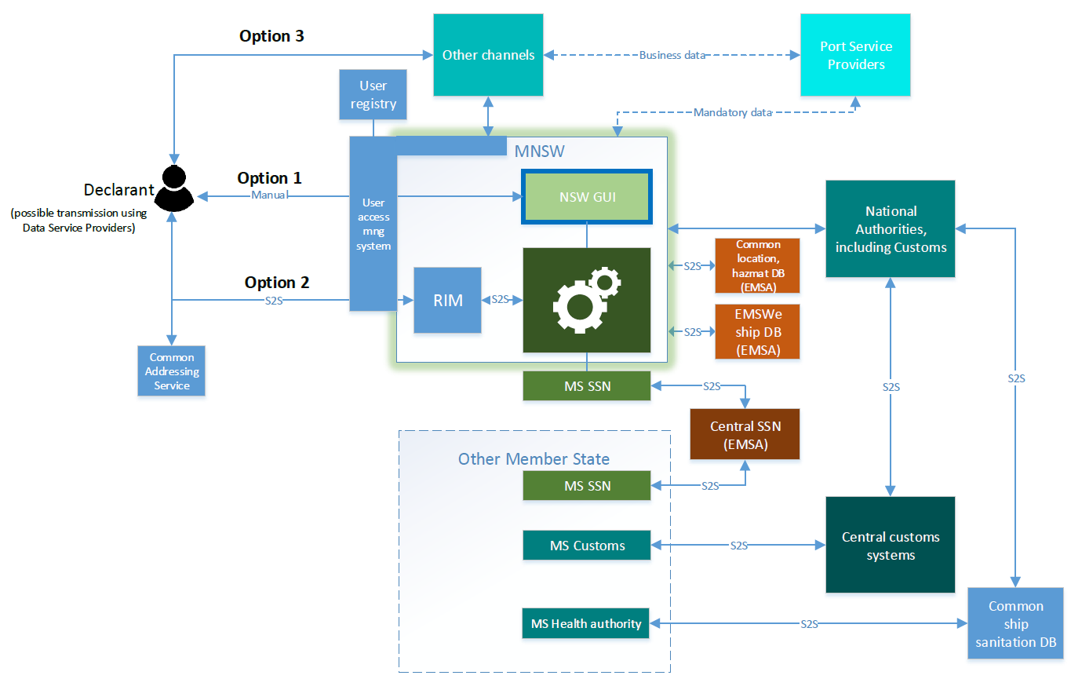
HL EMSWe architecture based on the Regulation
Notes:
Options 1, 2, 3 represent the possible channels for the declarant to submit reporting obligations.
Components in light blue are Commissions' responsibility to develop and establish
RIM component will have a shared responsibility between MS and the Commission – COM develops it, each MS have to integrate it in their MNSW platform and commission in collaboration with MSs will update the module

Slide 14
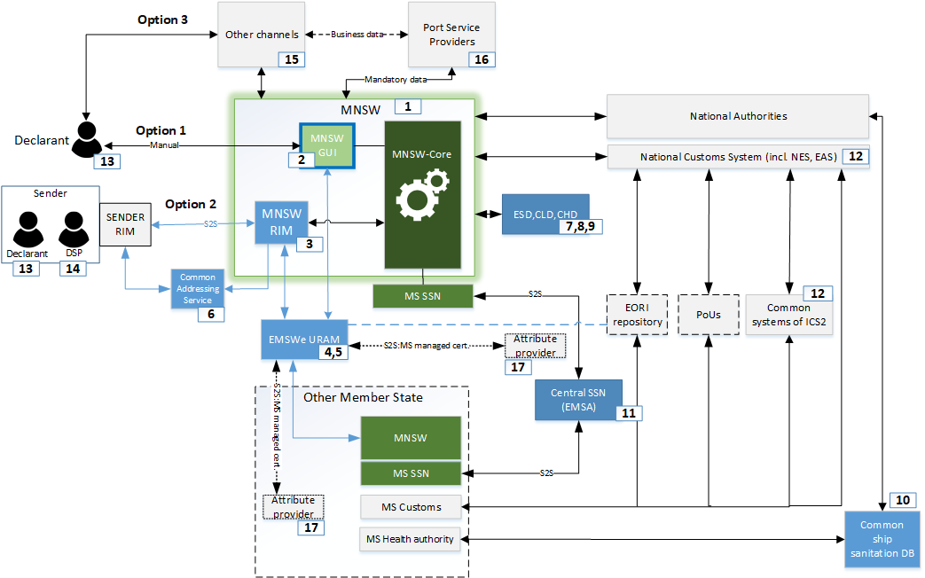
More detailed EMSWe architecture based on the Regulation

Slide 15
EMSWe data flow

Slide 16
Common objectives
HTI of ICS2
  limit the differences between the interfaces
  Facilitation of the industry and reduce administrative burden
EMSWe
  For the facilitation of maritime transport, and in order to further reduce the administrative burden … the information procedures for fulfilment of reporting obligations … should be further simplified and harmonised and should be technology-neutral
Notes:
For specifications and development MS has urged to find synergies with systems in Customs such as ISC2

Slide 17
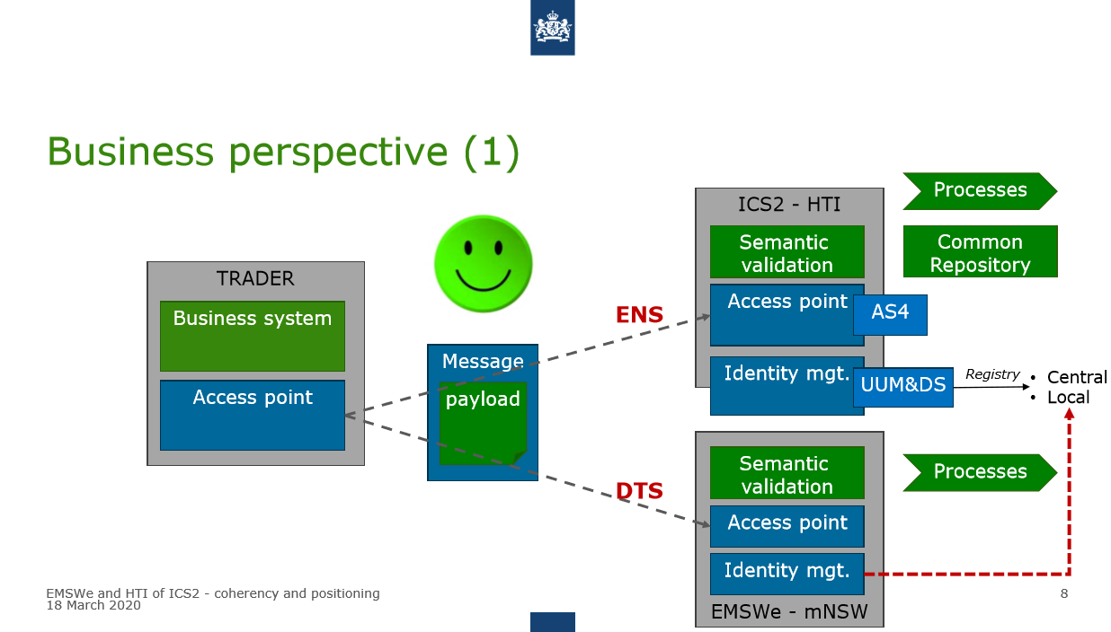
Notes:
For specifications and development MS has urged to find synergies with systems in Customs such as ISC2

Slide 18
Teams, projects, roles, responsibilities
Projects with interservice involvement |  | Stakeholders and involved entities
 |  | D1 | SRD.2 | D2 | EMSA | DIGIT | TAXUD B.1 | SANTE C.3 | HOME C.1 | ESTAT E.1
Data team
1.1 | Establishment of EMSWe data set | A / R* |  | C | R |  | S | C | C | C
1.2 | Defining ENS reference data | A / R* |  | I | C |  | S |  |  | I
1.3 | Amendment of the annex to the Regulation | A / R |  | C | C | C | C | C | C | C
1.4 | Defining the response messages for acknowledgements and decisions of authorities | A
1.5 | Defining the departure data elements to be re-used at arrival | A
1.6 | Defining the data elements to be shared via SSN | A
Interfaces team
2.1 | Specifications for the harmonised reporting interface module (RIM) | A | S | I | C | R | C
2.2 | Message Implementation Guide | A |  | I | R | C | S
2.3 | Common functionalities for the Graphical User Interface (GUI) | A |  | I | R |  | I
2.4 | Spreadsheet templates | A |  | I | R |  | I
2.5 | Structure for MSs’ helpdesk website | A / R | S | I | S |  | C
2.6 | Technical specifications for arrival and departure times | A / R | S | I | S |  | C
2.7 | Specifications for the uniform address format of the NSWs | A | S | I | S | R | C
2.8 | Specifications for the user registry (EORI) | A |  | I | I | R | S
2.9 | Specifications for the user authentication and access management | A |  | I | C | R | C
2.10 | Specifications for the Common Addressing Service | A | C | I | I | R
Databases team
3.1 | Specifications for the ship database | A |  | I | R
3.2 | Specifications the common location database | A |  | I | R |  |  |  |  | I
3.3 | Specifications for the hazmat database | A |  | I | R
Shipsan team
4.1 | Specifications for the Ship sanitation database | A |  |  |  |  |  | R

Slide 19
European Commission – DG MOVE
Unit D.1 – Maritime Transport and Logistics
move-emswe@eu.europa.eu
martins.zieds@eu.europa.eu

