Slide 1





CEF Digital 2023 - 3rd Call for Proposals
Slovenian Info Day
30 November 2023, 10:00–12:30

Slide 2
Welcome
Dr. Miroslav KRANJC,
State Secretary, Ministry of Digital transformation, Republic of Slovenia
Notes:
CNECT will be responsible for this chapter.

Slide 3
CEF- Digital
Call 1, Call 2 and Call 3 - Policy context
Mr. Gerasimos SOFIANATOS,
Deputy Head of Unit B.5. - Investment in high-capacity networks,
DG CONNECT, European Commission
Notes:
CNECT will be responsible for this chapter.

Slide 4
The Political Context: Digital Compass
2030 Digital Compass: The European Way for the Digital Decade
Digital Compass Policy Programme
Declaration on
Digital Principles
International
Partnerships
Gigabit for everyone,
5G in all populated areas
Universal access to internet services
Connecting EU with the rest of the world
Baseline 2020
Gigabit coverage | 59%
5G in all populated areas | 14%

Slide 5



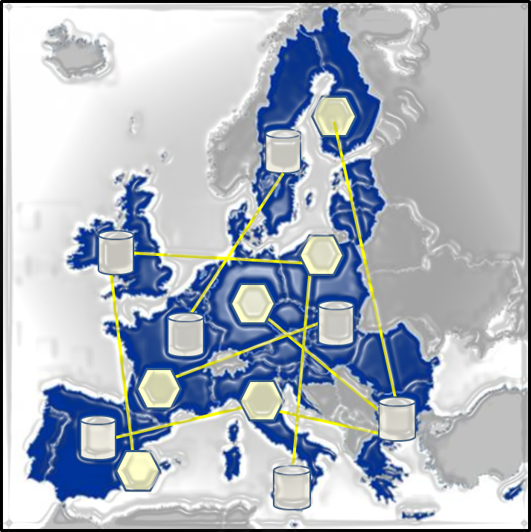



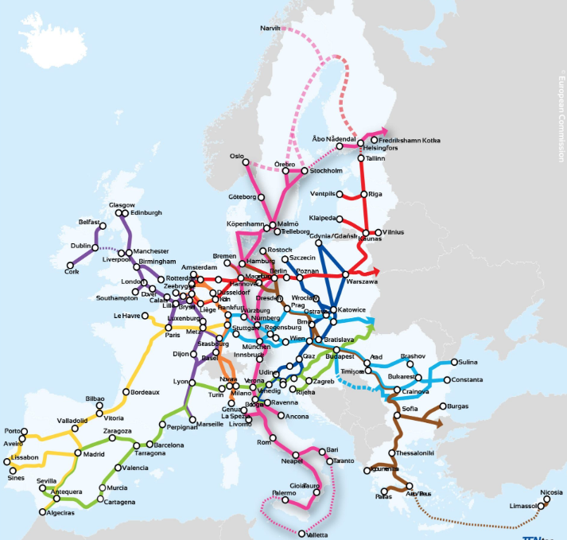

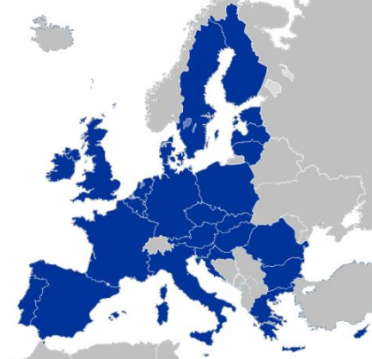
Connectivity for a post-COVID era
Socio-Economic Drivers and Use-Cases
New EU Digital Decade policy targets: 1Gbps to all households, 5G in all populated areas
Connecting the “large”: pan-European, cross-border backbones and 5G corridors
Connecting the “small”: IoT systems, towards a “zero-distance society”
Connectivity driven by innovative use-cases, stimulus to EU digital supply, strategic autonomy
AI
Digital Platforms & Solutions
HPC
Cloud
Data
Policy objectives
Gigabit infrastructure

Slide 6
Funding instruments for digital connectivity
A greener Europe
EU fit for the digital age
An inclusive Europe
Connectivity objectives
DIGITAL in the next MFF
2025: 100 Mbps to all households, upgradable to 1Gbps
2025: 1Gbps to all main socio-economic drivers
2025: Uninterrupted 5G coverage in all urban areas and all major terrestrial transport paths
2030 (Digital Decade): 1Gbps to all households; 5G in all populated areas
Horizon Europe:
R&D&I
Digital Europe:
Capacities & roll out
Connecting Europe Facility
€7.6 billion
CEF supports sustainable, cross-sector infrastructure
CEF supports access to key digital capabilities, innovations and services
CEF enables an inclusive Digital Single Market
Energy
Transport
Digital (2.000)
CEF– Digital: Connectivity
€2 billion
InvestEU
Next Generation EU
Recovery and Resilience Facility
ESIF
MS own investments
Private investments
CEF 2021-2027 (million €)

Slide 7
CEF 2 Digital - in figures
2 Billion
  Co-funding : rates from 30% (inside-MS infrastructures) to 75% (socio-economic drivers)
  Market Failure Intervention Logic
2 Work Programmes
  WP1 2021-23 / WP2 2024-27
  Synergy with RRF and other programmes (incl. via Blending)
7 Key Actions
  Strategic Backbones / 5G / Digitizing ener. & transport networks
  Coordination and support actions

Slide 8
Work Programme 2021-23 – Content Overview
5G Infrastructure
5G Communities
Backbone Infrastructure
Cloud Federations
Submarine Cables
HPC interconnection
Synergy Actions
5G Corridors
Quantum Communication Infrastructure
Operational Digital Platforms
Programme Support Actions
Financial Instruments
Blending Facility (tbc)
Studies, Communications & Other measures
Broadband Competence Offices
Smart Communities Support Platform
5G Strategic Deployment Agenda
Programme Monitoring and Impact

Slide 9
CEF-Digital Call-3 – policy context
Underpinning Digital Decade targets (5G & Gigabit)
Strengthening EU connectivity with the rest of the world (Global Gateway)
Ensuring EU resilience in a tense geopolitical context
Supporting the transformation of the telecom sector

Slide 10
CEF-Digital Call-3 : Building on Call 2 lessons
More time for applicants to prepare proposals
More time for MSs to provide support/approvals
Continuity with exclusion clauses and guarantees
Size of calls and readiness of topics
Indicative grant size of proposals

Slide 11
Call 3: Opened 17 Oct 2023 – Closes 20 Feb 2024
Accelerating 5G deployment
5G corridors (EUR 100 million):
  95M€ for works
  5M€ for studies
  5G communities (EUR 51 million)
  51M€ for works
  We expect around 15 new 5G standalone best practices
5G corridors:
  25M€ for works
  5M€ for studies and CSA (5G-cloud-edge integration)
  5G communities
  50M€ for works
  We expect around 15 new 5G standalone best practices
Strategic backbones
  Global gateways (EUR 90 million)
  75M€ for works, key strategic projects based on Global gateway priorities
  15M€ for studies
Total budget: 241M€
Quality of proposal is key for success of calls!

Slide 12

Presentations by topic
Join at
Slido.com
#CEFdigital

Slide 13

Call 3: 5G and Edge Cloud for Smart Communities
Mr. Gerasimos SOFIANATOS,
Deputy Head of Unit B.5. - Investment in high-capacity networks,
DG CONNECT, European Commission

Slide 14




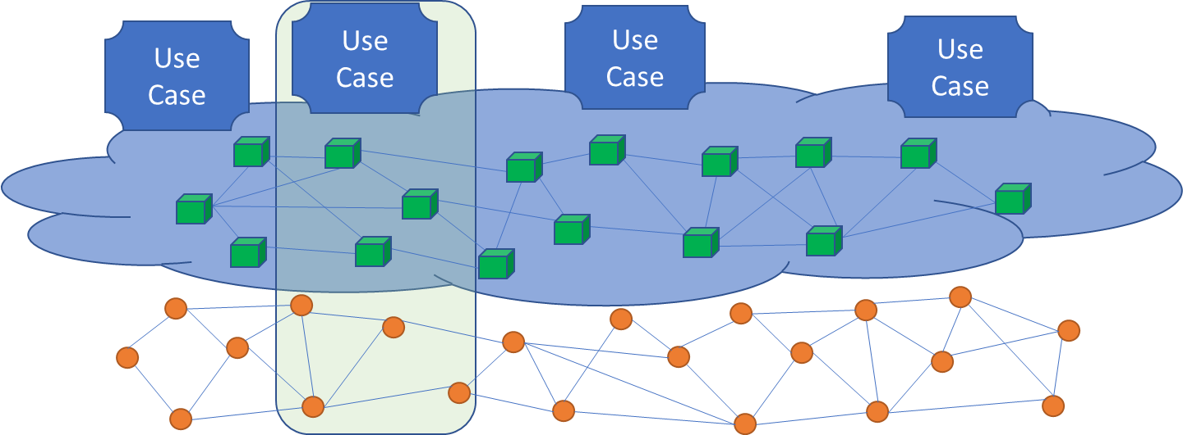
The 5G “continuum”
Large-scale 5G deployments Local 5G systems
Major transport paths
Urban areas
Rural areas
Geographical continuum:
From main corridors and cities to local communities and villages
Technological continuum:
Application-driven vertical integration, stimulus to EU digital supply chain
Cloud Edge
infrastructure
Connected objects and devices (IoT)
5G deployment and take up (bundling connectivity to applications via cloud-to-edge/data/IoT)

Slide 15
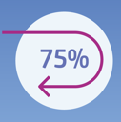


5G and Edge Cloud for Smart Communities
CEF-DIG-2023-5GSMARTCOM-EDGE-WORKS
Reimbursing up to 75% of the infrastructure costs
Facilitating an online community for stakeholders (5GSC.EU)
“partner search” function of the Funding & Tenders portal

Slide 16
Using CEF Digital to pool resources
Application-pull
Private resources
Verticals co-funded by other programmes
Public resources
Technology-push
Local digital transition plan
  Examples of CEF use cases:
  Healthcare digitisation: patient monitoring and assistance at home/ambulance/hospital…
  Disaster prevention: geo-environmental data, predictive modeling,…
  Immersive virtual education and smart working environments in public administration…
  Spreading to other scenarios:
  Smart agriculture and precision farming
  Industry 4.0, manufacturing and logistics
5G use cases to improve a Service of General Interest or develop new SGIs for a local community …
Stimulating European digital supply chain and standards
5G deployments linked to use cases and enabling digital capacities’ interconnection
Use Case
Use Case
Use case
Digital enablers and capacities
(Cloud, Data, HPC, QCI, AI,…)
5G infrastructure (Base Stations, link to backhaul, connected IoT)
CEF Grant Blending
CEF Digital contribution (75%)

Slide 17
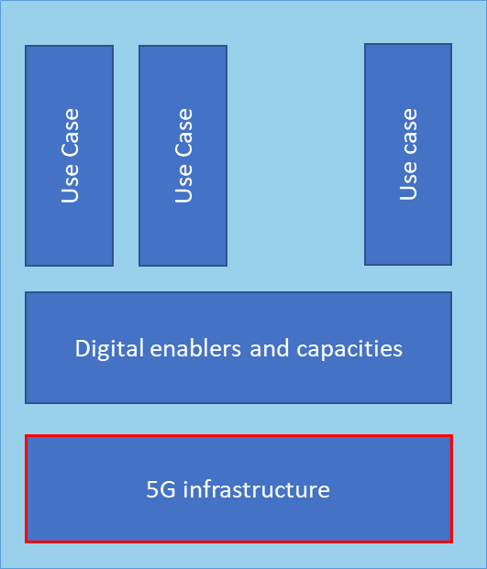
Synergy between programmes
Coordination & Support
Sharing of:
Requirement analysis
Technical specs
Reference architectures
UX tests and reports
SA notification best practices
Business models
Investment models
Partnership agreements
Technical assistance
….
RRF or National programmes
Potentially thousands projects/replicas
Coordination
& Support
  Facilitate replicability at EU level: common projects characteristics technical, procedural,…
CEF Digital
5G Communities
e.g. 50 best practices, depending on budget
Terms & conditions, licence models,….
2021
2022
2023
2024
2025

Slide 18

5G Communities
Early adoption initiative to boost 5G coverage & take up in Europe
Demand-driven: beneficiaries are providers of SGIs
Focus on projects that do not involve state aid or aid that can be considered compatible without notification
Innovative use-cases for which 5G is “indispensable”
Fibre backhaul capacity available
Best practice, blueprint for possible replication and/or co-funding under other programmes, including RRF
Up to 75% co-funding from CEF (Art. 14 of CEF Reg.)
Health, Education, R&I programmes…

Slide 19
5G and Edge Cloud for Smart Communities
CEF-DIG-2023-5GSMARTCOM-EDGE-WORKS
Funding
Raising Awareness
Call-3: 51 million euros
Deployment of 5G and Edge infrastructure elements that enable innovative use-cases for services of general interest or public authorities
Benefits of 5G in populated areas & the importance of reaching 5G targets
FYI: The dedicated Coordination & Support platform (CSA) will gather good practices & disseminate results
See also the call: CSA for edge cloud integration

Slide 20


5G and Edge Cloud for Smart Communities
CEF-DIG-2023-5GSMARTCOM-EDGE-WORKS
Eligible costs
Security Requirements
5G passive & active infrastructure, including 5G connectivity software & services and connectivity hardware/software for objects
Edge cloud hardware/software
Fibre backhaul, yet not the major focus (< about 10%)
Individual applications, internet software services
Applicants should fill in self-declarations, including guarantees approved by the Member State in which they are established, on the basis of national law
(Not applicable for the end-users of the consortium)

Slide 21

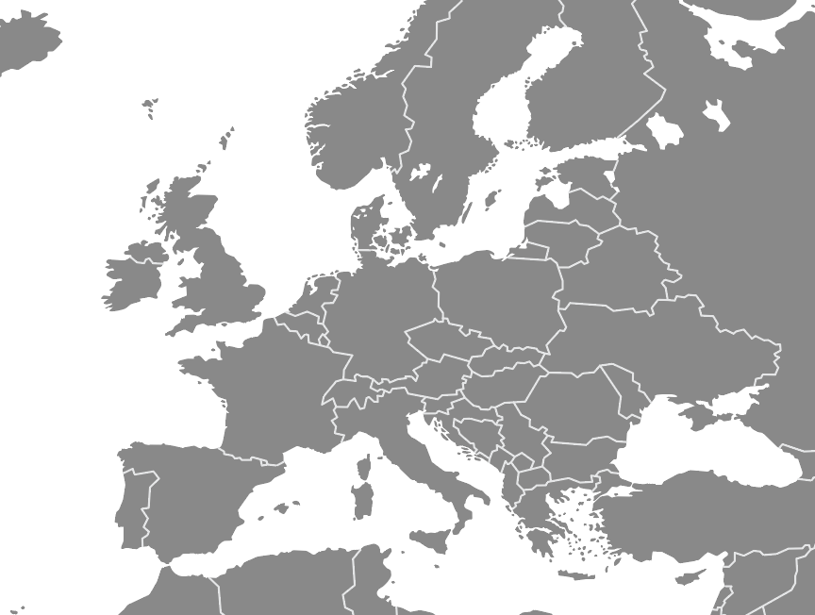

Call 1 to Call 2 Evolution
Call 1 (ongoing projects)
Connectow
5G4UH
PPDR 5G
Flanders Smart Fields
5GAGRIHUB
Hi5
5G4ASSAC

Slide 22
Call 1 to Call 2 Evolution
ED5GE
Private 5G network
Call 1 (ongoing projects)
Call 2 (submitted proposals)
SC Roscommon 5G Net
Laois 5G SC
5GMHI
Connectow
5G4UH
TUKE 5GSC
SC Limerick 5G Net
5G4LIVES
PPDR 5G
5 GENIUS
Flanders Smart Fields
5G Healthcare
5GAGRIHUB
Hi5
SmartPortPloce
ERL5G
5G.RURAL
5G4ASSAC
5G-TERRA

Slide 23
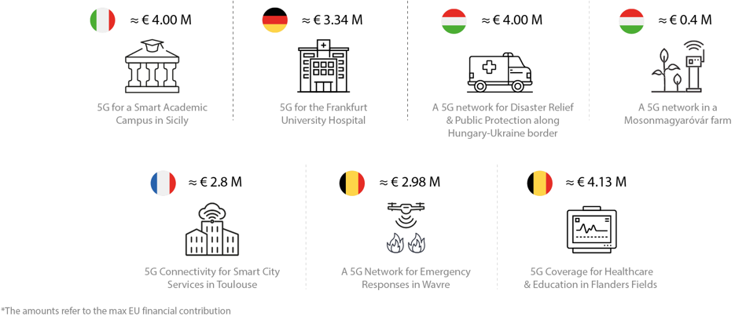
Example of projects

Slide 24
5GSC Call-1 & -2 trends
From projects’ portfolio
  Public Operators - Alternative Operators - Tower Companies
  Public & Private 5G Networks (MPN)
  Transitional flexibility: 5G Standalone (SA) & 5G non-Standalone (NSA) (RF upgrade, 4G core)
  Edge Cloud network integration (with EU-based cloud solutions)
    Key benefits:
            Densification: increase of the connected objects & devices
            Reduced power consumption
  Variety of IoT applications (port safety, city recycling, city traffic, precision agriculture)
  Multiple verticals (health, education, energy, transport)
  Positive impact in environmental transition and energy consumption

Slide 25
Call-3 in a snapshot
What’s new
  Bundling 5G with Edge Cloud deployment.
  Reimbursement of the Edge Cloud computing infra as an option (if deployed at the same location to take advantage of energy and time efficiencies).
What remains unchanged
  At least 2 partners: the owner of the 5G infra & the provider of the SGI use-case.
  Up to 75% reimbursement of the infra cost (passive & active).
    Fibre backhaul (up to 10%).
  Total funding: €51 million.
  Procurements should be in line with 5G cybersecurity toolbox (high-risk suppliers).
  Duration 36 months (extensions are possible).

Slide 26

5GSC Community Support Platform
Make sure to join the 5GSC Community Support Platform: 5GSC.eu
The platform is a networking & knowledge-exchange online platform where you can:
  Meet like-minded stakeholders & project partners
  Share good practices
  Stay up to date with 5G events
  Get information on call openings

Slide 27
Call 3: 5G and Edge Cloud for Smart Communities
Useful tips and Guidelines for
Applicants of Call 3
Mr Xavier DERREY,
Head of Sector of Unit “Connecting Europe Facility – Digital”, Health and Digital Executive Agency (HaDEA)

Slide 28

Programme sectors
HaDEA – the European Health and Digital Executive Agency
Health
Food safety
Space
Industry
Digital

Slide 29
Budget managed by HaDEA
(2021-2027)
Single Market Programme
Food safety
€1.3 billion
CEF Digital
€1.6 billion
EU4Health
€4.7 billion*
Out of total budget
of €5.3 billion
*in current prices
Digital Europe
€0.8 billion
Expected total budget managed by HaDEA will amount to over
€20 billion
Horizon Europe
Digital, Industry
& Space cluster
€6.1 billion
Including €500 million
under Next Generation EU
Horizon Europe
Health cluster
€5.4 billion
Out of total budget
of €8.2 billion, including €1.3 billion under Next Generation EU

Slide 30



CEF-Digital programme 2021-27
CEF-Digital budget: €1.6 billion for 2021-2027
5G coverage along transport corridors
Backbone connectivity for Digital Global Gateways
Quantum Communication Infrastructure
5G and Edge for Smart Communities
Backbone networks for pan-European cloud federations
Operational Digital Platforms
€142 millions (Work Programme 2021-27)

Slide 31
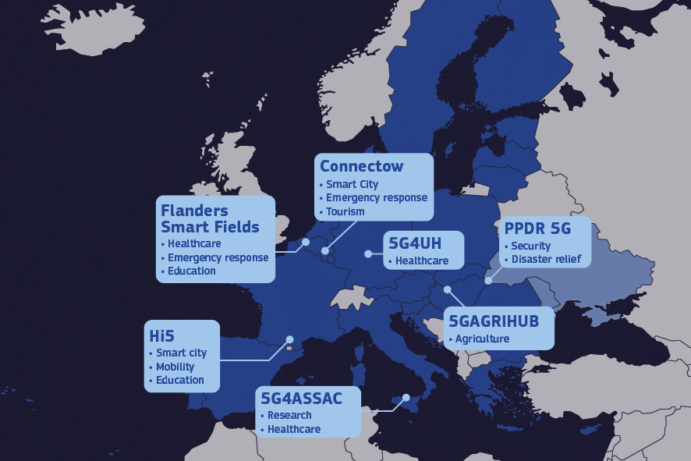




1st wave of 5G for Smart Community (5GSC) projects
7 projects funded in a first wave
Total investment €28 M
EU grants €21,4 M
Replicable 5G use cases for socio-economic drivers
Learn more

Slide 32
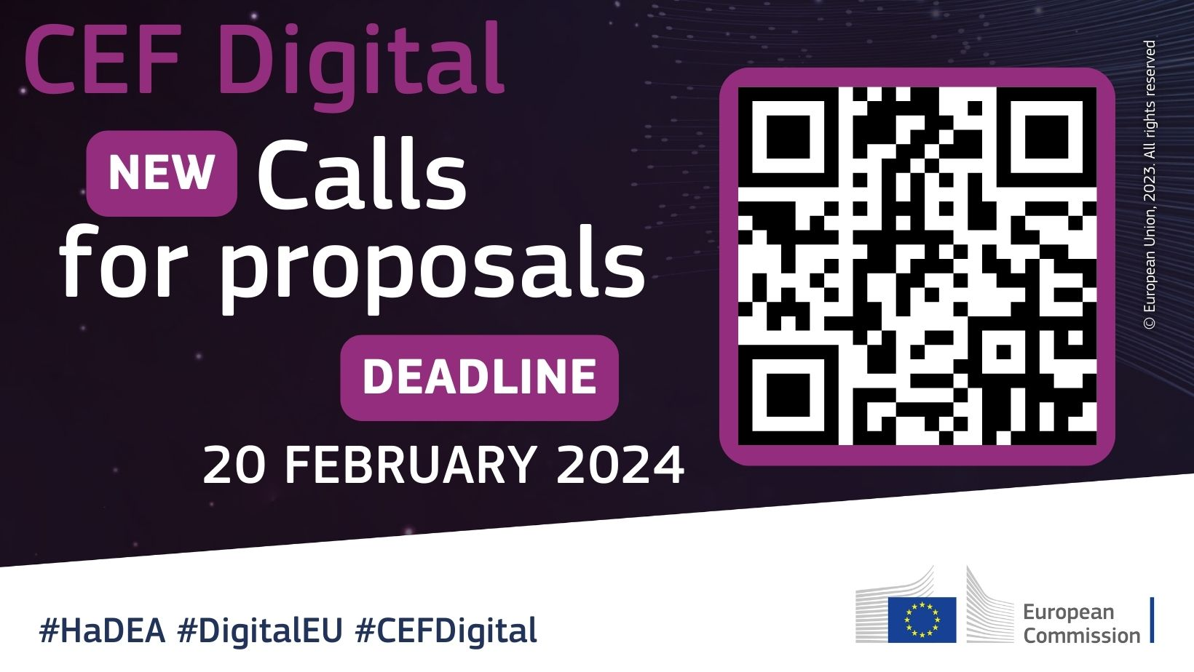



CEF Digital: Calls-3 are open!
hadea.ec.europa.eu
HaDEA – European Health and Digital Executive Agency
@EU_HaDEA
HADEA-CEF-DIGITAL-CALLS@ec.europa.eu

Slide 33



5GSC Consortium Composition
At least 2 partners:
The owners of the funded 5G infrastructure:
the company (MNO) that will operate the network infrastructure (possibly a private network and with unlicensed 5G spectrum)
The end-users:
public authorities or providers of services of general interest (during the lifetime of the project)

Slide 34
Scope
Scope | MNO | End-User | Out of scope
5G active infrastructure (5G radio equipment)
5G passive infrastructure (additional base stations necessary)
Licenses and software for 5G connectivity
Connectivity elements of mobile or fixed devices (antenna equipment, transceivers and connected sensors)
Fibre backhaul | (< 10%)
Upgrade of existing infrastructure
Edge computing infrastructure, including hardware and software
Internet & software services
Development of the 5G use case
Use case design

Slide 35
Quality of proposal
What is the reader looking for?
  Simple language
    Avoid jargon and do not take any background knowledge for granted
  Information easy to find
    It is your responsibility to demonstrate how your proposal addresses the award criteria as indicated in the call text. The evaluation of your proposal is based on the content you provide in the application form; be as specific and clear as possible.
    No assumptions or requests for additional information will be made.
  Mandatory annexes
  Relevant maps, graphs, etc. (optional annexes)
Notes:
To be able to assess/evaluate the proposal

Slide 36
Mandatory annexes - Requirements
    Digital security declarations signed by the participating entities
    Digital security guarantees signed by the participating entities & approved by Member States
    End-user declaration - no (sufficient) 5G connectivity service available
    MNO declaration - beyond coverage obligations
    Member States agreement - Letters of support
    Local/regional authorities letter - no other support/roll-out planned

Slide 37
DO’S DON’TS
Application Process
Read carefully the Work Programme & Call document;
Always use the application forms and templates provided in the Submission System;
Read the evaluation criteria and convincingly demonstrate the need for EU funds;
Complete all sections and submit mandatory supporting documents (security declaration & guarantee etc.)
Submit as many times you wish, updating your application, before the call deadline.
Don’t forget to describe the technical architecture of the 5G use cases;
Don’t include activities which are out of scope;
Do not forget to register all beneficiaries, affiliated entities and associated partners in the Participant Register;
Don’t forget to put both the 2 minimum applicants in the system;
Don’t wait until the last minute to submit your application.

Slide 38

Applicant’s checklist
Did you…
  Contact external stakeholders (administrations, MS), as early as possible in order to get support letters, security guarantees approvals, in time
    Check the National Contact Points (europa.eu)
Deadline by 20 February 2024 at 17:00 CET (Brussels time)
  Complete your application sufficiently in advance to avoid any last-minute technical problems. Don’t leave submission to the last day!
Notes:
Here you can add many more:
Scope: Does your proposal fit in the scope of the Work Programme and the call for proposals for which you are applying?
Proof-read your proposal
Do one last check to ensure that your proposal is clear and easy to follow and explain issues, including local context, that may be evident to you
External evaluators can only assess your proposal based on provided information – no assumptions will be made
Make sure that your proposal demonstrates the added value of CEF Digital funding
encode all sections of application form part A directly in the F&T platform?
…read through, complete, and upload application form part B?
…complete part C directly in the F&T platform (for works proposals)?
…have your digital security guarantees approved by your Member State (if required by the call conditions)?
…attach all mandatory annexes:
see section 5. Admissibility and documents of the relevant call text

Slide 39
Be well prepared for your applications!
  Digital Security – Read carefully the new Communication from the Commission on the Implementation of the 5G cybersecurity Toolbox by Member States
  Benefit from the 5GSC Support Platform – capacity building sessions (available recordings/material), community network, cooperation and 5G use-case replicability across Europe
  Check regularly the Frequently Asked Questions in the Funding & tender opportunities portal
  CEF-Digital Info day of 26 October Recording and presentations available

Slide 40
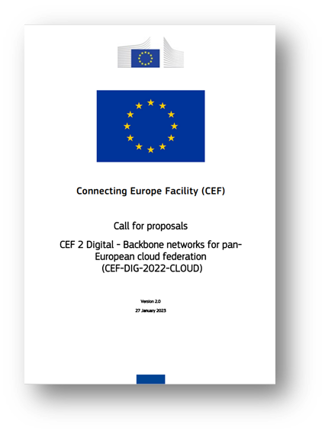
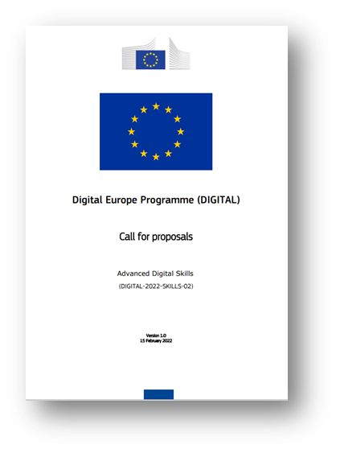
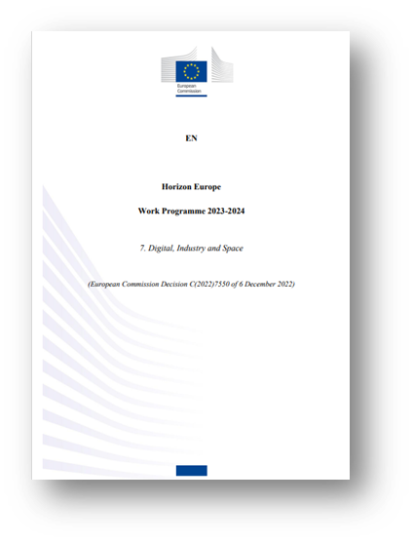
Useful links
Guidance documents
How to participate
Reference documents
Funding opportunities
Funding & tender opportunities
Helpdesk & Support
Helpdesk & Support Services
Detailed guidance for applicants and beneficiaries
Participant Register
Horizon Europe
Digital Europe Programme
Connecting Europe Facility
Support Videos

Slide 41

HaDEA at your service
Thank you!
#CEFDigital #DigitalEU
hadea.ec.europa.eu
HaDEA – European Health and Digital Executive Agency
@EU_HaDEA
© European Union 2020
Unless otherwise noted the reuse of this presentation is authorised under the CC BY 4.0 license. For any use or reproduction of elements that are not owned by the EU, permission may need to be sought directly from the respective right holders.
HADEA-CEF-DIGITAL-CALLS@ec.europa.eu

Slide 42

Call 3: 5G coverage along transport corridors
Ms Bianca JITEA,
Policy Officer, Unit E.1 - Future Connectivity Systems,
DG CONNECT, European Commission

Slide 43
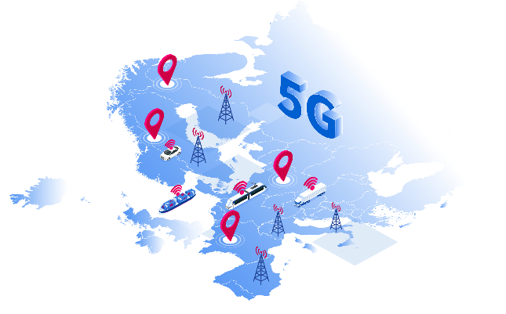
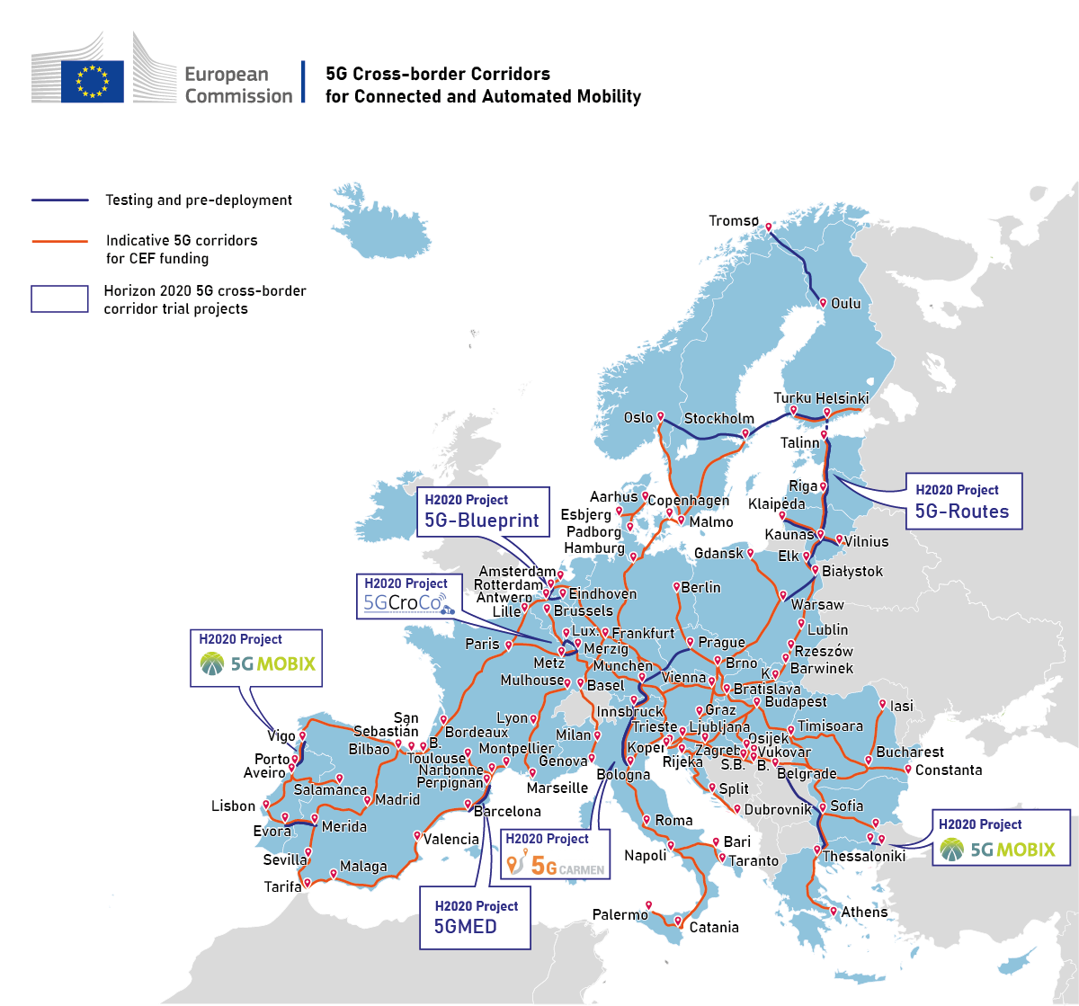
5G Corridors:
driving the EU Green and Digital Transition
Multi-country project (MCP) Vision: Pan-EU 5G corridors for Connected and Automated Mobility
Private investment with public funding of cross-border and "challenge" areas
CEF Digital
  Objective: 26.000km transport paths along TEN-T 49 intra-EU borders; Investment required: ~EUR 5,4 bn
  Planned EC funding ~€800M for 5G Corridors
  Call-1: projects launched in 2023
  Call-2: closed, evaluation results in Q4 2023
  Call-3: 17 October 2023 - 20 February 2024
Blending or coordination with RRF, InvestEU and national programmes
Smart Networks and Services Joint Undertaking formally tasked to coordinate Strategic Deployment Agendas( Road & Rail)

Slide 44
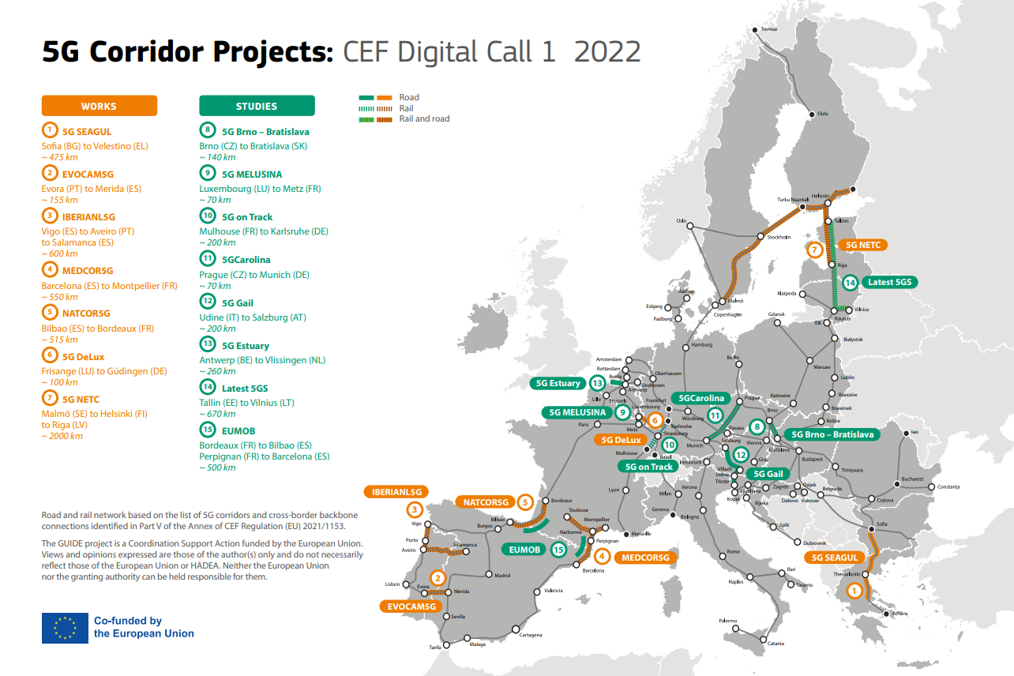

Slide 45
5G Corridor Planning
CEF Digital 5G corridor deployment calendar & planning
Year | 2021 | 2022 | 2023 | 2024 | 2025 | 2026 | 2027 | 2028 | 2029 | 2030 | EU Budget
Early Wave Call 1 | Call Q4-Q1 |  | Studies |  |  |  |  |  |  |  | 42 MM €
 | Call Q4-Q1 |  | Deployment (CEF/RRF)
Call 2 |  | Call Q4-Q1 |  | Studies |  |  |  |  |  |  | 28 MM €
 |  | Call Q4-Q1 |  | Deployment (CEF/RRF)
1st big Wave (Call-3) |  |  | Call Q4-Q1 |  | Studies |  |  |  |  |  | 100 MM €
 |  |  | Call Q4-Q1 |  | Deployment (CEF/RRF)
2nd big Wave (TBC) |  |  |  |  | Call Q1-Q2 | Studies |  |  |  |  | TBC
 |  |  |  |  | Call Q1-Q2 | Deployment (tbc)
Last Wave (TBC)
5G Corridor CEF Budget: 170 MM € for 2021-23
Call-1 Studies and Projects launched in 2023 (8 studies & 7 works)
Call-2 Studies & Projects will launch in 2024: winning projects to be announced shortly
Call-3 : Published on 17/10/23, EU budget 100 MM € (50% co-financing)

Slide 46
Call 3 Objectives
    Leverage the needed private investment to establish a full pan-European network of 5G corridors, for road, rail and waterways, with a focus on cross-border sections
    Deploy paths following the TEN-T corridors (indicative list in Part V of CEF Regulation Annex), but not limited to
    Attain uninterrupted coverage across borders and along national sections of transport paths, thus enabling service continuity for vehicles, trains, barges etc., on the move
    Provide 5G connectivity that meets stringent QoS requirements for CAM, FRMCS, RIS and multi-service application of 5G services, including non-safety related services
    Transport modes covered: rail, road, inland waterways and/or a multimodal combination thereof (i.e., smart logistics use cases in multimodal logistics platforms and ports, etc.)

Slide 47
Call 3: What to expect?
Proposals for deployment works based on the 8 CEF-funded inception studies conducted as part of Call 1
New deployment work proposals based on preparatory work done outside of the CEF-Digital Work Programme
Inception studies to prepare the groundwork for deployment projects to be submitted in upcoming calls under the 2nd big wave in 2025
CEF Digital Budget EUR 100 million
Up to 50% co-financing for Works & Studies

Slide 48
Scope – 5G deployment works
    Investing in challenging areas where market forces alone will not deliver needed quality of service
    Deployment/ installation of
      Passive network elements including civil works: dark fibre, 5G radio stations, towers, masts and/or pylons, etc.
      Active network elements: antennae, storage and computing capabilities such as network controllers, routers, switches, exchanges, edge MEC/node etc.
      Specific track side devices (road, rail) for CAM use cases, such as sensors, cameras to monitor traffic, including connected road-side units
    Studies for preparatory works, such as network planning, to be deployed as part of proposed works within the same application

Slide 49
Consortium Composition
    Minimum 2 applicants (beneficiaries; not affiliated entities) from at least 2 Member States or a Member State & an associated/ 3rd country
    Exception: minimum 2 applicants (beneficiaries, not affiliated entities) from at least one Member State - when there is no terrestrial border with another Member State - 5G corridor deployment projects crossing the border into a 3rd country or terminating at a port with maritime connections to other EU Member States
Notes:
Exception introduced

Slide 50
Possible Consortium Members
    5G spectrum band owners / telecom operators
    Tower companies
    Public authorities/agencies in charge of traffic and infrastructure management
    Road operators
    Rail infrastructure managers
    Original equipment manufacturers (OEM)
    Mobility service providers (such as innovative solutions providers for traffic management and intelligent transport systems)
        A broad range of cooperation models
Notes:
Regarding the last bullet on cooperation model, the "who does what" depends for instance on network sharing options with leads to the next slide on efficiencies and synergies

Slide 51
Call requirements: deployment works
    Cross border areas – Threshold 15%, more if market failure
    Make use of 5G pioneer bands
    FRMCS 900MGhz and 1900MHz also in scope
    If C-ITS using 5.9 GHz is covered by the project, compatibility/analysis to be addressed
    Go beyond coverage obligations (self-declaration MNO required)
    Digital security requirements ! declarations and guarantees
    “Market failure declaration” from coordinator – no other 5G infrastructure present or credibly planned

Slide 52
Efficiencies and Synergies
Sharing Network infrastructure (passive/active) is encouraged to reduce costs and speed-up deployment, e.g., where road and rail transport paths run in parallel
  Passive: Civil works, backhauling, mast, pylons, co-location
  Active: Secure Radio Access Network (RAN) slicing for different use cases
Integrating 5G corridors with edge nodes and cloud infrastructure to develop innovative mobility ecosystems and to also meet the needs of local communities on the way
Synergies with CEF Transport could be foreseen
Complementarity with national deployment projects covered by different instruments, such as the RRF, ESIF, or Invest EU
Notes:
The triggering of economic efficiencies, taking advantage of the multi-service feature of 5G technology, as well as synergies with other funding instruments are encouraged with the view to speed-up the pace of deployment and lower deployment costs
Passive: e.g. between MNO ad Rail infrastructure manager
Active: RAN slicing for different CAM use cases (e.g. highway maintenance, C-Vand for FRMCS services (e.g. as a fallback option in case of FRMCS infra failure). RAN slicing is like a end-to end VPN (or a tunnel) within the 5G connectivity with predicatable QoS and guaranteed SLA to enable specific use cases

Slide 53
Slovenia in call 2: 5G ADRIA
Inception study submitted by Slovenia & Croatia focused on defining the needed 5G infrastructure to support future traffic-related services to be used along TEN-T transport corridors
The addressed transport route will span from Slovenian Port Koper via Ljubljana to Bregana border crossing, continuing in Croatia to Zagreb and further to Port Rijeka
Will deliver common steps and results that could be transferable to other corridors in both countries
Consortium: Telemach Slovenija, sirokopasovne komunikacije, d.o.o., together with its partners Druzba za Avtoceste v Republiki Sloveniji D.D, Transmitters and Communications Ltd, and Univerza v Ljubljani
Results of call 2 with successful proposals to be published shortly

Slide 54
Slovenia in call 3?
5G ADRIA to prepare the groundwork for future deployment work, namely to
match the existing passive and active infrastructure along the corridor against current traffic information and management services. The study will represent the foundation for the evolution of future networks and services;
introduce initial standardized CAM services with improved traffic information and management, requiring improved 5G coverage with higher data demands and vehicle density;
introduce advanced CAM services with cooperative safety and real-time international traffic information exchange and traffic management, putting pressure on dense 5G coverage, high-data throughput, low-service latency and high-service reliability;
prepare the basis for next-generation networks with outstanding performances that might not be achievable in the near future, e.g. services requiring extremely high data throughput and low latencies.
Deployment works foreseen?

Slide 55

Call 3: Backbone connectivity for Digital Global Gateways
Thomas KÜPPER
Policy Officern Broadband and Submarine Cables
Unit Investment in High-Capacity Networks
Directorate-General for Communication Networks,
Content and Technology (DG CONNECT)
European Commission

Slide 56

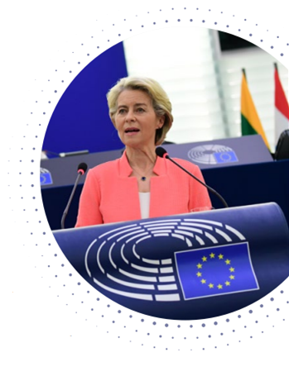
“We will build Global Gateway partnerships with countries around the world. We want investments in quality infrastructure, connecting goods, people and services around the world.
We will take a values-based approach, offering transparency and good governance to our partners.
We want to create links and not dependencies!
And we know how this can work. Since the summer, a new underwater fibre optic cable has connected Brazil to Portugal.
[…]
In an unprecedented manner, we will invest in 5G and fibre.”
President European Commission, Ursula von der Leyen
State of the Union speech to the European Parliament, Strasbourg,
15 September 2021

Slide 57
Connectivity Ambition
2025 Gigabit Society Objectives
  100 Mbps to all households, upgradable to 1Gbps
  1Gbps to all main socio-economic drivers (schools, businesses etc.)
  Uninterrupted 5G coverage in all urban areas and all major terrestrial transport paths
2030 Digital Compass Targets
  All European households will be covered by a Gigabit network
  All populated areas covered by 5G

Slide 58
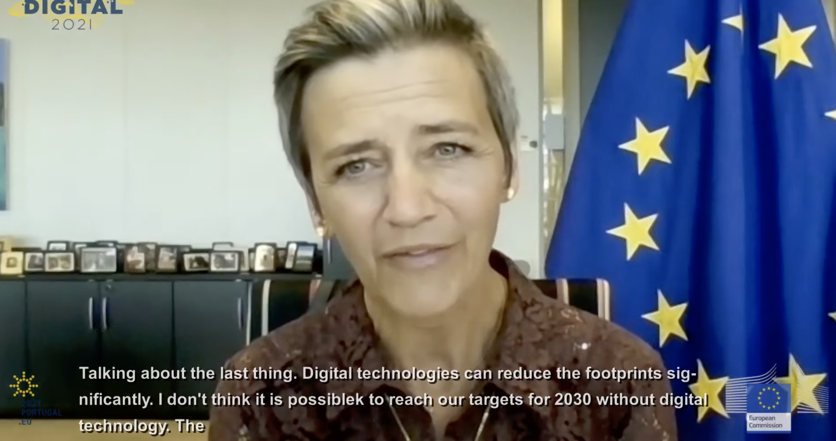

Slide 59
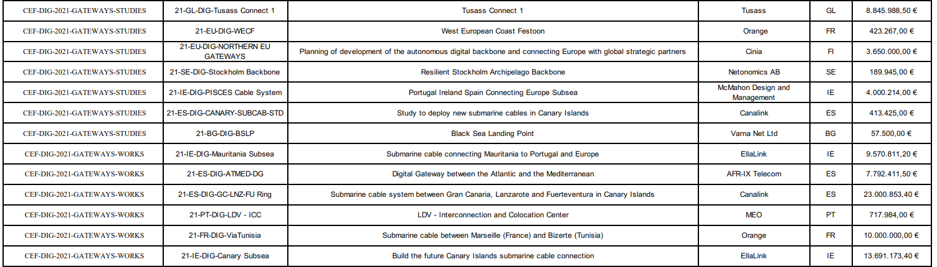

Digital Global Gateways - CEF Call 1 Results

Slide 60
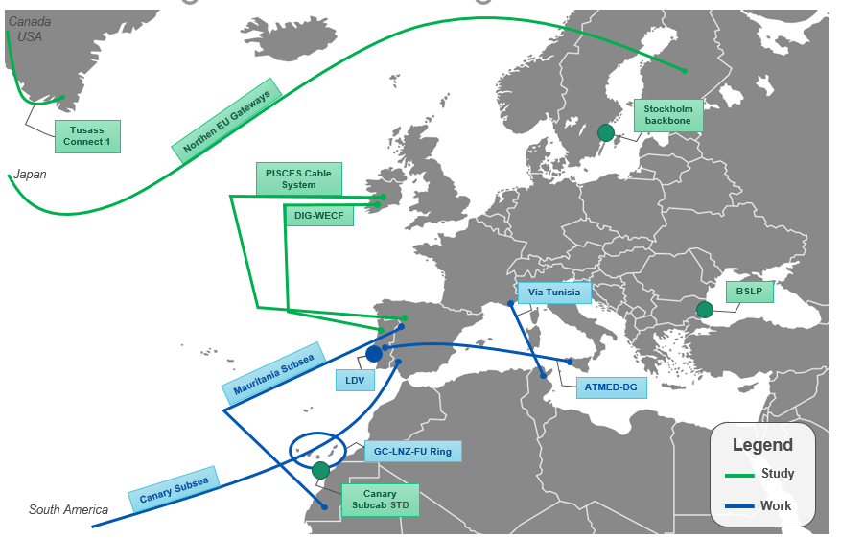
Digital Global Gateways - CEF Call-1 map
Please note that this map is a draft and may not reflect the real path of the cables.

Slide 61








Digital Global Gateways
CEF Call-1 financed project
1 OCTs – Greenland
3 ORs – Canary islands

Slide 62
Digital Global Gateways
Total volume of the GAs
The CEF-Digital Call-1 is enabling Digital Global Gateways projects (studies + works) with a total volume of ≈176 MM €.
≈ 81.9 MM €

Slide 63
Backbone connectivity for Digital Global Gateways
CEF-DIG-2023-GATEWAYS-WORKS & STUDIES
1. Objective
Support the deployment of strategic networks as part of the Digital Global Gateway Strategy of the EU by addressing connectivity needs, such as:
  (1) Connecting territories of the EU including its Outermost Regions.
  (2) Supporting the specific connectivity needs of the Member States, which are islands themselves, or have islands as part of their territory.
  (3) Intermeshing backbones to interconnect major connectivity points in the EU.
  (4) Addressing the specific needs of Overseas Countries and Territories in the EU.
  (5) Ensuring international connectivity to EU partners worldwide as a basis for European strategic autonomy.
  (6) Promoting synergy projects addressing other objectives of CEF Digital, including sector specific considerations encompassing the connectivity of large-scale digital capacities such as HPC or cloud.

Slide 64
Backbone connectivity for Digital Global Gateways
CEF-DIG-2023-GATEWAYS-WORKS & STUDIES
2. Scope
Support the deployment of backbone connectivity for routes within Member States, between Member States, and between the EU and third countries, including to remote territories where:
(1) there is a lack of redundancy, or
(2) existing infrastructure cannot satisfy demand, or
(3) the users in the territories suffer from suboptimal services and prices.
3. Security requirements
Exclusion of non-EU controlled entities (art. 11.4 CEF regulation).
Exception for infrastructure connecting EU with third countries: legal entities in that third country where their participation is indispensable for the achievement of the objectives can participate subject to security guarantees approved by the third country.
Security declaration that no security sensitive equipment or services procured from third country suppliers.

Slide 65
Backbone connectivity for Digital Global Gateways
CEF-DIG-2023-GATEWAYS-WORKS & STUDIES
4. Technology neutral call
Digital Global Gateways can make use of the technology best suited including e.g.:
• Submarine Cable Systems,
• Satellite Infrastructure,
• Connectivity to internet exchange points, and
• Inter-Connection of Backbones with networks within the supported territories
5. What will be co-financed
For works: Costs required to construct and deliver the infrastructure for the foreseen lifetime, from end to end, including cable landing station and their connectivity. Operating costs, and costs for the land ownership excluded.
For studies: All preparatory work required to design, deploy and deliver a backbone network, e.g., marine ground surveys for submarine cables, the application for required permits, technological solutions, including any step prior to signing a contract with a supplier, etc.

Slide 66
Backbone connectivity for Digital Global Gateways
CEF-DIG-2023-GATEWAYS-WORKS & STUDIES
6. Changes in Call-3
Alignment with Digital Network Strategy
  Focus on Global Gateway
Reinforcement of sovereignty:
  Where guarantees are requested (international gateways),
  no change of ownership/control imposed (10 years)
  Security provisions: additional reference to the Communication of 15 June 2023
  New template Business plan financial spreadsheet (works only)

Slide 67
Backbone connectivity for Digital Global Gateways
CEF-DIG-2023-GATEWAYS-WORKS & STUDIES
7. Maximum co-financing rates
Studies within a works proposal may also be financed up to 50%!
Smart Cables are in scope!
Call-3 overall budget is 90 M€ (up from 40 M€ in Call-1, similar to 100 M€ in Call-2).
Split 75M€ for works and 15M€ for studies
Indicative grant size: up to 20 M€ for works and 5 M€ for studies.
Works: 30 %
Studies: 50%
Strong Cross-border Dimension: 50%
In Outermost Regions: 70%

Slide 68
Business plan financial spreadsheet
CEF-DIG-2023-GATEWAYS-WORKS
New required document
Submitting a Business plan financial spreadsheet is an admissibility condition only for Works proposals
For a matter of proportionality, the requirement applies only to this priority because the requested grants are larger
Its main purpose is to help applicants demonstrate the market failure and assess the effect of the EU financial assistance

Slide 69
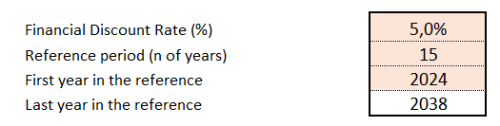
Business plan financial spreadsheet
CEF-DIG-2023-GATEWAYS-WORKS
The Excel template is available in the Submission System and is password protected.
Only the input cells/sheets can be modified.
All instructions are detailed in the “Notice” sheet
We have adopted the template that is used in the CEF-Energy sector. In future Calls we plan to adapt it to the Digital Global Gateways.

Slide 70
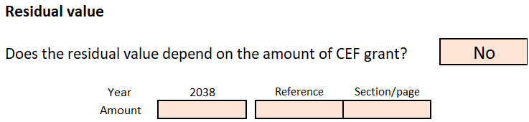
Business plan financial spreadsheet
CEF-DIG-2023-GATEWAYS-WORKS
The questions on revenues/residual value depending on the CEF Grant should be replied “No”
This dependency happens often in the energy sector, where regulated asset bases (RAB) are common, but this is in principle not applicable to digital global gateways
The Financial Discount rate (net of inflation) is prefilled at 5%
If this hurdle rate is not adapted to the project at stake, it can be modified but the new rate must be justified (e.g. with a WACC calculation)

Slide 71
Questions & Answers

