Slide 1
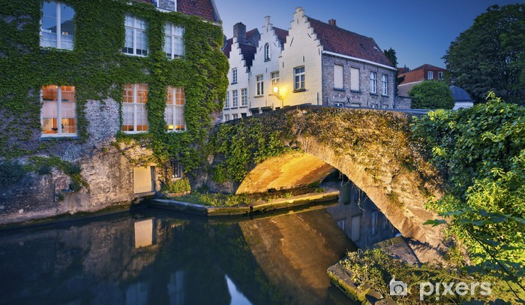
From the Declaration of Bruges until today: the first decade of the Reflection Group and the way forward Ameels Vera, Policy officer Flanders Heritage (Belgium)

Slide 2
Declaration of Bruges (2010)
Belgian Presidencies statement
EU CH
is rich and divers: monuments, cities of art, archaeological sites, museums and collections, archives, traditions and cultural and natural landscapes
is a major source of both direct and indirect employment
plays a significant role in the quality of life of European citizens
contributes to the development of a common but diverse European identity
is an important factor in stimulating cultural diversity and intercultural dialogue
classified on the EU level under culture but closely related to a variety of other sectors such as agriculture, spatial planning, media, research, environment and tourism, etc.

Slide 3
Declaration of Bruges (2010)
Belgian Presidencies statement
European Union
has a facilitating role in culture –day to day management and preservation on national or regional level
has wider decision-making powers in other policy areas with direct or indirect consequences for heritage
The cultural heritage sector
contributes to the implementation of the policy of the European institutions
but could organize itself to better serve its interests and concerns at EU level

Slide 4
Declaration of Bruges (2010)

Slide 5
Declaration of Bruges (2010)
Belgian Presidency declared that:
it is important to play a proactive role vis-à-vis the developments, challenges and opportunities which present themselves within European policy
it would be advisable to prepare a specific, long-term plan which searches for possibilities to ensure that the potential of cultural heritage is better incorporated in the general policy of the European Union
Interaction with the European Union policy-making level is central
One of the central elements in the long term plan:
to set up a European platform: an umbrella organization representing governments, academics, professionals, subsidized institutions in charge of the collection of heritage elements and the civil society, which can respond to the developments, challenges and opportunities that present themselves within European policy

Slide 6
Declaration of Bruges (2010)
One of the central elements in the longterm plan
to set up a European platform: an umbrella organization representing governments, academics, professionals, …, and the civil society, which can respond to the developments, challenges and opportunities that present themselves within European policy

Slide 7
Reflection Group EU and Cultural Heritage

Slide 8
Reflection Group EU and Cultural heritage
2011
First steps taken to bring all parties toghether
Mission Vision of the RG
Belgian secretariat and rotation chairmanship
Informal expert platform for exchange, discussion and reflection
Complements various formal working groups and bodies of Members States’ representatives
Efficient networking and mutual trust
Longterm engagement of the members

Slide 9
Reflection Group EU and Cultural heritage
Actions:
Exchange of information and cooperation on:
A diversity of topics corresponding to national needs, policies and activities, connected to the Presidency of the Council of the EU
Council Conclusions, EU presidencies meetings, CAP-paper, Workplan for Culture, EYCH 2018, European Year of Rail…

Slide 10
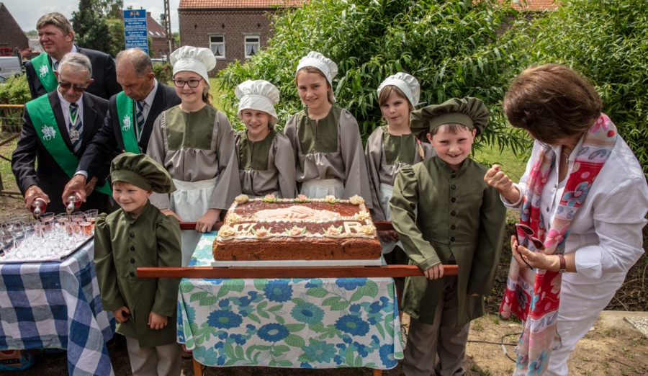
Reflection Group EU and Cultural Heritage

Slide 11
Reflection Group EU and Cultural heritage
10th anniversary
Time to look back – Time to look forward
What changed over the years ?
Which way to go ?

Slide 12
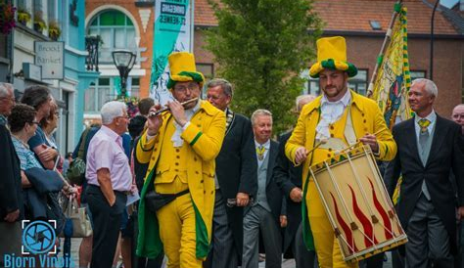
From the Declaration of Bruges until today

Slide 13
From the Declaration of Bruges until today
EU CH
is rich and divers …. heritage more than ever needs to be taken in all its complexity
plays a significant role in the quality of life .... transversal topics and initiatives such as sustainability / climate change / Green Deal / new European Bauhaus
classified on the EU level under culture but closely related to a variety of other sectors such as agriculture, spatial planning, media, research, environment and tourism, etc. …… heritage domain needs an interdisciplinary conduct, professionals and experts included into strategic discussions that affect our environment, economy and society

Slide 14
From the Declaration of Bruges until today
Develloping a European platform: an umbrella organization representing governments, academics, professionals, and the civil society, which can respond to the developments, challenges and opportunities that present themselves within European policy
several groups ( EHHF, EHLF, EAC, OMC-groups, EU Expert group, Portuguese presidency initiative, Friends of CH network …. (re-)position to what other groups are doing
complementary of existing activities needs to be established, within the European and international frameworks and while respecting particular objectives i.e. cultural heritage & climate change (European Commission, Council of Europe, Unesco, Icomos with the climate heritage Network, …

