Slide 1

REPUBLIC OF SLOVENIA
MINISTRY OD CULTURE
DIRECTORATE FOR CULTURAL HERITAGE
Heritage Information and Documentation Centre
Intangible Cultural Heritage
Ljubljana, 21. 1. 2025

Slide 2
Legislation
Cultural Heritage Protection Act (ZVKD-1) (Official gazette of the RS, no. 16/08 and changes)
Regulations on the Register of Cultural Heritage (Official gazette of the RS, no. 66/09)
Regulations on the Categories of Cultural Heritage and Safeguarding guidelines (Official gazette of the RS, no. 102/10)
Safeguarding guidelines for intangible heritage
(1) The safeguarding guidelines for living heritage shall include measures to ensure the safeguarding of living heritage, including the identification, documentation, research, protection, promotion, enhancement and revitalisation of the various aspects of that heritage. More specific safeguarding guidelines shall be established on the basis of the state or state of conservation of the heritage phenomena, which shall be divided into continuous, reconstructed and vanished heritage.
(2) Intangible heritage is inextricably linked to the bearers of the phenomenon (individuals, groups and communities), the material elements (objects, tools, products) and the space where this heritage is represented, created or expressed. The material context of intangible heritage and the possible exercise of copyright and related rights should therefore also be taken into account when setting safeguarding guidelines.
Categories of intangible heritage
orral traditions and expressions
performing arts
social practices, rituals and festive events
knowledge and practices concerning nature and the universe
economic knowledge and skills other

Slide 3
Institutions
Ministry of Culture
  governmental body - overall responsibility for the protection of cultural heritage
  definition of heritage policy,
  financial planning of state budget and financial support to conservation and safeguarding activities,
  co-ordination with other ministries,
  maintenance of the Register of Cultural Heritage.
Coordinator for the Safeguarding of Intangible Cultural Heritage (SEM)
  identify, document, study, evaluate and interpret intangible heritage,
  coordinate and propose the inscription of intangible heritage in the Register,
  prepare proposals for the declaration of intangible heritage of special significance,
  advise the bearers of intangible heritage on the safeguarding,
  coordinate the work of the museums and the Institute with regard to the conservation of intangible heritage and cultural spaces.

Slide 4

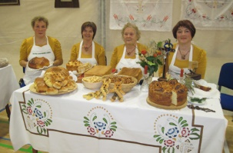
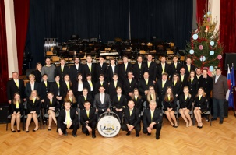
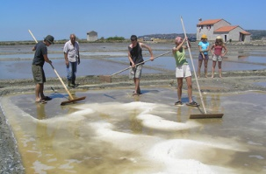
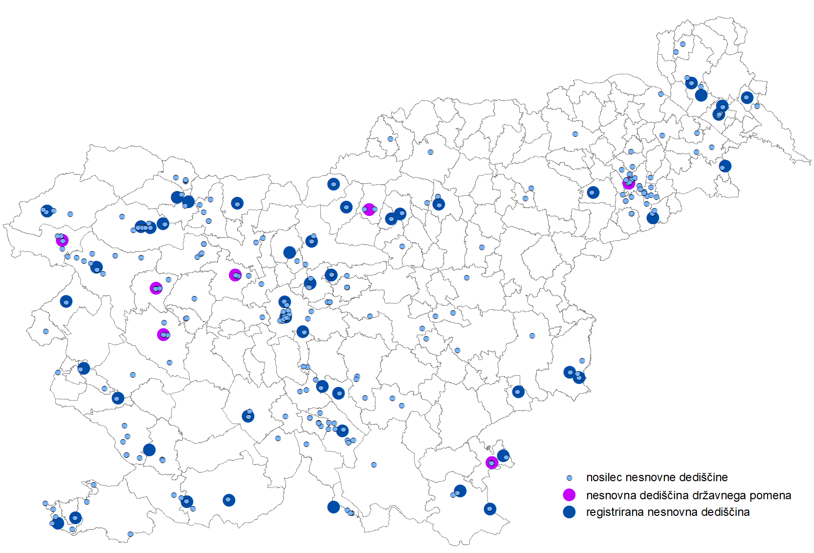

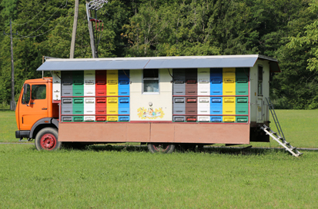
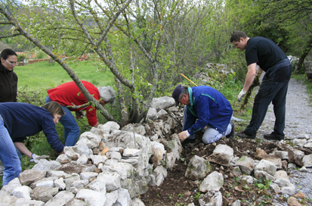
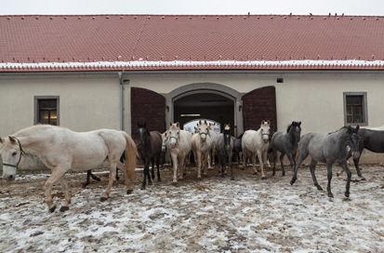
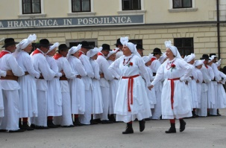
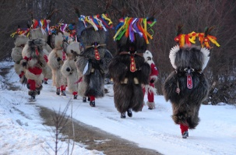
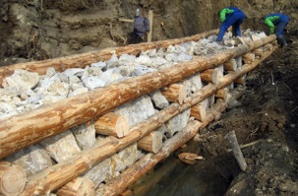
Register of intangible cultural heritage
Register established in 2009, systematic recording started in 2012
Elements and bearers of intangible heritage are recorded
Proposals for registration are prepared by the Coordinator for the Safeguarding of Intangible Cultural Heritage (SEM) on the basis of initiatives (mainly by bearers)
status | number of elements bearers
intangible heritage of national significance | 10 | 58
registered intangible heritage | 114 | 317
total | 124 | 375
Notes:
RNSD = inventar kot ga definira UNESCO Konvencija

Slide 5
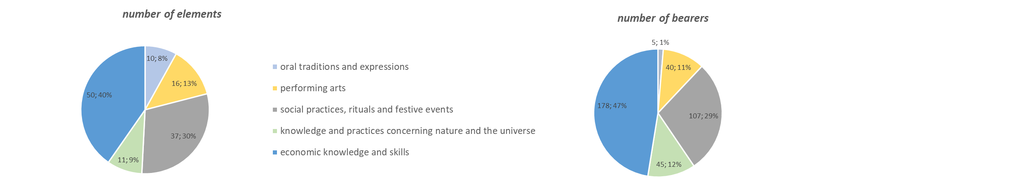
Types of intangible cultural heritage

Slide 6
JPR-NKD 2021-2025
Call for proposals for the selection of public cultural projects in the field of intangible cultural heritage

Slide 7
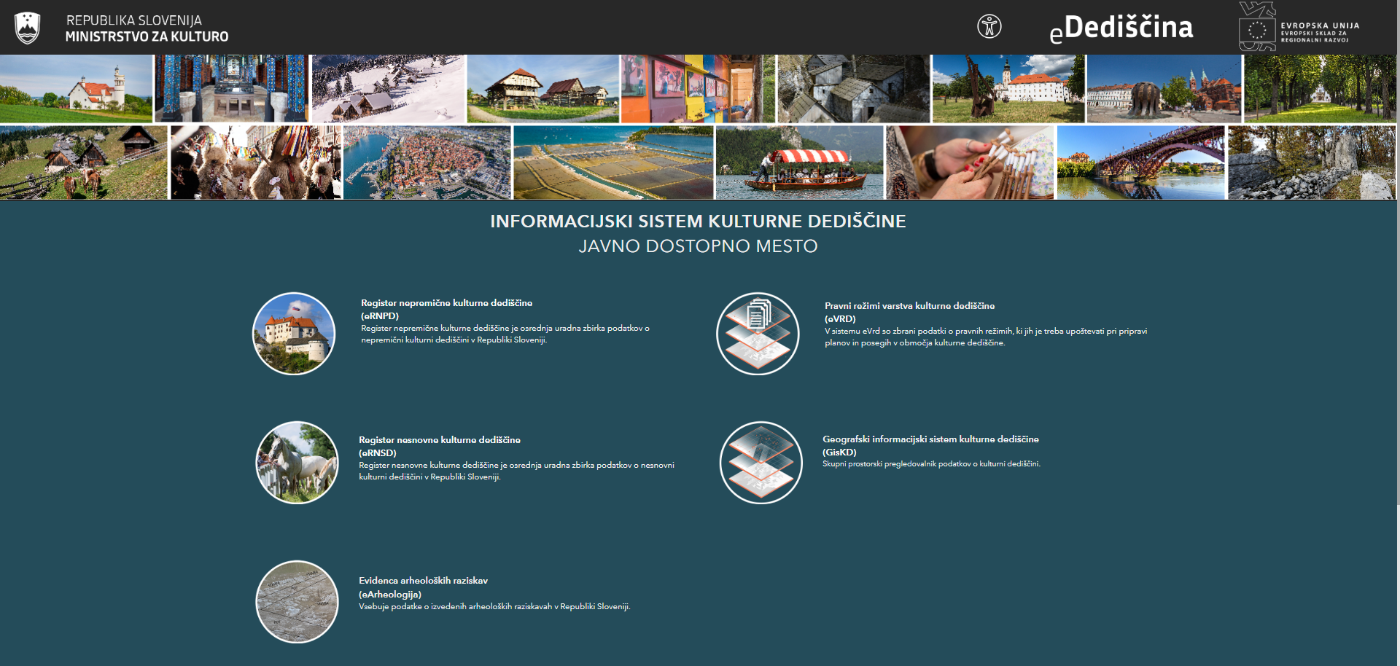
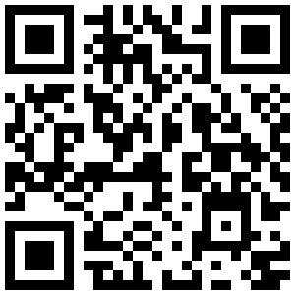
https://geohub.gov.si/ghapp/iskd

Slide 8
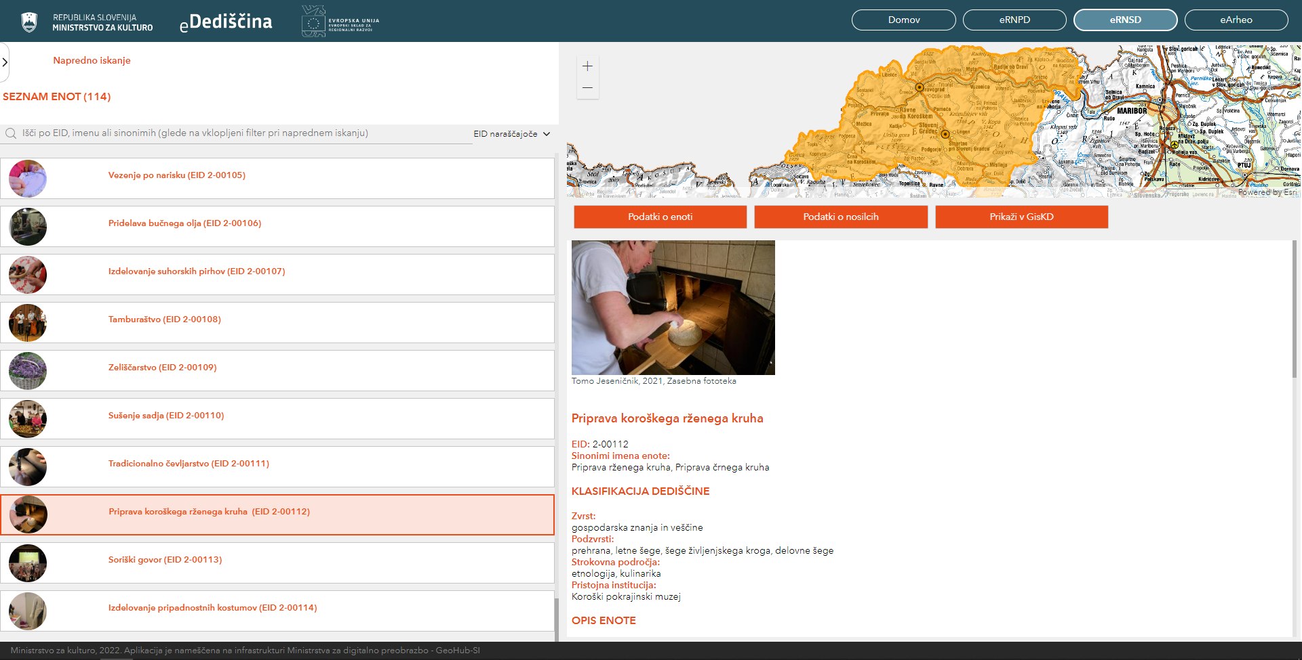

Slide 9
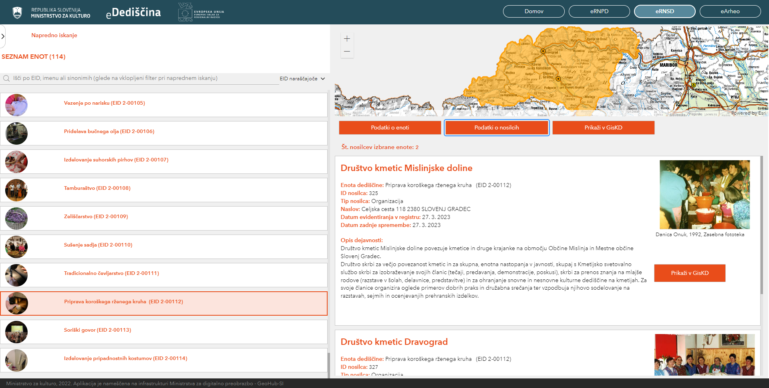

Slide 10
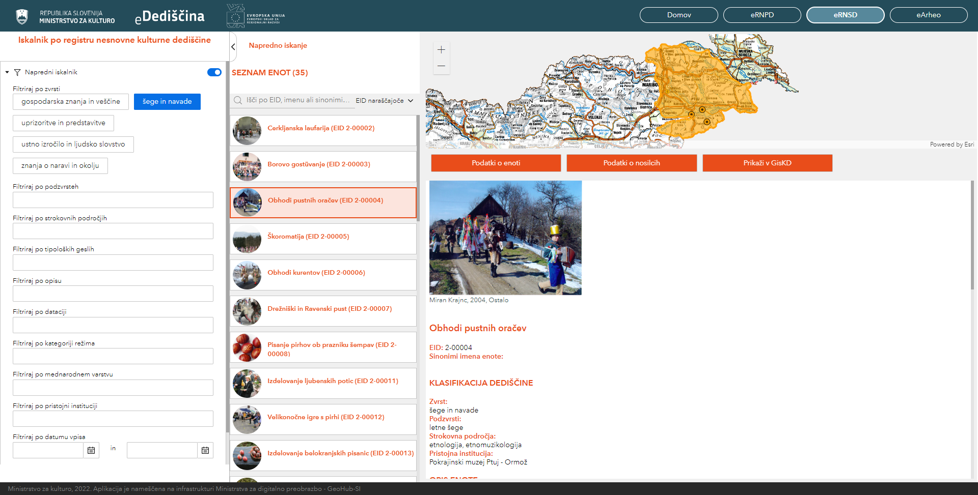

Slide 11
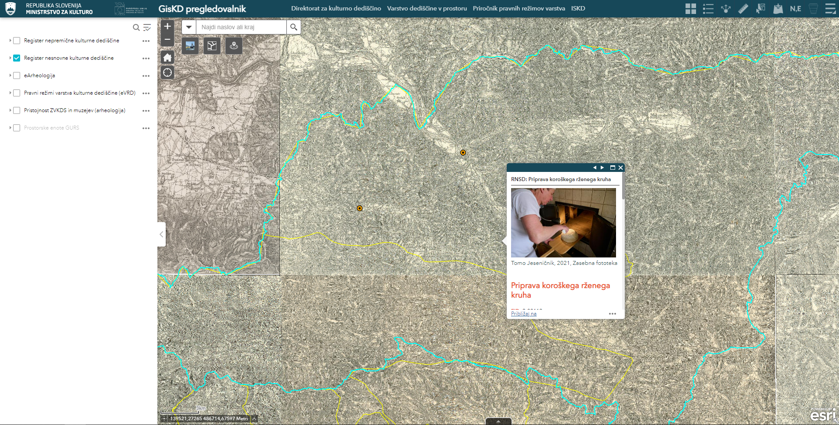
https://geohub.gov.si/ghapp/giskd

