Slide 2
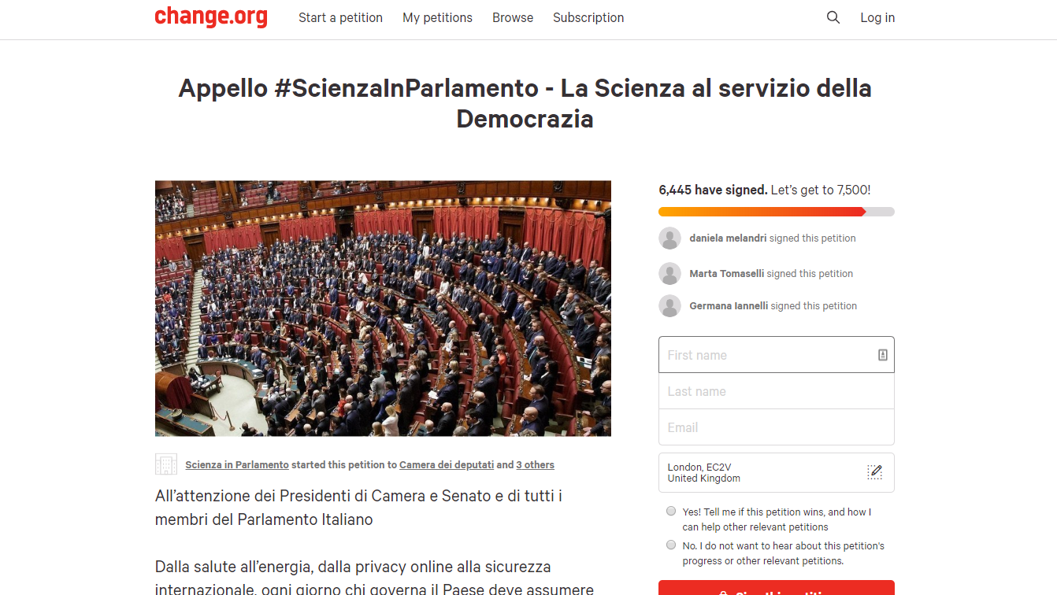

Slide 3
Some supporting institutions

Slide 4
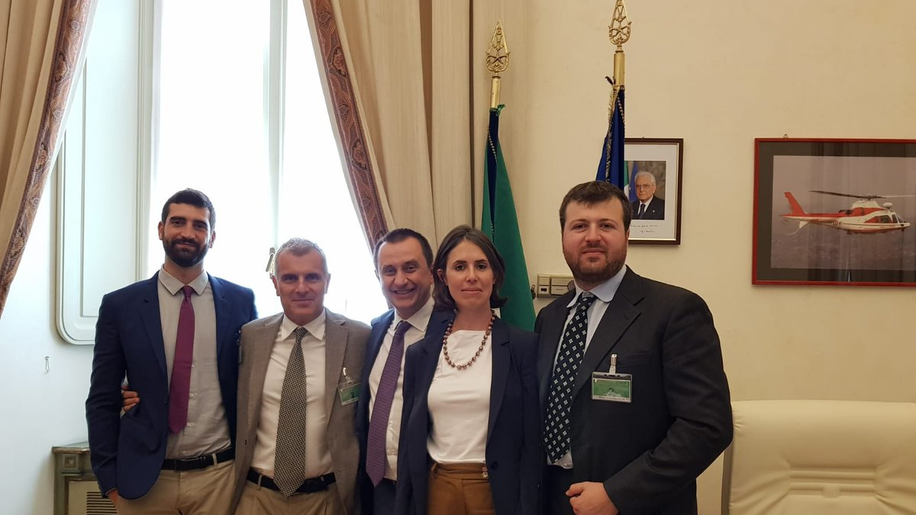
Meeting with the Vice-President of the Chamber of Deputies – 9/6/19

Slide 5
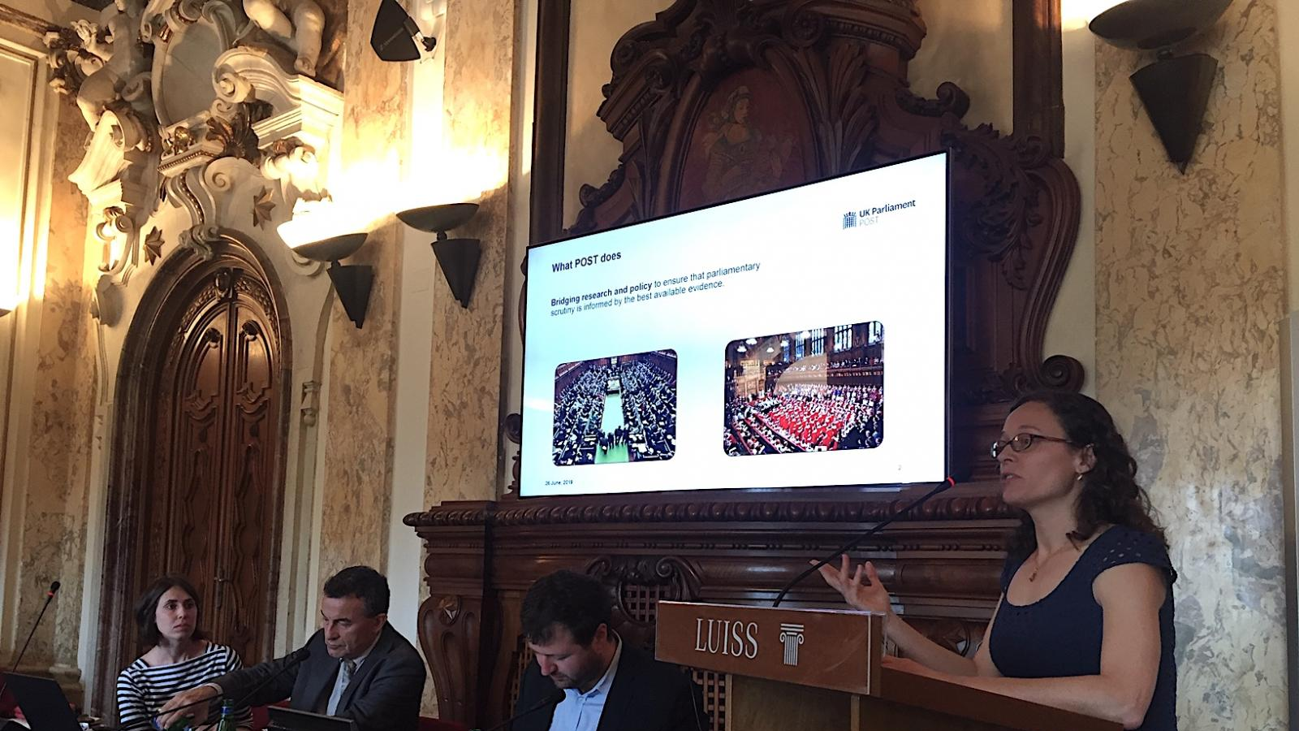
Workshop at LUISS University - 26/6/19

Slide 6
Conference in Cambridge – 26/10/19

