Slide 1
Regional Stakeholder Event on Horizon Europe Implementation
Ex-ante and ex-post controls:
From H2020 to Horizon Europe
Ljubljana, 11 November 2019
#HorizonEU
Common Audit Service
Stamatios Anthis, Deputy Head of Unit

Slide 2
Agenda
1. Introduction on Controls
2. Experience from Horizon2020
3. Horizon Europe: Systems and Processes Audit
4. Horizon Europe: Cross Reliance on Audits
5. Horizon Europe: Public Consultation
6. Way Forward – Audits in Horizon Europe
Notes:
Go through background, explain that we build on the experience of H2020, target on streamlining the H2020

Slide 3
Ex-ante controls
• Authorising Officers (AODs) must put in place internal control systems suited to the performance of their functions;
• AODs must ensure equal treatment for all
Beneficiaries;
• The control system shall ensure an appropriate balance between trust and control and must be cost effective;
• Controls must be developed with due consideration to the programme objectives and taking into account the associated costs for all stakeholders.
Notes:
We must develop a common framework for ex-ante controls.
We cannot adopt different approaches to the same issue
We accept to the major extend possible the usual accounting practices of the beneficiaries, to the extent that they are not in breach of the Grant Agreement’s rules

Slide 4
Ex-ante controls
Principles
Balance between trust and control
Minimize burden on beneficiaries
Equal treatment
Methodology
Limited information requested ex-ante (Financial statements, use of resources)
Risk considerations may justify asking the beneficiary for further information and/or evidence.
Notes:
Principles that define the baseline towards methodologies of ex ante controls

Slide 5
Ex-post controls in H2020 – The design
More Simplification
      25% flat rate for indirect costs
      One set of documents : MGA and annotated
      A governance to increase synergies
        The creation of the Common Audit Service for all H2020 ex-post audits
        One Horizon 2020 (Corporate) Audit Strategy
More Transparency
      Annotated Model Grant Agreement containing Examples, best practices, Lists and procedures , Specific cases and exceptions
      Research Enquiry Service & FAQ
      Online Indicative Audit Programme (regularly updated)

Slide 6
DG Declaration
of Assurance
Why do we need an audit?
I, the undersigned Director-General, declare that the information contained
in this report gives a true and fair view [1].
I state that I have reasonable assurance […] which is based on my own judgement and on the information at my disposal […]
However the following reservation should be noted:
Brussels, 31 March 20XX
"Signed"
The Director-General
[1]True and fair in this context means a reliable, complete and correct view on the state of affairs in the service.
Reservation concerning the rate of residual errors with regard to the accuracy of financial statements in the Framework Programme
Notes:
Fundamental on the budgetary Discharge process

Slide 7
Errors. Why do they occur?
Misunderstandings of the rules;
Lack of attention to the detail of the provisions of the grant agreements.
Notes:
The Common Implementation Service is striving to ensure that the errors and their consequences are properly mitigated and diminished

Slide 8

The consequences of errors:
Beneficiaries
Non-optimal use of funding available
Recoveries
European Commission
Scrutiny of the Budgetary Authority and ECA
Increased error rate
Increased ex post audit efforts
Corrective measures

Slide 9
Audit Cycle
Planning
Execution
Reporting
Strategy
9

Slide 10
Audit Planning
Selection of
beneficiaries
In-house:
mission planning
Externalised:
batch preparation
10
10
10
Notes:
10

Slide 11
Audit in H2020 – Main detected errors (1/2)
Personnel costs – due to:
Incorrect productive hours calculation
Incorrect remuneration costs - e.g. estimated
Incorrect time working on action claimed
Other - e.g. unreliable/missing timesheets
Subcontracting - due to:
Lack of adequate supporting documents
Not foreseen in Annex I nor agreed by EU services
Other errors – including e.g. no value for money,
Notes:
Scope
State of play as of today
H2020 CAS closed audits
(521 audits – 1115 audited participations - 74% External Audit Firms vs 26% In-House audits)
Value % against all negative adjustment
Indirect costs excluded
No reclassification

Slide 12
Audit in H2020 – Main detected errors (2/2)
Other goods and services - due to:
Lack of adequate supporting documents
Cost not related to the action
No direct measurement of the cost
Other errors – e.g. indirect costs claimed as direct costs , no value for money
Travel - due to:
Cost not related to the action
Other errors – e.g. lack of adequate supporting documents
Notes:
Scope
State of play as of 6 January 2019
H2020 CAS closed audits
(521 audits – 1115 audited participations - 74% External Audit Firms vs 26% In-House audits)
Value % against all negative adjustment
Indirect costs excluded
No reclassification
Considering the H2020 Audit Strategy is based on 9000 participations to be audited, the following figures represent only 12,4% of the multiannual Audit Strategy.
► Please considered them with prudence !

Slide 13
Ex-post controls in H2020 – The Feedback
Main feedback from Audited Beneficiaries
      Beneficiaries welcome audits conducted centrally by the Common Audit Service.
      Preparatory files in H2020 ex-post audits can be time consuming.
      Certificate on Financial Statements (CFS): external auditors may not have the specialized knowledge needed for H2020 projects.
      The calculation of personnel costs can be complex and time consuming.
      Disproportionate audit effort on costs categories with low participation in the overall budget (e.g. travel costs and subsistence).
      LRI: too long procedures.
Notes:
a) Mandate could be enlarge
b) More preparation needed for H2020 audits: SPAs + Increased number of permanent files + Use of the PP (So Permanent files naturally constitued)
c) Reporting : personnel wizardd) Reporting requirement : Re-usability of the reporting requirements / Permanent Files
e) Should be considered
f) Flat Rate : Article 31 Unit Costs with allocation keys

Slide 14
Horizon Europe: the novelties in audit
Systems and Processes Audit (SPA)
Wider cross-reliance on audits and assessments
Notes:
Wider cross-reliance on audits and assessments – including with other Union programmes – should be envisaged, in order to reduce administrative burden for beneficiaries of Union funds. Cross reliance should be explicitly provided for by considering also other elements of assurance such as systems and processes audits.
Article 48 proposal for Horizon Europe
In addition, the Commission or funding body may rely on combined systems reviews at beneficiary level. These combined reviews shall be optional for certain types of beneficiaries and shall consist in a systems and process audit, complemented by an audit of transactions, carried out by a competent independent auditor qualified to carry out statutory audits of accounting documents in accordance with Directive 2006/43/EC. They may be used by the Commission or funding body to determine overall assurance on the sound financial management of expenditure and for reconsideration of the level of ex-post audits and certificates on financial statements.

Slide 15
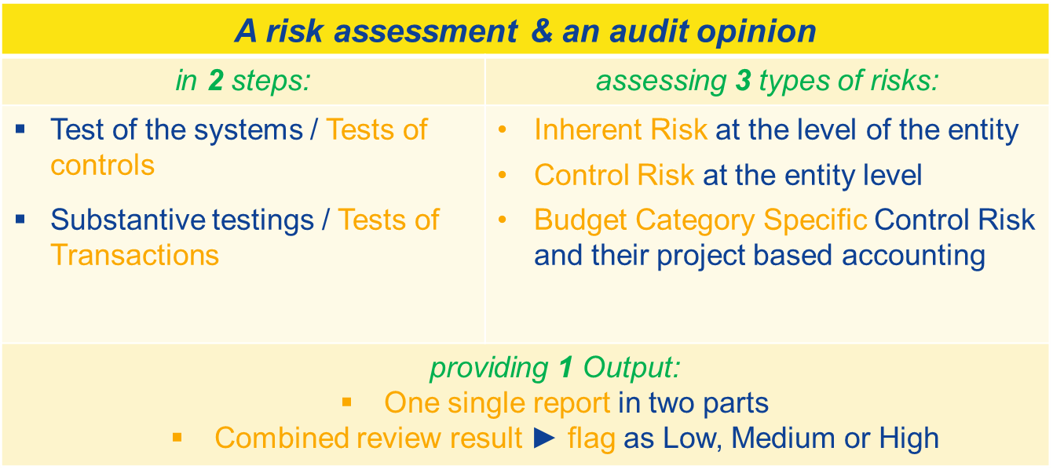
System and Process Audit
What is a SPA ?
HE Rfp Article 48

Slide 16
System and Process audit
Objectives
- Reduced administrative burden;
- Less but more focused audits;
- Reliance on the internal control system of the beneficiary (prevent and detect error)
Consequences
- Timing of the SPA (with first audit)
- Future audits (less audits, less CFS?)
Notes:
Reduction of administrative burden – the clear objective is to reduce the administrative burden of audit, especially on large beneficiaries who would expect to be, over the course of Horizon Europe, subject to several audits and many CFS.
Stratification of the error rate – the aim will be to have a proportion of the population that can be treated as “key items” with no (or very low) error, which will be excluded from the Common Representative Sample.
An SPA will be undertaken at the time of the first audit of a participation. In this way the systems audit can be complemented by the substantive testing to arrive at an overall conclusion for the beneficiary.
Where an SPA is given, the number of additional audits should be kept to an absolute minimum, possibly complemented by other forms of assurance (CFS or other reporting).
An SPA will be undertaken at the time of the first audit of a participation. In this way the systems audit can be complemented by the substantive testing to arrive at an overall conclusion for the beneficiary.
Where an SPA is given, the number of additional audits should be kept to an absolute minimum, possibly complemented by other forms of assurance (CFS or other reporting).

Slide 17
Cross-reliance
NEW
  Simplified audit and control system:
Key features
  Combined reviews
  Single audit principle for joint funding
  Possibility for enhanced cross-reliance
Combined review
Combines systems and process audit with an audit of transactions
Optional for certain types of beneficiaries
May lead to less Certificates on Financial Statements
Single audit principle for joint funding
A single audit for actions that receive joint funding from different Union programmes
Possibility for enhanced cross-reliance
Possibility for the Commission to rely on audits on the use of Union contributions carried out by other persons or entities
reduced audit burden for beneficiaries

Slide 18
Cross-Reliance
Factors of success
Having "conditions equivalent" between EU programmes irrespectively of the management mode,
Enhancement of corporate IT tools:
Taking into account international benchmarks:
  International Standard on Auditing (ISA)
  INTOSAI
  COSO
Notes:
Mainly 6 International Standard on Auditing (ISA) :
ISA 315 - Identifying and assessing the risks of material misstatement through understanding the entity and its environment
ISA 320 - Materiality in planning and performing an audit
ISA 330 – The auditor's response to assessed risk
ISA 600 – Special considerations - audits of group financial statements (including the work of component auditors)
ISA 610 – Using the work of Internal Auditors
ISA 620 – Using the work of auditor's expert

Slide 19
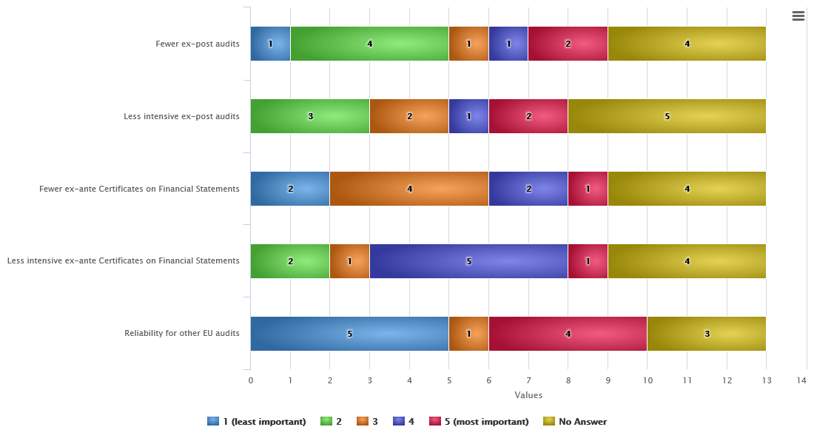
5. Results of the public consultation – Control Strategy (1/3)
What type of benefits would you expect from a Systems and Processes Audit (SPA)? (rank by order of preference)
Notes:
Final results of the public consultation for BeNeLux the situation is very similar as a proportion.

Slide 20
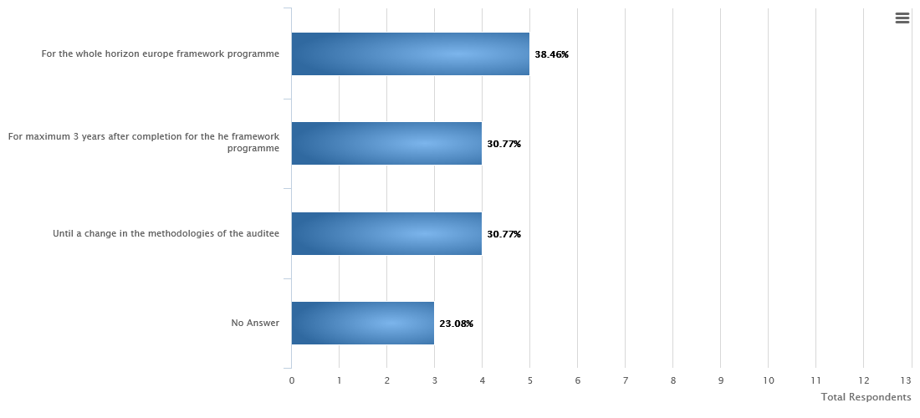
5. Results of the public consultation – Control Strategy (2/3)
The Systems and Process Audits (SPA) should be valid...
Notes:
For Benelux 79% instead of:
For the whole FW 45,2%
Until a change 33,9%
No answer 25,99%
For max 3 years 14,69%

Slide 21
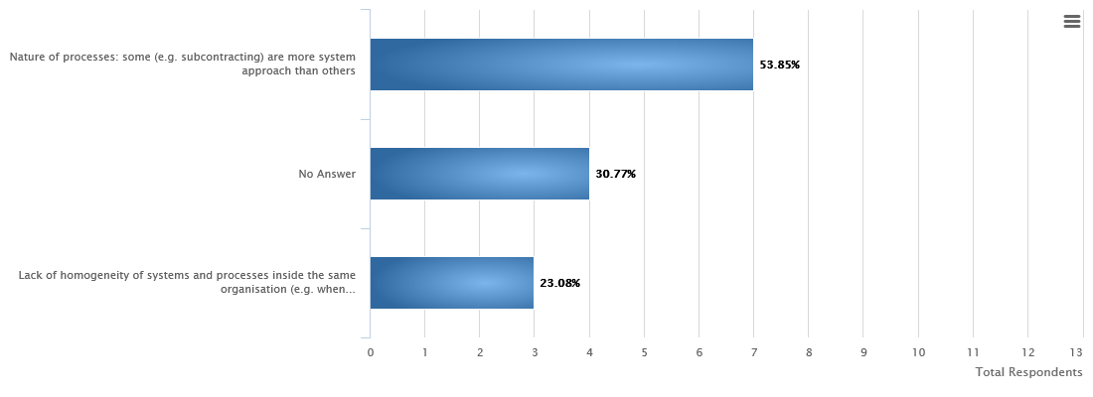
5. Results of the public consultation – Control Strategy (3/3)
What are the limitations to a SPA?
Notes:
Lack of homogeneity – 40,68%
Nature of processes – 31,64%
No answer 36,72%
Other 10,73%

Slide 22
Way Forward – Audits in Horizon Europe
Pilot System and Process Audit on a number of beneficiaries
Further consultation with beneficiaries and member states
Discussion with the Central Services of the Commission regarding further simplification
Discussion with Services of the Commission responsible for shared management
Launch of the Horizon Europe audit campaign (creation of an audit strategy)
Notes:
Reduction of administrative burden – the clear objective is to reduce the administrative burden of audit, especially on large beneficiaries who would expect to be, over the course of Horizon Europe, subject to several audits and many CFS.
Stratification of the error rate – the aim will be to have a proportion of the population that can be treated as “key items” with no (or very low) error, which will be excluded from the Common Representative Sample.
An SPA will be undertaken at the time of the first audit of a participation. In this way the systems audit can be complemented by the substantive testing to arrive at an overall conclusion for the beneficiary.
Where an SPA is given, the number of additional audits should be kept to an absolute minimum, possibly complemented by other forms of assurance (CFS or other reporting).
An SPA will be undertaken at the time of the first audit of a participation. In this way the systems audit can be complemented by the substantive testing to arrive at an overall conclusion for the beneficiary.
Where an SPA is given, the number of additional audits should be kept to an absolute minimum, possibly complemented by other forms of assurance (CFS or other reporting).

Slide 23
Thank you
for your
attention & participation !

