Slide 1
Eurostars 2
WEBINAR, 12.01.2021
HOW TO SUBMIT AN APPLICATION
Federica Vitale
Eurostars Programme Management Officer
Submission deadline: 4th February 2021, 8PM (Brussels time)

Slide 2
Questions to applications@eurostars-eureka.eu
Call information: https://www.eurekanetwork.org/open-calls/eurostars-feb2021

Slide 3
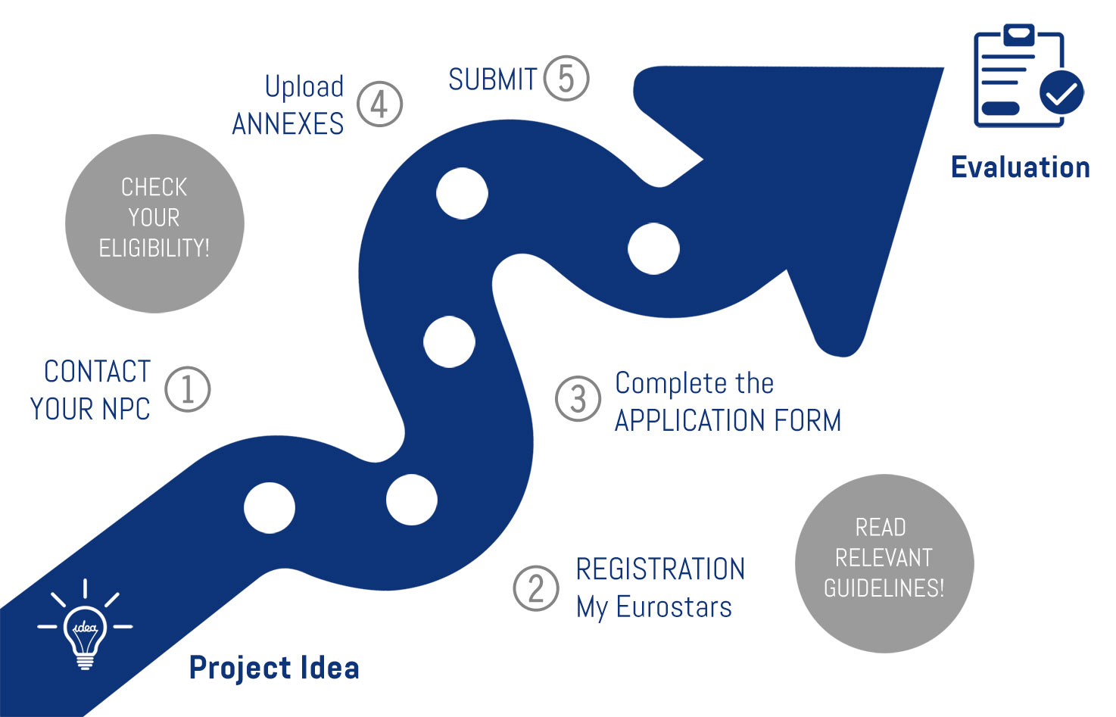
Easy application
Notes:
Applying for Eurostars is easy.
The first important thing is to contact your National Project Coordinator, even before you start completing your application form. It is important to contact your NPC because they can support you during the application phase, and they will give you information about national eligibility criteria and funding rules. Remember that Eurostars has some eligibility criteria which apply to every organization, independently on their nationality, but that countries might also set some additional eligibility criteria at national level. Also remember that Eurostars applies a decentralized funding process, meaning that each participant receives funds from their own country. Each country has its own funding rules (ex. some countries fund only certain types of organizations). It is thus important that you contact the NPCs, to be aware of all the criteria and rules, and apply successfully.
The second step is to register to our website and create your account. Check the eligibility guidelines and guidelines on how to complete the application form, which can be found on the Eureka’s website.
Then you complete your online application form, you upload all the annexes and submit the proposal.

Slide 4
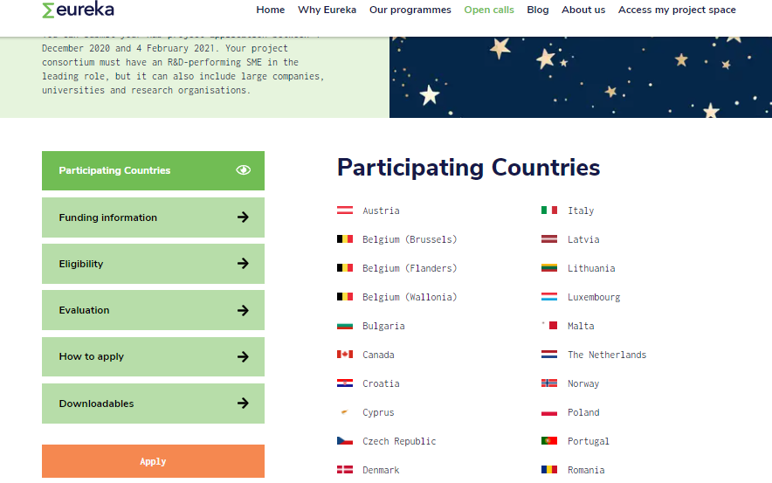
Registration
https://www.eurekanetwork.org//
Step 1
Step 2
Step 3
Notes:
In order to register, make sure you use Google Chrome as browser, otherwise you won’t be able to see some parts of the application form. If you forget about this, don’t worry, because whenever you log in to the submission platform to work on your proposal, the platform will remind you of that.
How to register? Go to Eureka’s website at www.eurekanetwork.org. On the top menu, click “Open calls” and select “Eurostars call for projects.” You will land on a page with all the information about the Eurostars call. When you are ready to register, click on the button “Apply” at the bottom of the page.

Slide 5
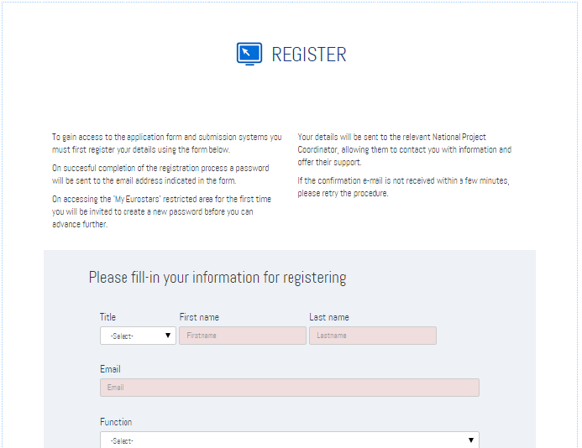
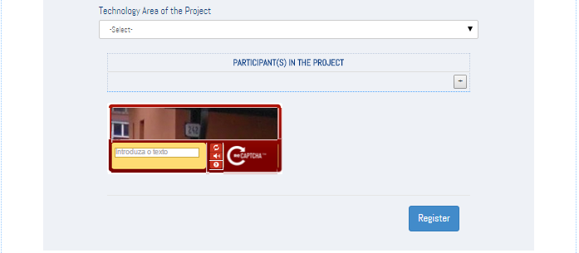
Registration
Step 4
Notes:
You will then be able to see this registration page. Simply complete the information requested here: information about yourself, your organization, your role in the project, a short summary of the project, including its the technological area, and information about the project participants. Once you click Register, you will receive an automatic email with a temporary password and a link. You need to click on that link in order to complete your registration.

Slide 6
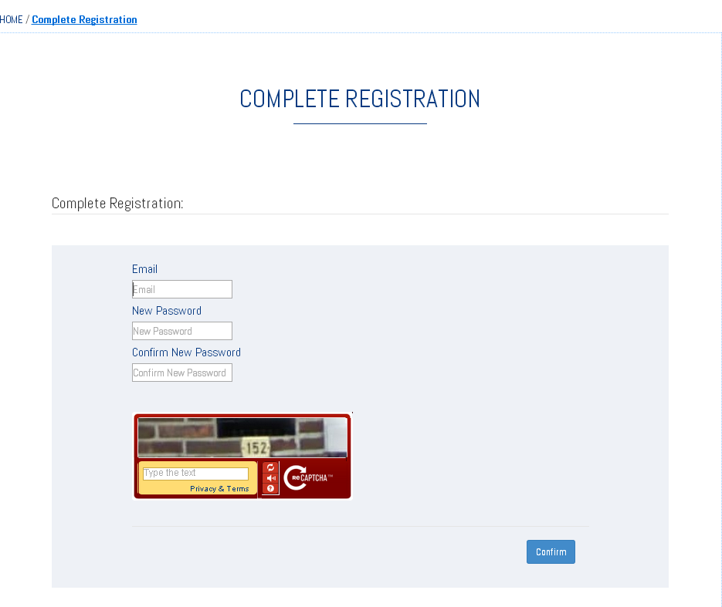
Complete Registration
Notes:
Once you click on the link, you land on this page, where you are asked to choose a new password. Choose the new password and click Confirm. You will be automatically logged in to the submission platform.
After you have completed your registration, you receive an automatic email informing you that the registration was successful.

Slide 7
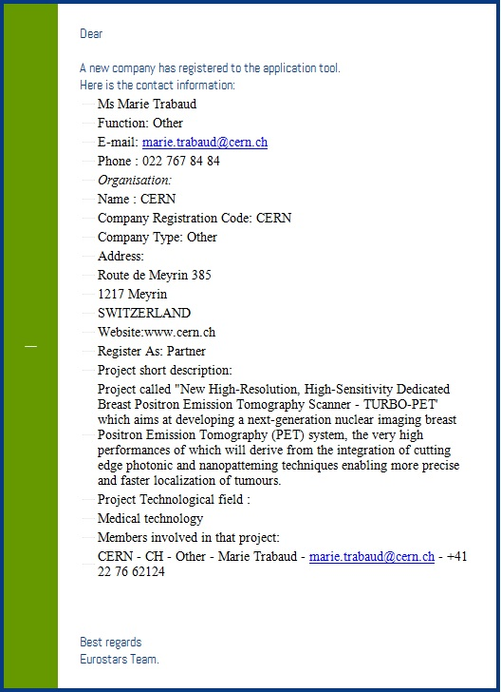
Registration
To inform the NPC about
Contact person information
Organisation information
Role
Project short description
Members involved
Notes:
Your national project coordinators, too, receive an automatic email informing them about the new registration. Please be aware that the information you have inserted in order to register on the website will not be used to evaluate your proposal; it is just used for information purposes. Don’t worry if you have made a mistake in the data provided to register (ex. you have said that the technological area of the project is semiconductors, but it is agriculture, or you have said that you are a large company instead of an SME). The only information used to assess your application is the one you provide in your application form, so this one must be correct.

Slide 8
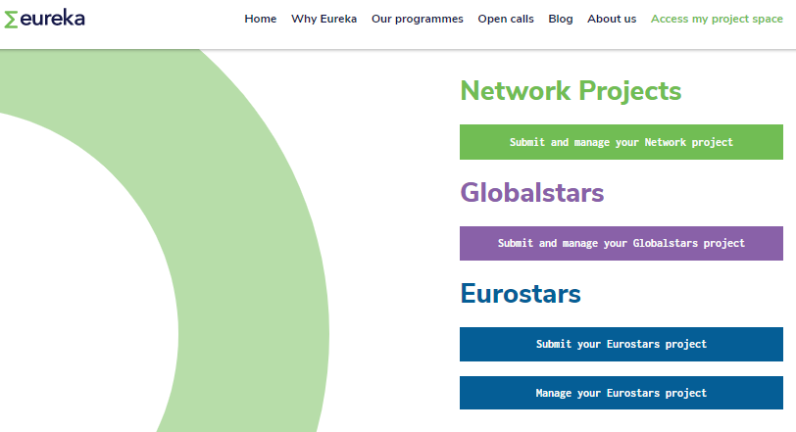
Log in
https://www.eurekanetwork.org//
Notes:
After the first access, you can log in again to the submission platform by going to the Eureka’s website and clicking on Access my project space > Submit your Eurostars project.

Slide 9
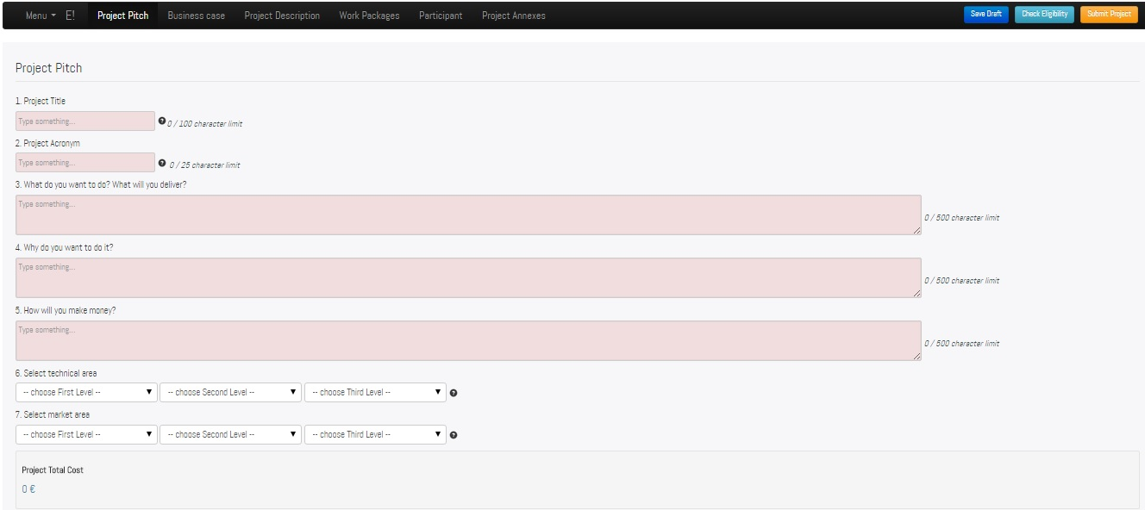
Project Application Form (PAF)
Notes:
Once you are logged in, you will immediately see the application form. Remember that the application form must be completed in English, we do not accept any other language.
All the parts of the online application form can be seen on the bar, on top of the screen. Next to the Menu, you can see the project pitch, business case, project description, work packages, participants, and project annexes. Also, you can always save your work by using the save draft blue button, on the top right of the screen. Always save your changes – after 30 minutes of inactivity you are logged out from the platform and any unsaved change will be lost.
If you click the button “Check Eligibility” you can perform an automatic check of the eligibility of your proposal – more details in the next slides. The yellow button is to submit the proposal once this is ready. Please notice that the button to submit the proposal will be enabled on the 13th January, so you will be able to submit your proposals only from the 13th January. All the registrants will be informed as soon as the button is enabled.

Slide 10
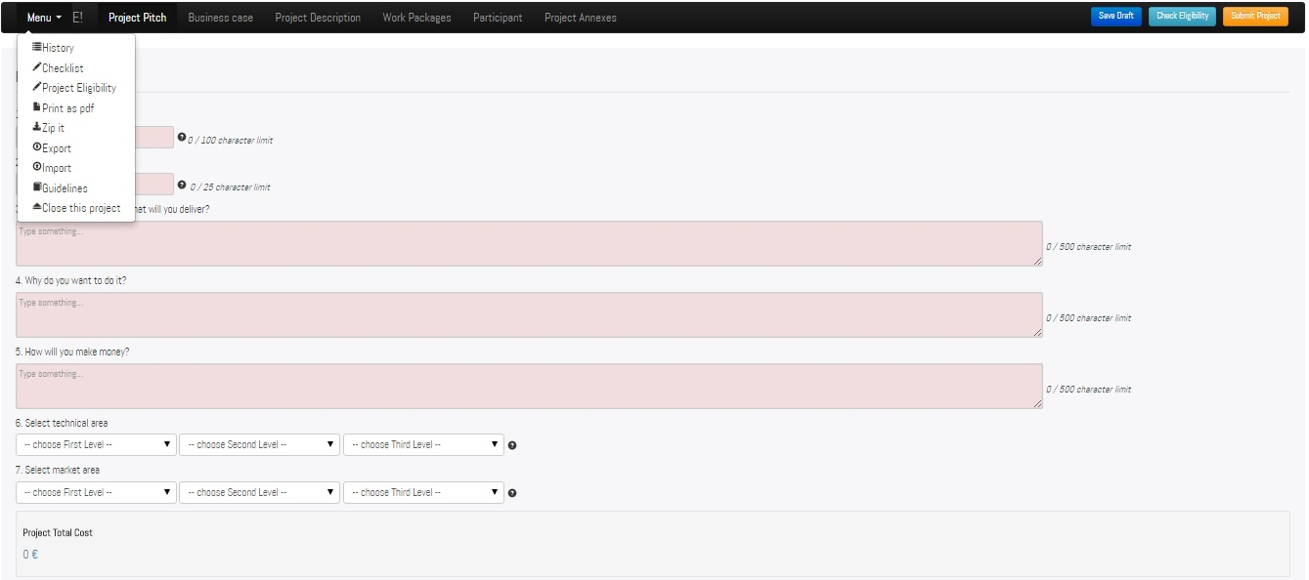
PAF- Menu
Notes:
If you click on the Menu, you will be able to visualize 9 different items. Let’s see them one by one.

Slide 11
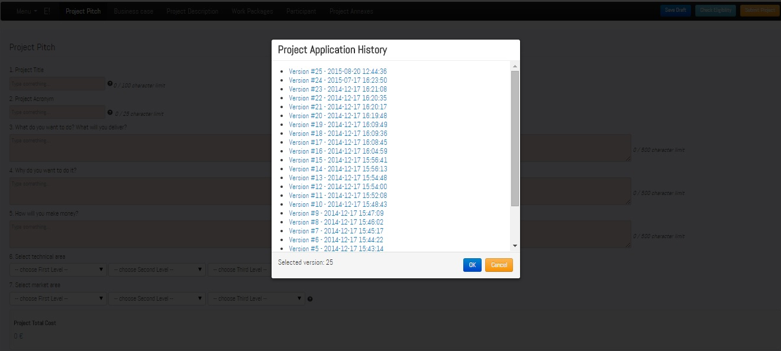
PAF- History
Notes:
Under the history you can find the previous saved versions of your project applications. This gives you the possibility to have access a previous version of your application and make edits.
Each version displays the date and the time of when each version was saved.

Slide 12
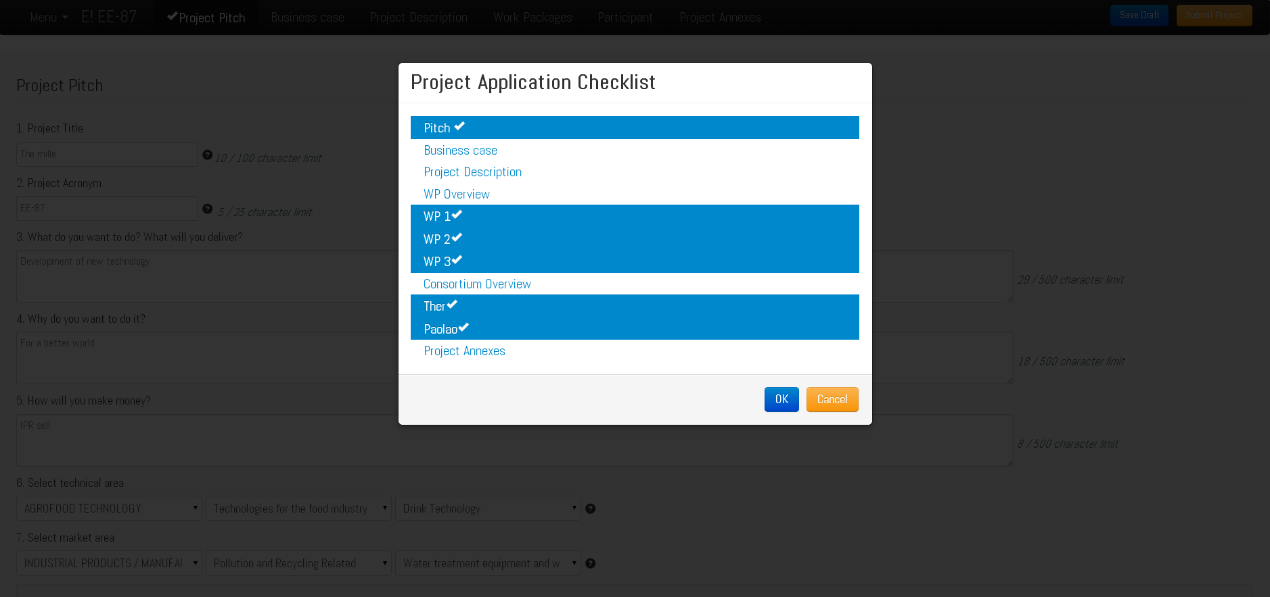
PAF- Checklist
Notes:
The checklist gives you an overview of the sections you have completed and the ones that need to be completed. This will help you to keep tack of your progress. The complete sections have a checkmark next to them.

Slide 13
PAF – Eligibility Check
Click here anytime to check the eligibility of the project
Notes:
Through the next feature you can check whether the application meets some Eurostars eligibiity criteria. It is just a computer check, intended as a support to the applicant, it does not replace the eligibity check, which is performed during the evaluation phase.

Slide 14
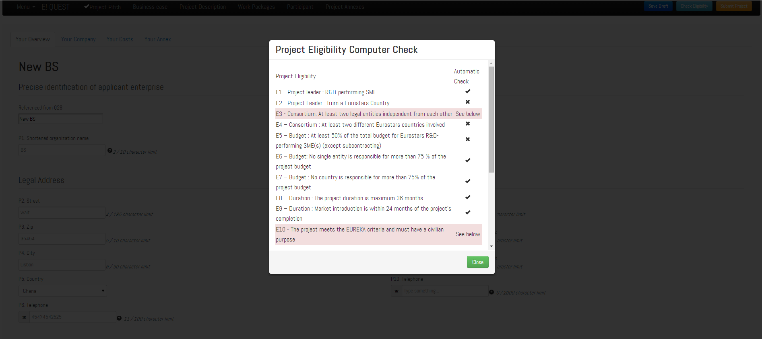
PAF – Eligibility Check
Criteria E3 and E10 cannot be electronically verified
Notes:
Each project has to meet 13 eligibility criteria. 10 of them are international and 3 are national. Please check the eligibility guidelines on the Eureka’s website for more information. Through this button you can only visualize the 10 international eligibility criteria: a checkmark means you have fulfilled that criterion, an X means you haven’t, so you need to change some info in the application form. Two criteria cannot be electronically verified: E3 (- The project contains at least two independent participants) and E10 (- The project meets the EUREKA criteria and must have a civilian purpose), and they are highlighted in pink

Slide 15
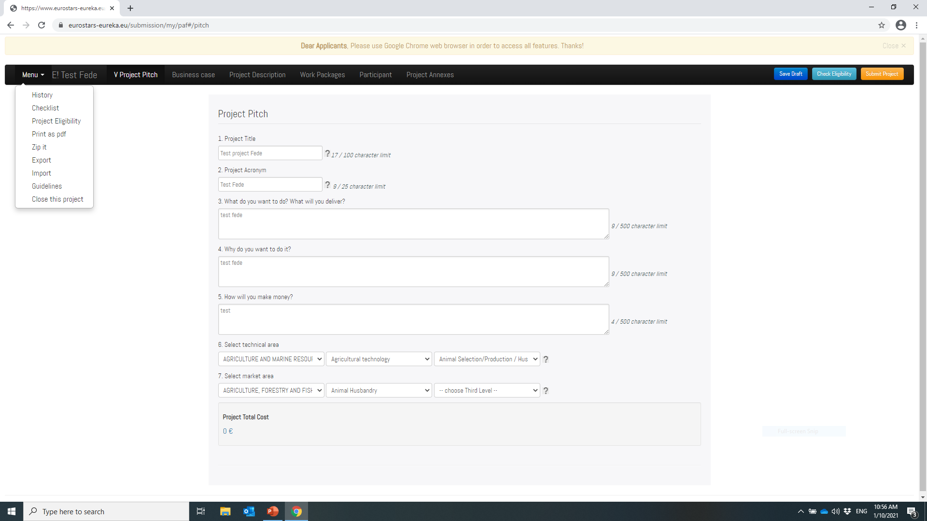
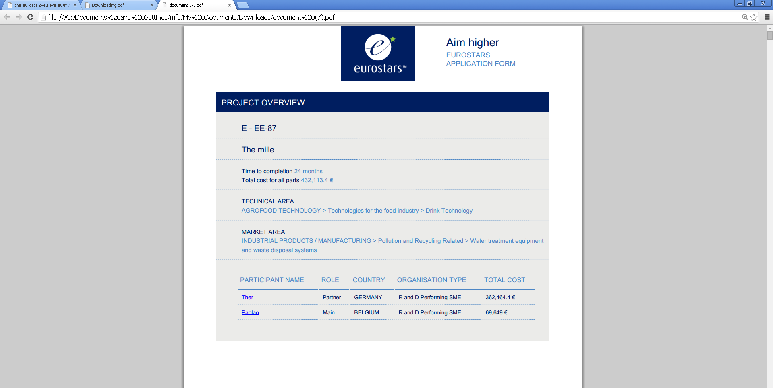
PAF – Print as PDF
Notes:
At any point you can download a pdf form of your application by using the print pdf button.

Slide 16
PAF – Zip it
Notes:
By clicking Zip it you can download a folder with the annexes that you have included in the application form.

Slide 17
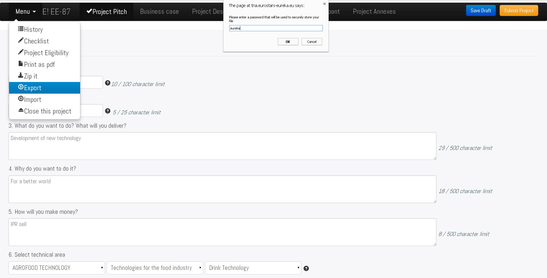
PAF – Export
Notes:
An importnat feature of the online application is the export and import function.
By clicking the export button, an encrypted version of your project application is created. This version can be saved on your computer for safety reasons. In order to visualize the data in it, you need to import it again in the platform.
Once you click the export function, a password will be asked by the system. Once you insert your password, the file will be downloaded and you can save it in your computer.

Slide 18
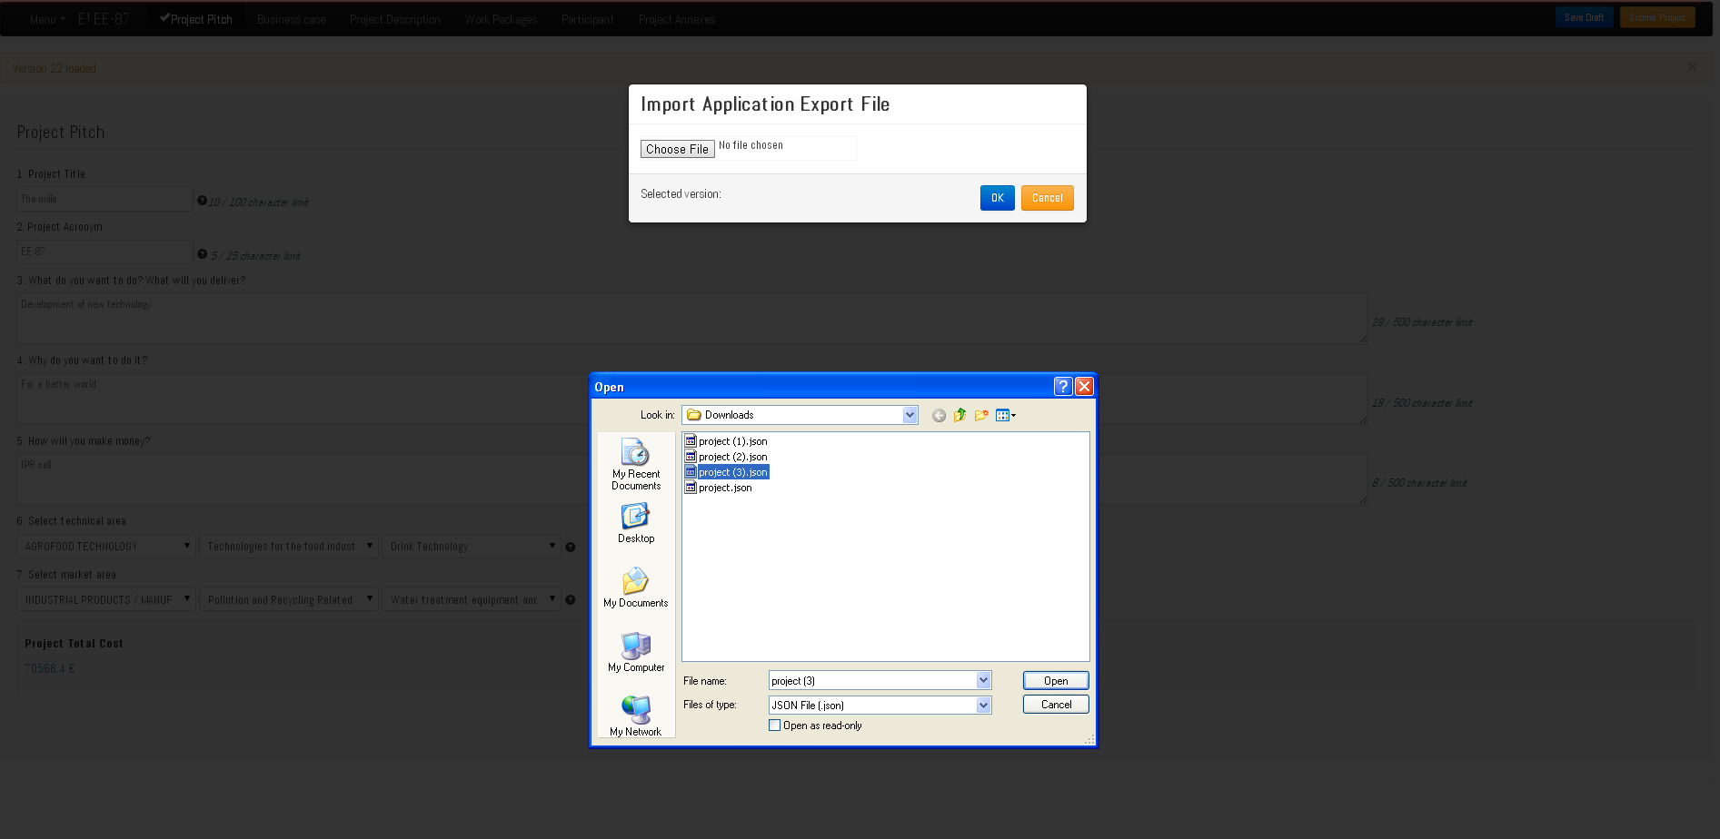
PAF – Import
Notes:
In order to visualize the data in the file, log in to the submission platform, click Import, and upload the file.

Slide 19
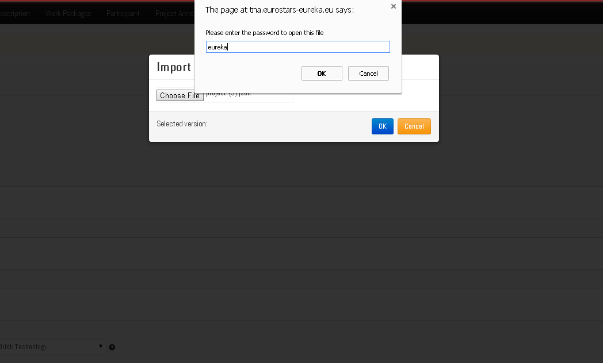
PAF – Import
Enter password created to download the “Export” file
Notes:
You press Ok and then you enter your password. You will then be able to see the data in the application form.
You can import the file by using your account or even another account, and whenever you want, also months after the submission.

Slide 20
PAF – Guidelines
Notes:
By clicking Close this project you can log out from the platform.

Slide 21
PAF – Close this project
Notes:
By clicking Close this project you can log out from the platform.

Slide 22
PAF – Content
Project Pitch
Business case
Project description
Work packages
Participants
Project annexes
Notes:
The application form has 6 parts . We are now going to see each one of them, starting from the project picth.

Slide 23
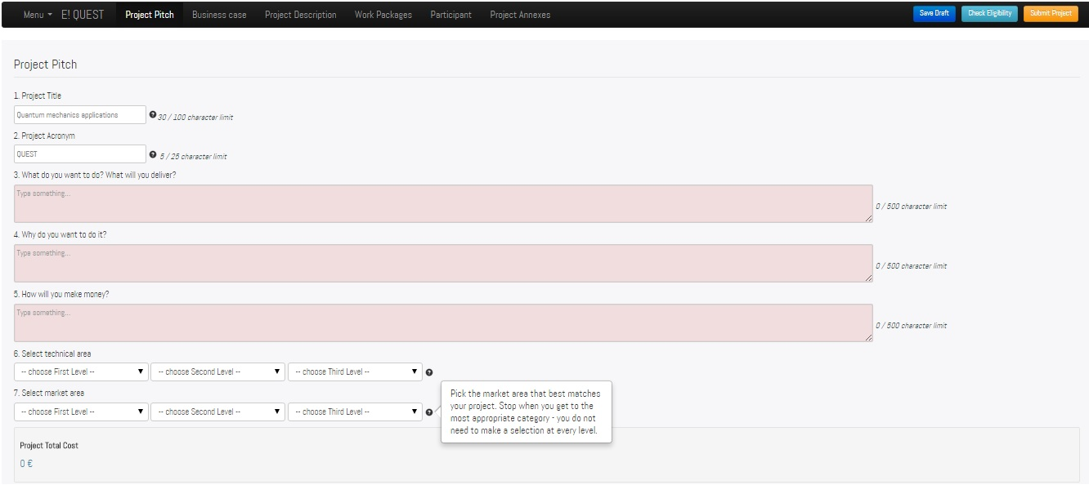
PAF – Project Pitch
Click the ´?´ icon to open the help box
Notes:
In the proejct pitch you must provide general information about your project, including its title, acronym, technology and market areas. As you insert the acronym, this will be displayed in the black bar on the top of your screen.
Be aware of the character limit. Check the help box for guidance on how to complete the fields – the help boxes are indicated with a question mark.
The last field of this page shows the Project Total Cost. This will be completed automatically once you have completed the cost sections in the part of the application form dedicated to the participants information – see next slides.

Slide 24
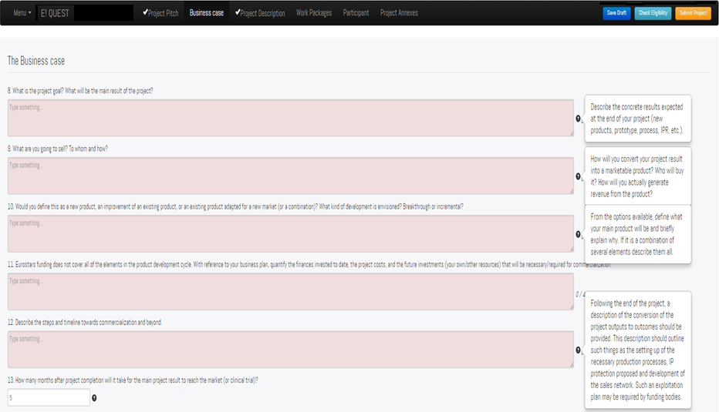
PAF – Business Case
Notes:
In the second part of the application you have to describe the business case.
Notice the checkmark next to Project Pitch in the black bar: the checkmark appears every time you complete a section of the application form. However, it does never appear for the sections Work Packages, Participants and Project Annexes.

Slide 25
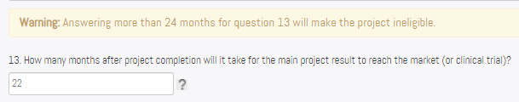
PAF – Business Case
Notes:
Pay special attention to question 13 – which is about the time when you will start the commercialization phase or clinical trials. One of Eurostars eligibility criteria states that market introduction or clinical trials must start within 24 months after the end of the project. If it takes you more than 24 months to start market introduction or clinical trials, the project will be ineligible. Note the warning message.

Slide 26
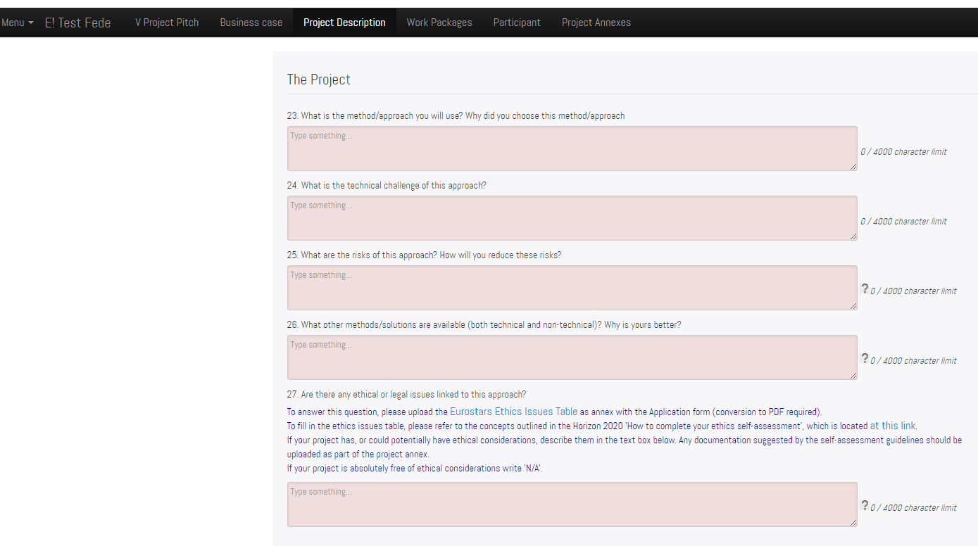
PAF – Project Description
Ethics ready table – Highly recommended to be uploaded as an annex
Notes:
Then you will have to describe your project. Here you will have to consider also the possible ethical and legal issues that your project might raise. It is strongly recommended to download the ethics issues table, complete it and attached it as a project annex (see Project Annexes section). You can download it from the submission platform, where you can also find a link to the Horizon 2020 guidelines on how to use the table.

Slide 27
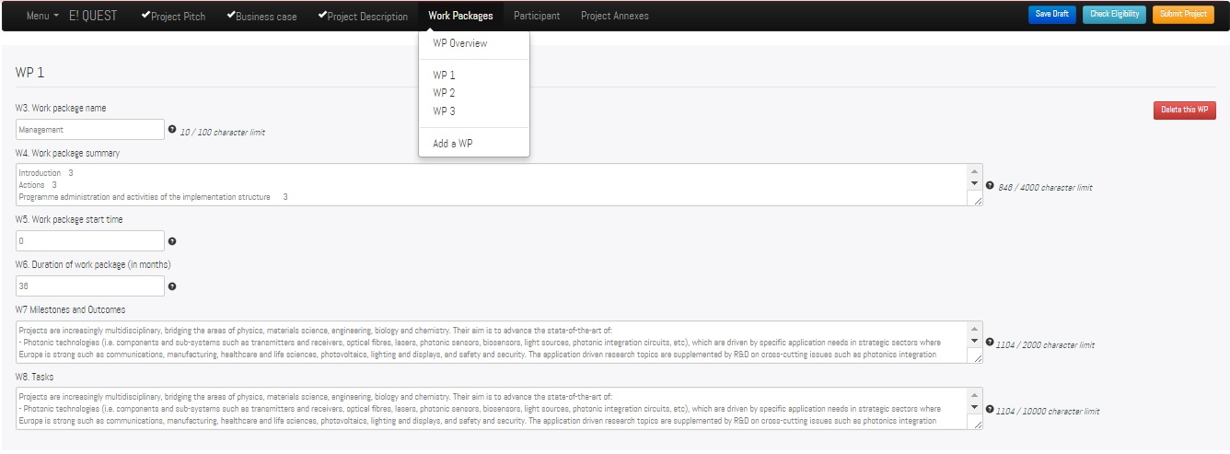


PAF – Work Packages
Delete a Work Package
Add a Work Package
Notes:
Let’s move to the section Work Packages. Here sometimes applicants get confused on how to use this section but it’s simple. When you click on Work Packages you will see a dropdown menu with the work packages overview and then the button “Add a WP”. If you click Add a WP, you will create WP 1 and you will see immediately the fields to complete for this work package (work package name, summary, start time, duration etc.). You can always create new WPs and delete them, if you need to, by using the red button on the right.

Slide 28
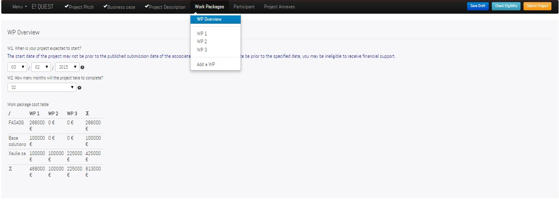
PAF – Work Packages
The Work package cost table is automatically updated with the participant name and costs entered in the Participant section (P29)
Notes:
You need to complete also the fields in the WP Overview, that is start date of the project and project duration. The start date of the project may not be prior to the submission deadline. Should the start date be prior to the specified date, you may be ineligible to receive financial support.
Also remember that a Eurostars project cannot last more than 36 months (this is another eligibility criterion). The platform won’t allow you to select more than 36 months.
The work package cost table is not filled in manually at this stage; it will automatically update itself as you insert cost information in the section dedicated to the participants.

Slide 29
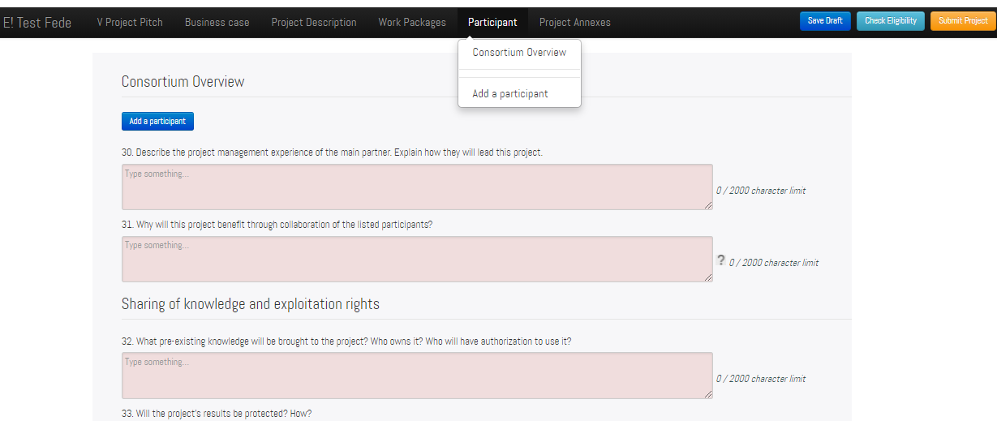
PAF – Add and remove participants
Notes:
The participant section works with the same logic as the work packages section: you can add as many participants as there are in the project.

Slide 30
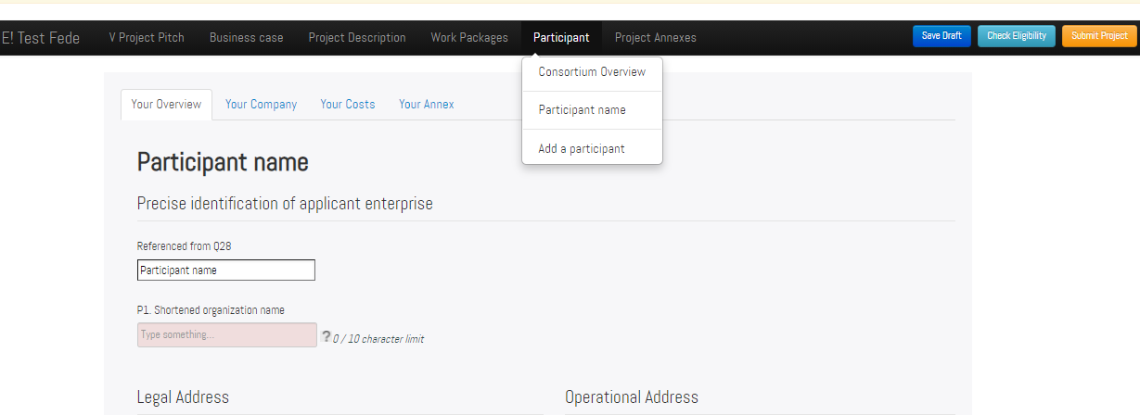
PAF – Add and remove participant
Notes:
Every time you add a participant, this appear in the scroll down menu.

Slide 31
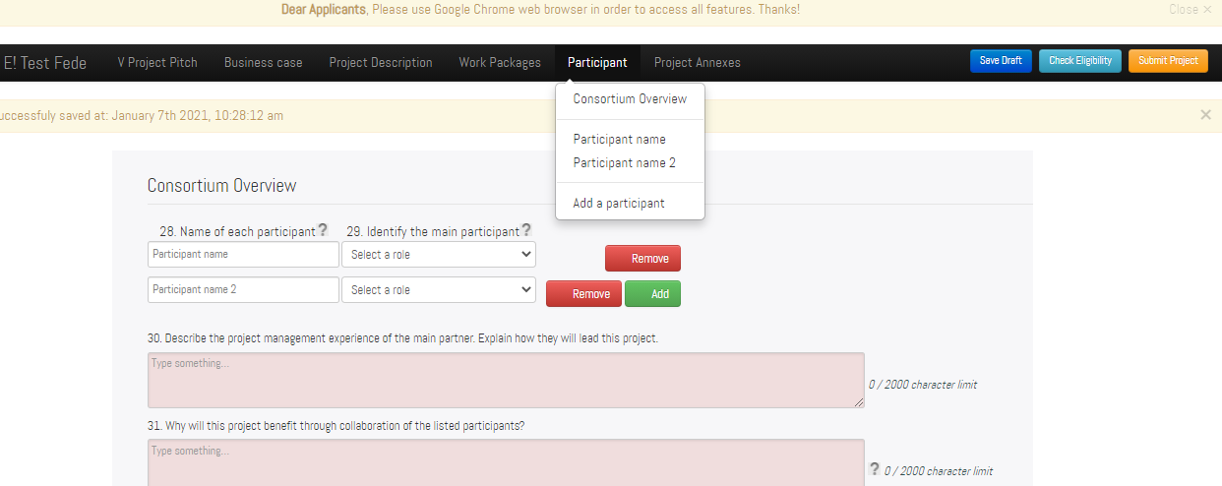
PAF – Add and remove participant
Notes:
To remove a participant, go to Consortium Overview and use the red button.

Slide 32
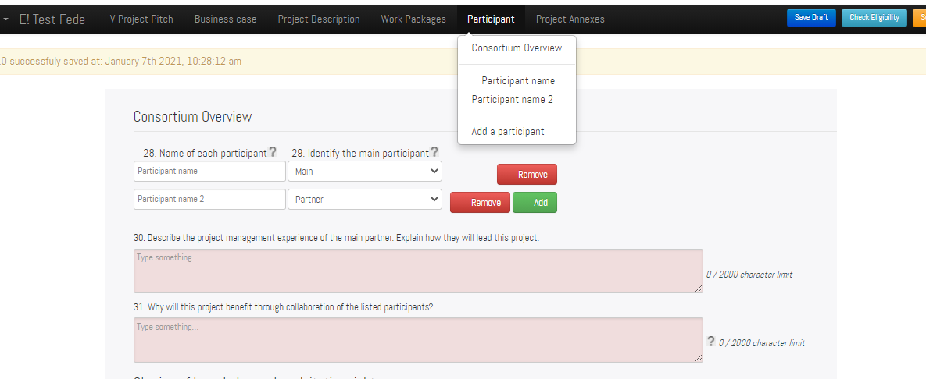
PAF – Specify the role of the participants
Notes:
In the consortium overview, remember to specify the role of each participant in the project - who is the main partner and who is/are the partners. Remember that the main pax must be R&D SME otherwise the project is not eligible.

Slide 33
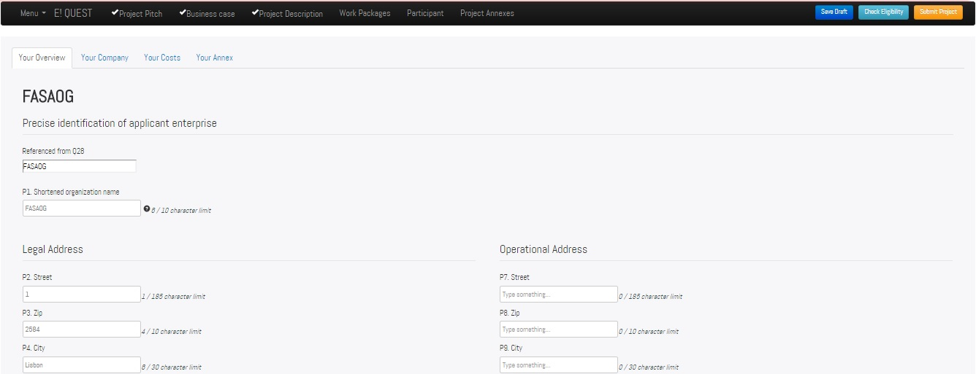
PAF – Participant Overview
Notes:
Per each participant, you will need to provide specific information.

Slide 34
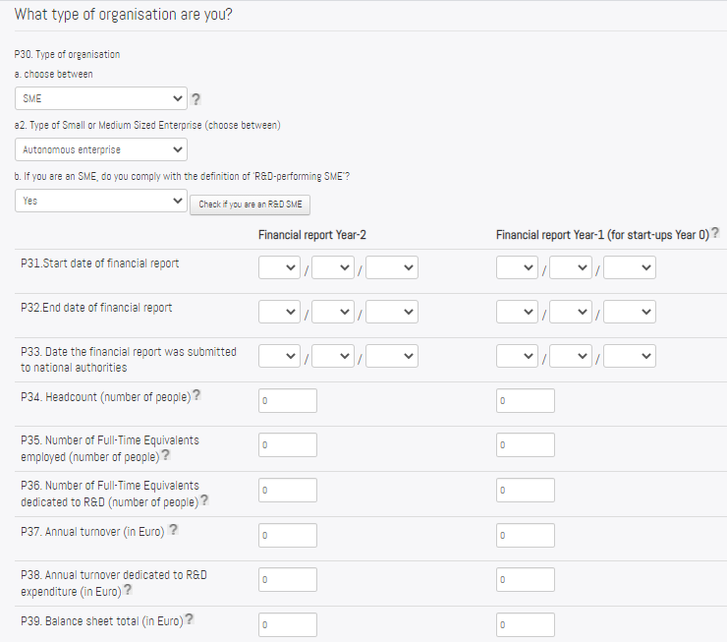
Are you an SME? Check the definition here
Start-ups must provide forecast value and should upload a business plan as annex – contact your NPC to know national rules for start-ups!
Are you an R&D SME? Check the guidelines here
For a start-up with no closed accounts data must still be provided !!
Notes:
In the second tab, Your Company, you must provide information on the type of organization. If you are an SME, you will have to specify if you are an autonomous, linked or partner SME and whether you are an R&D-performing SME. You need to refer to the definition of SME provided by the European Commission – you can easily find this definition online, and a link is also provided on this slide. For the definition of R&D SME, you should instead check the Eligibility guidelines, on Eureka’s website – the link is provided on the slide.
You also need to complete questions P31 to P39. Depending on the type of organization, you may provide different information here. For example, organizations that are 100% publicly funded may not need to complete these fields. Check our guidelines and call your NPCs to know exactly what information you need to provide here. If you are a startup, you still have to complete the financial information; do not write 0 (zero), or the project will be ineligible! You need to provide forecast values. Contact your NPC to know more about this. Also, some countries apply specific rules for startups, and they might ask you to provide additional information.

Slide 35
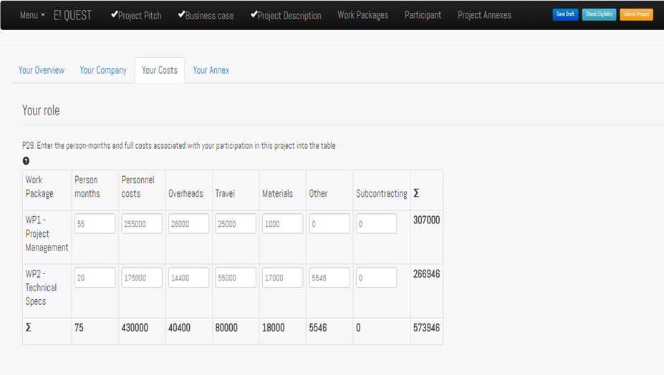
PAF – Participant Costs
Notes:
Per each participant, you need to provide information on the costs of their activities per work package.

Slide 36
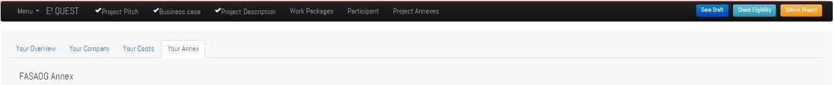
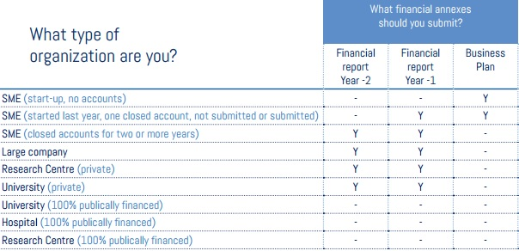
PAF – Participant Annex
Only PDF format is accepted
Combine all annexes and upload as a single document, max 50Mb
Notes:
Finally, you will have to upload the financial annexes. Before, check the guidelines on how to complete the application form on Eureka’s website and contact your NPC in order to know which financial reports you need to upload and if any other documents are needed. Only organizations that are 100% publicly financed may not need to upload the financial annexes. Startups must provide a business plan.
The annexes must be combined and uploaded as 1 single document with max size of 50mb. The financial annexes can be in your national language.

Slide 37
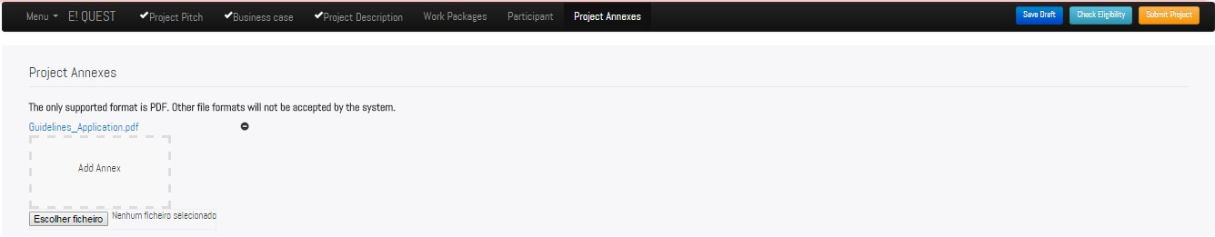
PAF – Project Annexes
    Illustrations, graphics and Gantt charts cannot be included in the application form. Submit these and additional information as one single document as an annex.
    It must be in English.
  Only PDF format is accepted, max. 50Mb.
Notes:
The next and final section of the application form is the project annexes, where you have to upload all the project annexes combined in one PDF document with maximum size of 50 Mb. Only in English. It can have for example gantt charts or some graphics of your project.
Do not upload too many information as annex, select the ones that you consider more important. The evaluators have a limited time to assess each applications and they won’t be able to read long annexes.

Slide 38
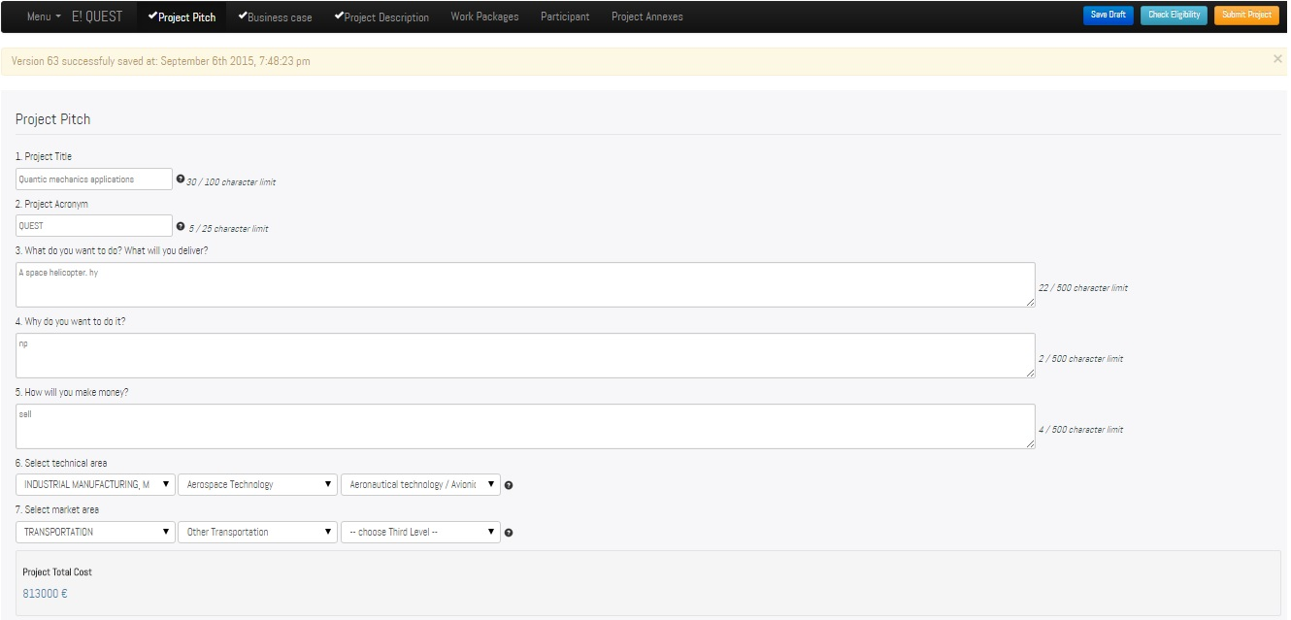
PAF – Save draft
Save your changes regularly! After 30 minutes of inactivity, you are logged out.
Notes:
Regularly press the Save Draft button, it’s the blue button on the top right corner. For security reason, the platform will log you out automatically after 30 minutes of inactivity, so make sure you regularly save your changes. If you saved successfully, a message appears with date, time, and number of the saved version.

Slide 39
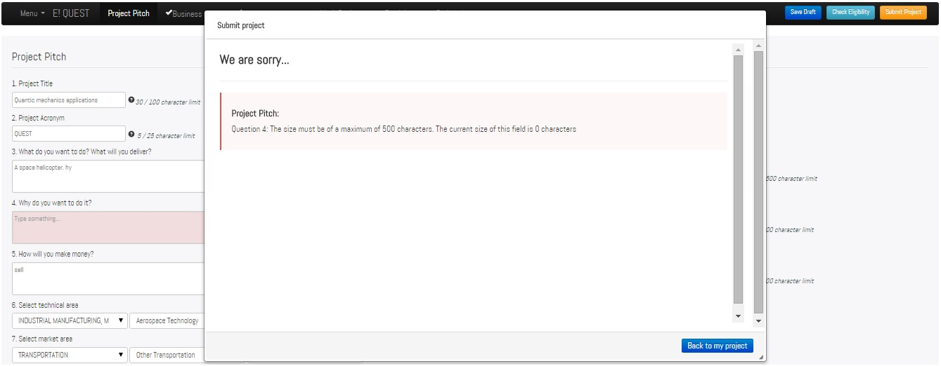

PAF – Submit (error)
Notes:
Once your application is ready, you can submit it by clicking the yellow button.
If some questions are not complete, the platform will display this error message, informing you on which question still needs to be filled in. You can go back to that question, complete it and then submit again.

Slide 40
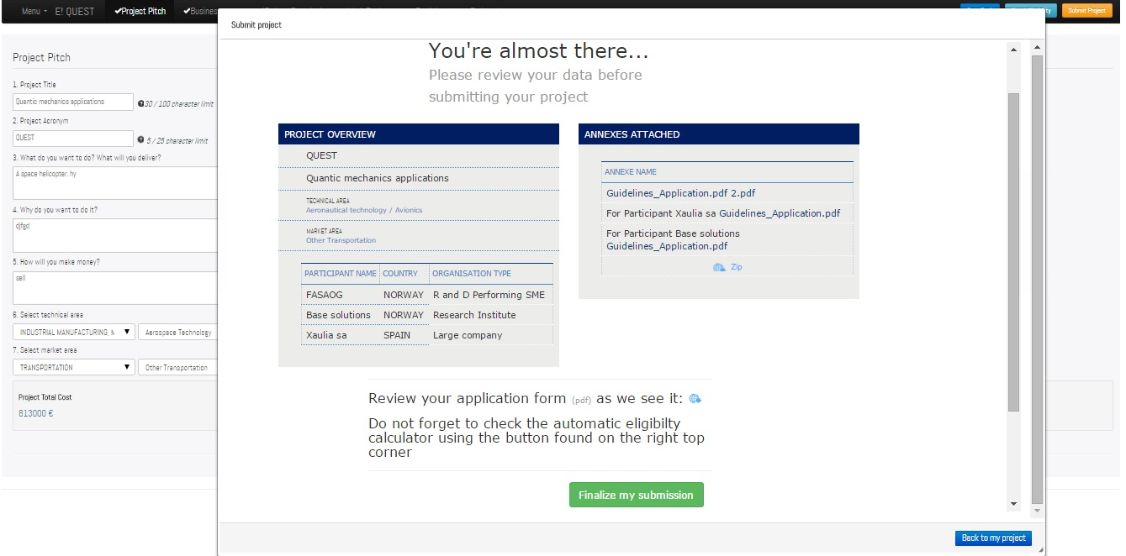
PAF – Submit (finalize)
Notes:
Once you submit the proposal, this screen appears, asking you to review the data entered in the form and perform the computer eligibility check. After you have checked everything, you can finalize the submission by clicking on the button.

Slide 41
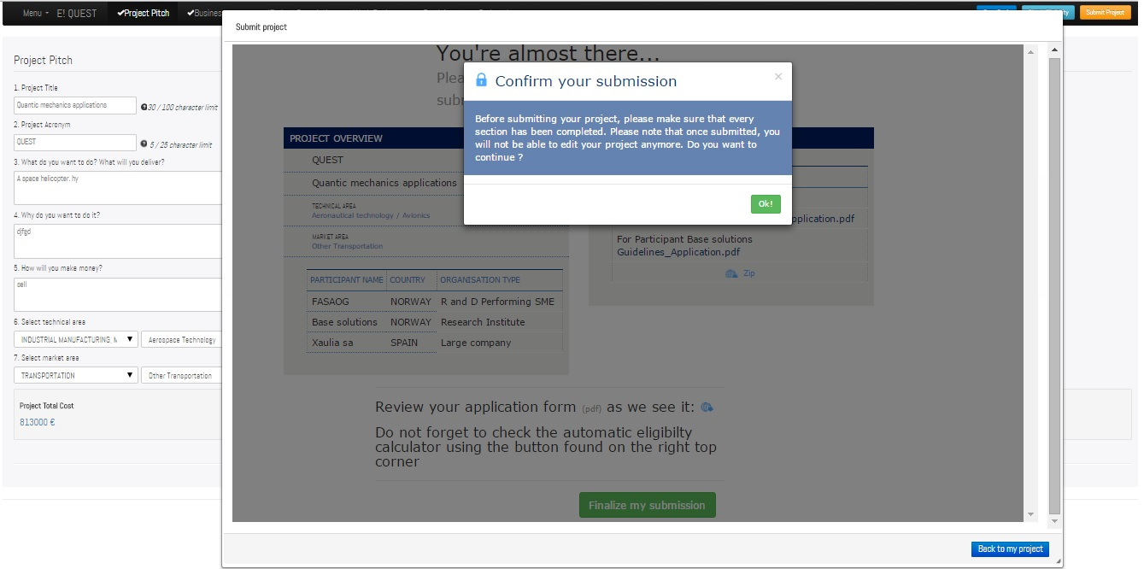
PAF – Submit (finalize)
Notes:
Then, a second pop up message asks you to confirm the submission and gives you again the possibility to review the application – remember that once the application form is submitted, you won’t be able to make changes to it. You can then confirm the submission…

Slide 42
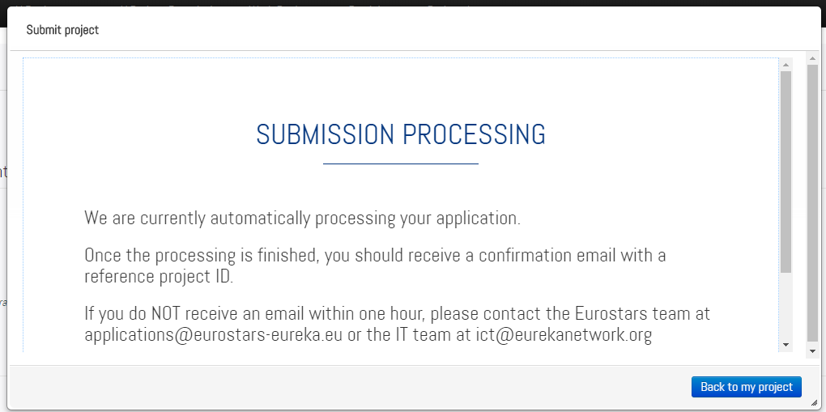
PAF – Submit (finalize)
Notes:
…and this message appears, informing you that your application is being process by the system.

Slide 43
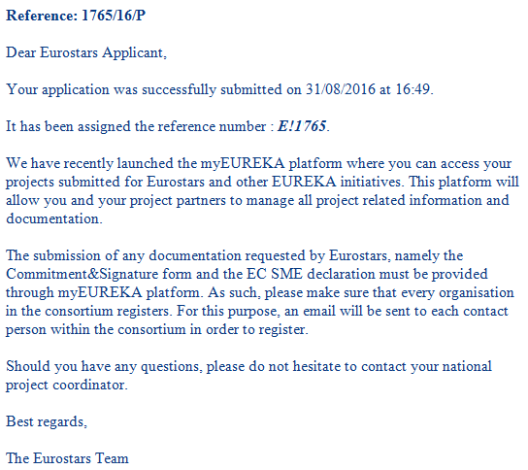
PAF – Confirmation successful submission
To:
Registrant
NPCs
ESE
Notes:
If the submission is successful, you will receive a confirmation email with the project reference number, day and time of the submission, and project ID. If you don’t receive a confirmation message within an hour of your submission, please contact us.
The same confirmation email will be received by the ESE and the NFBs.
In this email, you are reminded of the next steps to complete your submission: each participant in the consortium must log in to myEureka and upload one or two documents, depending on the type of organization (see next slides). You have seven days to submit the documents.

Slide 44
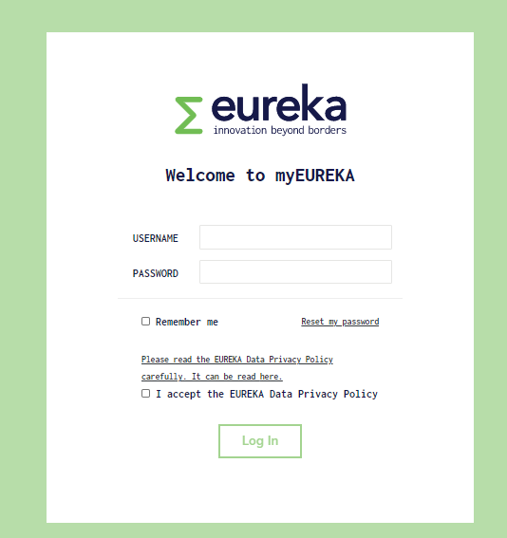
Log in to myEUREKA
Once submitted, all contact persons are invited to register to myEureka (www.myeureka.io)
  Each partner must download, complete and submit the
    C&S form
    SME declaration (only for SMEs)
If the contact details of a partner have changed, inform us immediately.
Notes:
Each partner of the consortium will receive an invitation email to create an account on the myEureka platform and complete the Commitment and Signature form and, in case of SMEs, also the SME declaration.
The email inviting the partner to log in to myEureka is sent to the email address provided for the partner in the application, so make sure that for each partner of the consortium you provide the correct email address, otherwise they won’t receive the invitation email. If the contact details are wrong or have changed, don’t waste time and inform the Eureka Secretariat immediately!
Each partner logs in to myEureka and submits the forms. You have 7 days to do this. Failure to deliver all the documents will lead to your project being declared as incomplete and being removed from the process.

Slide 45
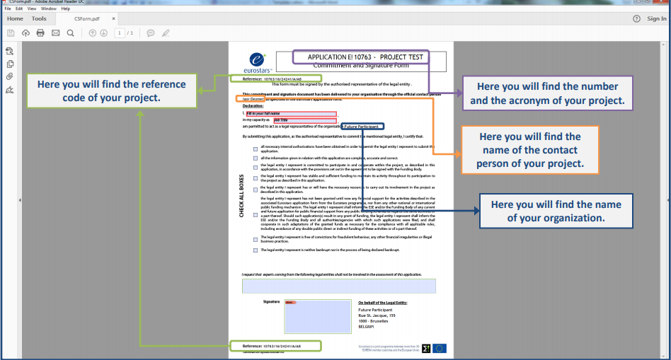
On myEUREKA
Commitment & Signature form
Check the guidelines here
Notes:
Some applicants struggle with the download of the C&S form, that’s why before filling it in, you should read our guidelines that show step by step how to download this form. The guidelines are on this link.

Slide 46
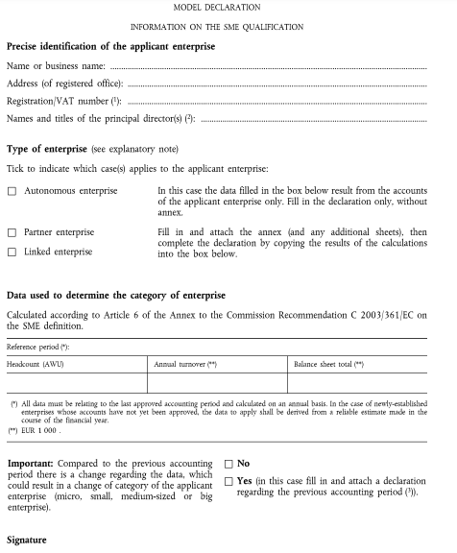
On myEUREKA
Read the European Commission’s SME definition for guidance
SME declaration
You can already take a look at the SME declaration here
Notes:
This is instead the SME declaration. This form can be already downloaded from the Eureka’s website, if you already want to take a look at it. In order to complete it, you should read the SME definition that was formulated by the European Commission. It’s a document that you can easily find online, the link is also included in this slide. The doc explains what an SME is, and the three types of SME (autonomous, partner and linked). This information is the same you need when completing your application form.
If you need assistance on how to complete this document, contact your NPC.

Slide 47
Application – To Do List
Contact your NPC and read the guidelines
Complete the application form:
  Make sure that each organisations has the correct status
  Make sure all contact details are correct
Upload annexes
Submit!
Make sure all partners log in to myEureka and submit C&S form (all) and SME declaration (SMEs)
Notes:
So to wrap up, here is a to do list.

Slide 48
Additional information
The platform allows only one registrant per application. If you want more people to work on the same application, share the credentials. Don’t work simultaneously, or data is lost.
Don’t use special characters.
After the first access to myEureka, you can access myEureka via Eureka’s website: click “Access my project space” and “Manage your Eurostars project”.
Notes:
Here’s a recap and some additional information.

Slide 49
Notes:
Thank you for your attention.
In the next slides, you can read a list of factors for success. Check them before you start completing your application. Check also what our experts look at when they evaluate your proposal, here’s the link: https://www.eurekanetwork.org/programmes/Guidelines%20for%20evaluation%20applicants.pdf?language_id=1

Slide 50
Factors for Success
Be available
    Allow time for necessary preparation (partner search, project proposal, consortium agreement…)
Build up a « win-win » cooperation
    Show complementarities and added value of trans-national partnership during and after the project
Show partnership’s ability to meet its commitments
    Demonstrate each party’s management, scientific and technical skills as well as its available financial resources for the project
Nowadays, public money is a scarce resource
    Demonstrate the fact that you have good financial health and have considered all of your options.

Slide 51
Factors for Success
Set clear, measurable and verifiable objectives
    Define success indicators for technological performance as well as the commercial and financial targets to achieve
Demonstrate clearly why the projects should be financed
    Highlight the risks and the strategic character of the project in terms of expected commercial and financial impact
    Is it value for money?
Be technologically ambitious while remaining realistic
    Define a methodical approach in line with partnership, budget and time limit set for the completion of the project and the marketing of its results

Slide 52
Factors for Success
Point out the innovative nature of the proposal submitted
    Present new industrial applications and their impact on the industry sector and relevant markets
Describing the technology is the easy bit there is more…
    Who are you? Describe the benefits of this partnership, the added value that each organisation brings?
    Focus on the project methodology (objectives, means, results)
    Appropriate and realistic cost breakdown
    Analyse the risks. How will you mitigate against them?

Slide 53
Factors for Success
Don’t forget your market (it sounds strange, but people do)
    Product plans, exploitation plans, commercialisation strategy.
    Analysis and comparison with state of the art.
    Barriers to market entry?
    Competitive advantages?
    Realistic market share? Will you actually make ROI?
    Or how to protect it – Good IPR analysis/strategies are rare
Fill in the project application carefully and ensure it is clear
    Promote the key elements the evaluators are looking for and ask an objective party to read it
    Proof read it – this is the cheapest way of making it better.
Don’t allow yourself to be surprised by anything
    Do your homework
    Speak to your National Project Coordinator (NPC)

