Slide 1




Slide 01
EVIDENCE-INFORMED POLICYMAKING: WHAT KIND OF EVIDENCE DOES THE 21st CENTURY POLICYMAKER NEED?
Knowledge based and informed policy making: challenges, mechanisms and the state of the art
International landscape
Science Meets Parliament
PIRET TÕNURIST
Ljubljana, 15 November 2019
@piret.tonurist
oe.cd/opsi
@OPSIgov
opsi@oecd.org

Slide 2


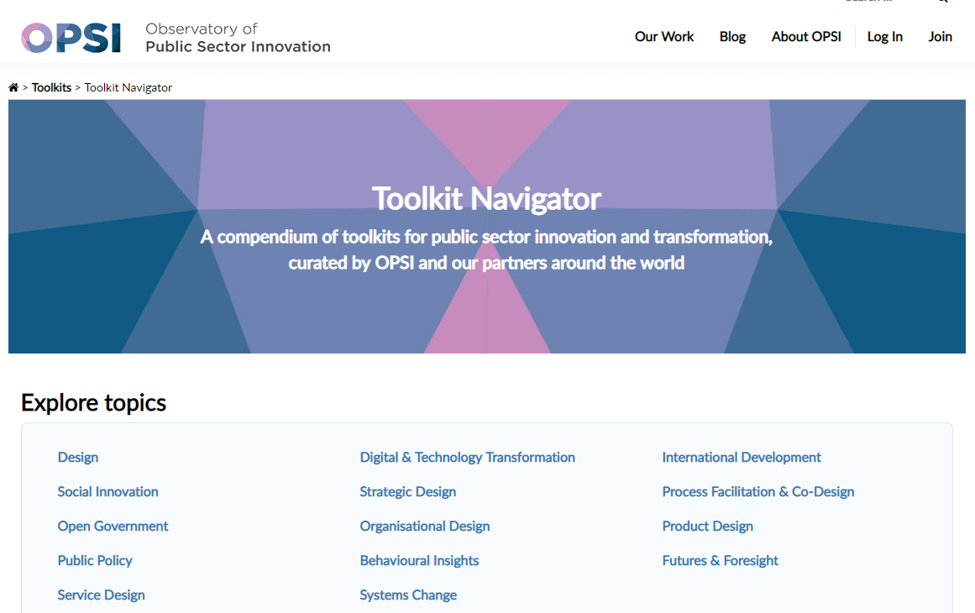

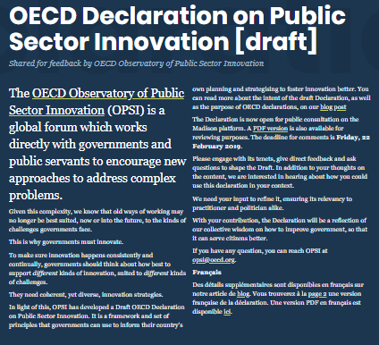
WHAT OPSI DOES
PROVIDING TRUSTED ADVICE
UNCOVERING
WHAT IS NEXT
TURNING THE NEW INTO NORMAL
PUBLIC SECTOR INNOVATION

Slide 3

Slide 19
PIRET TÕNURIST
ADDRESSING LEARNED HELPNESSNESS AND CREATING NEW FEEDBACK SYSTEMS
PUBLIC SECTOR INNOVATION DECLATRATION
https://www.oecd-opsi.org/projects/innovationdeclaration/
A SYSTEMIC APPROACH TO PUBLIC SECTOR INNOVATION

Slide 5
SOME CORE QUESTIONS
Evaluating Public Sector Innovation
Support or hindrance to innovation?
How to make evidence useful for the innovation practise that it is not only about taking account of the past, but it allows for learning for the future?
How to integrate evidence throughout the innovation lifecycle?
How to account for different types and forms of innovation in evidence-informed policymaking?
How does evidence work under uncertainty, with unplanned activity without clear goals or timeframes?
How evidence outline and account for different options for innovation and change?
How to evidence go beyond silo-thinking and capture cross-boundary effects of innovation?
How can evidence help counteract lock-in in organisations and not kill of transformative change?
How can evidence create room for experimentation and facilitate learning from failure?
How to describe the value-added of innovation without an adequate baseline comparison or a uniformly understood measure of value?
THE OBSERVATORY OF PUBLIC SECTOR INNOVATION

Slide 6

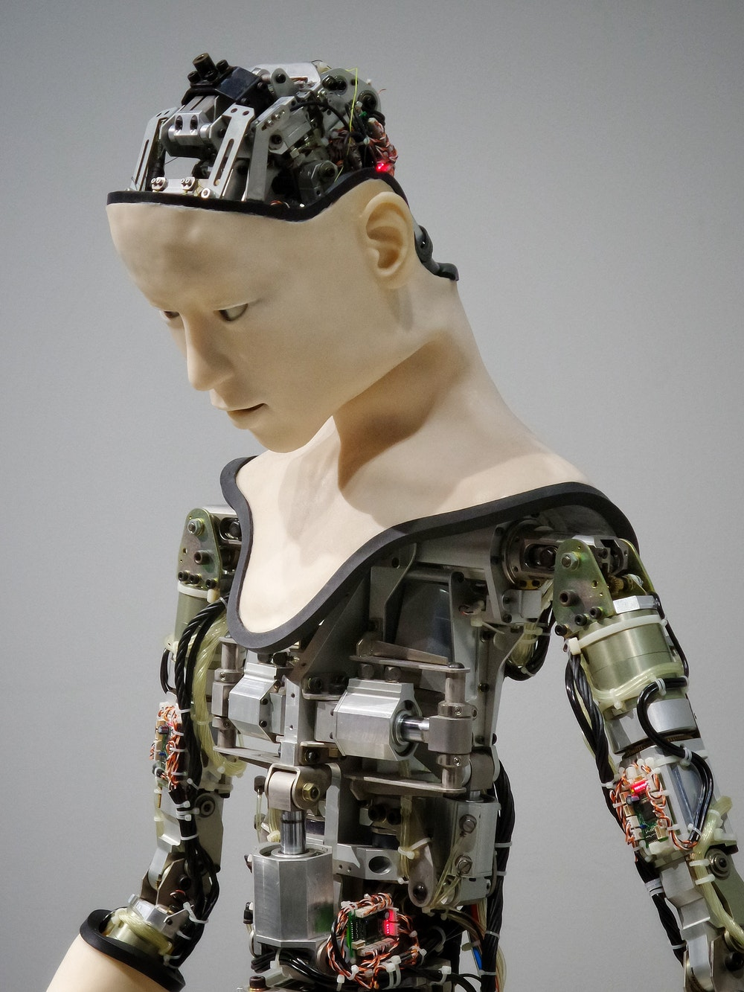
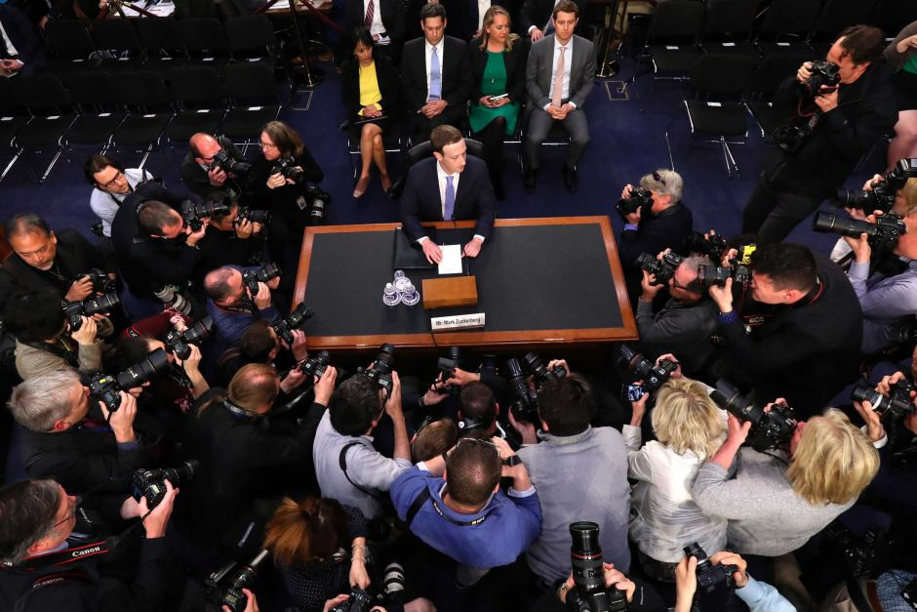

Why is innovation more important than ever?
Source: abc.net.au
Source: unsplash.com
NEED FOR INNOVATION
Notes:
Source: abc.net.au

Slide 7
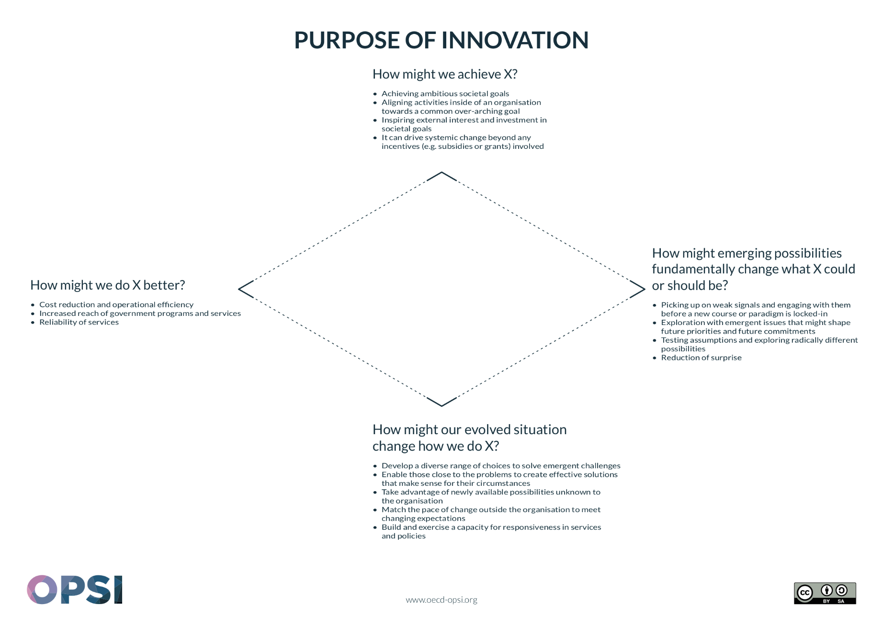

Slide 8
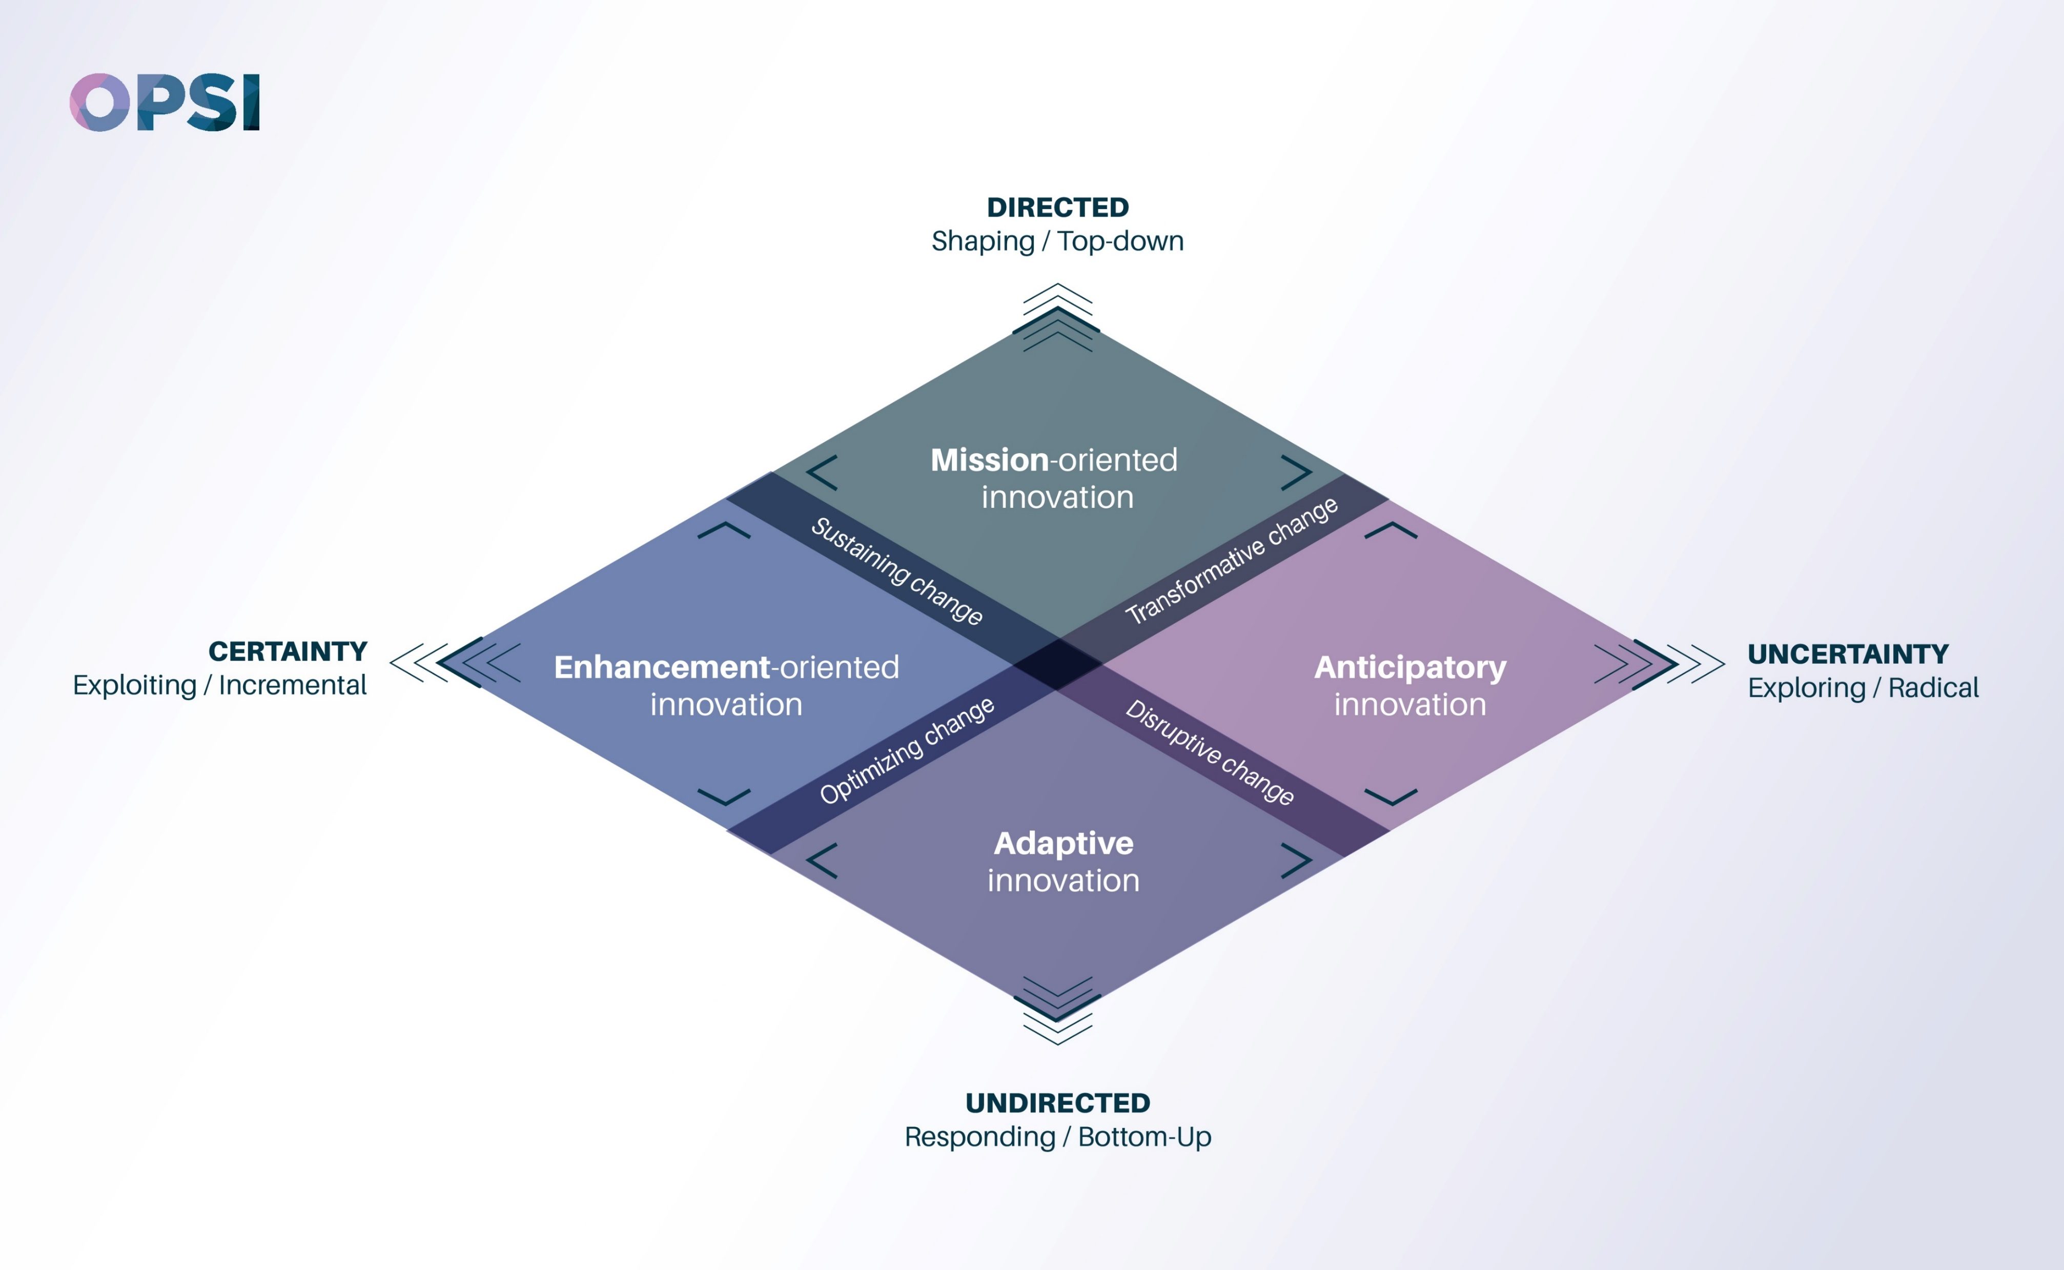

Slide 9
TOOLS & METHODS
DIFFERENT TOOLS AND METHODS AS STARTING POINTS FOR INNOVATION SUPPORT DIFFERENT KINDS OF INNOVATION ACTIVITY
Systems thinking, strategic design, open innovation, and challenges and prizes etc.
Lean, business process management, quality control, and behavioural insights etc.
Horizon scanning, strategic foresight, futures thinking, speculative design, lead users, regulatory (or other) sandboxes, mechanisms of challenge, and longer-term structured discovery-based challenges etc.
Positive deviance, design, transparency, participatory or co-design, co-creation, exploration of edge cases, and through suggestions boxes and ideas management systems
Etc.
HOW YOU GENERATE DATA IS AS IMPORTANT AT WHAT KIND OF DATA IS GENERATED…
AIG EXPERT GROUP MEETING IN PARIS

Slide 10
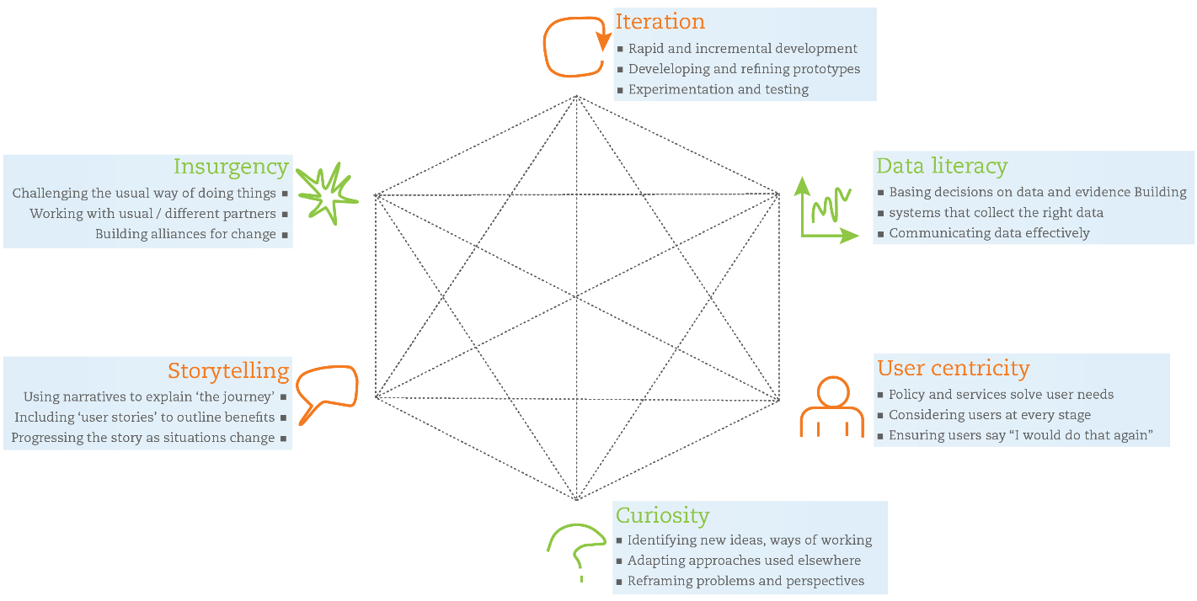
Slide 13
NEW PUBLIC SECTOR SKILLS

Slide 11
THE NEW APPROACH TO GENERATE DATA: TRADITIONAL VS DESIGN APPROACHES
Problems of “traditional” public sector | Features of design thinking as solutions to public-sector needs
Disjointed incrementalism Cost-driven problem-solving without asking whether the fundamentals are right and user needs are met | Designing for the fundamental need Tailored solutions based on user needs
High-risk piloting Large-scale pilots with considerable risk and costs. | Low-risk prototyping Small-scale pilots and failing fast and smart
Lack of joined-up thinking Disconnect between analysis of problems, solutions and implementation | A complete innovation process Design-led, joined-up innovation process
Lack of citizen engagement No guarantees that citizens’ needs are met and limited buy-in to government solutions | A citizen-centred process User involvement throughout the innovation process to co-design and test solutions, resulting in higher ownership of solutions
Poor understanding of citizen needs Gap between what people want and what they say want, and ineffective methods to determine the difference | Direct understanding of citizen needs Observation of user behaviour to discover unidentified needs
Lack of tangibility Important messages subsumed in information overload | Dynamic tangibility Visualisation of relationships and processes through which solutions work
Silo structures Problems with co-ordination and collaboration, both inside and outside of government | Multdisciplinary teamwork Ways of assessing the relevancy of actors and devising techniques to help multidisciplinary teams collaborate.
Designing for the average Services and policy are designed for a notional average user in an average situation | Designing for extremes Accounting for extremes, ensuring that solutions cover a wide range of users and scenarios
THE OBSERVATORY OF PUBLIC SECTOR INNOVATION

Slide 13
BI CASES BY REPORTED POLICY AREA
Note: The data is drawn from the OECD 2016 Behavioural Insights Case Survey Dataset.
Source: OECD, 2017e: 53.
THE OBSERVATORY OF PUBLIC SECTOR INNOVATION

Slide 14
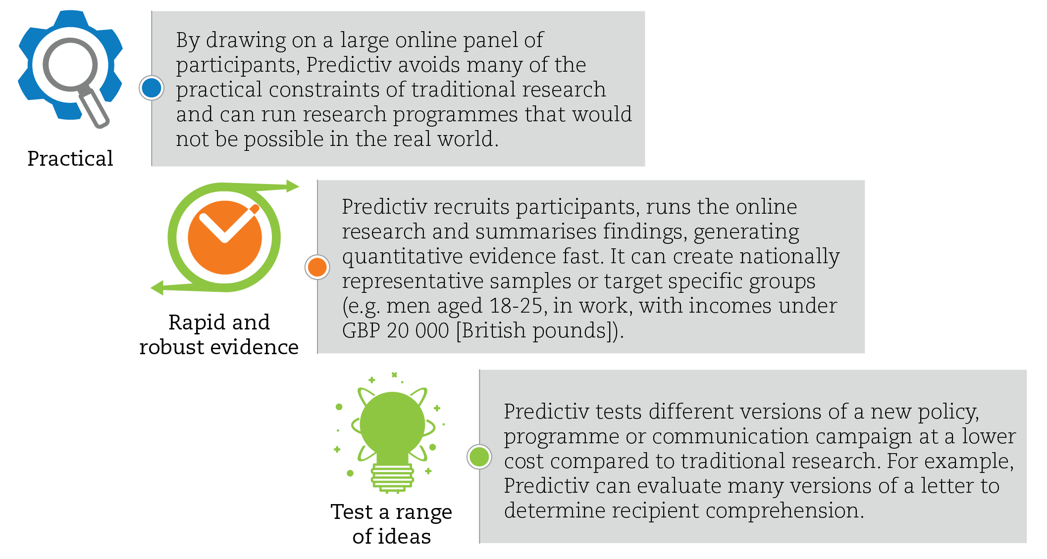
Slide 13
Behavioral approaches: Predictiv (UK)
Source: OECD (2018), “Embracing Innovation in Government: Global Trends 2018”, http://www.oecd.org/gov/innovative-government/embracing-innovation-in-government-2018.pdf.; Predictiv (n.d.), “ Predictiv for policymakers & practitioners”, www.predictiv.co.uk/governments.html.
DATA INFRASTRUCTURE AND VALUE

Slide 15
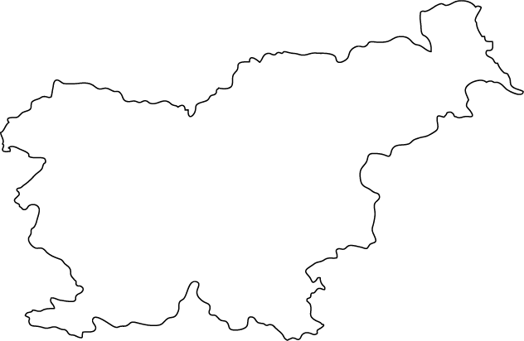
IMPLEMENTATION OF SYSTEM CHANGE IN GOVERNMENT
MAKING PUBLIC PROCUREMENT EFFECTIVE IN SLOVENIA
BEHAVIORAL BIASES
TECHNOLOGY
The Observatory of Public Sector Innovation (OPSI) will apply systems thinking to analyse the main systemic barriers and challenges to effective procurement in Slovenia
The project is funded by the EC through the Structural Reform Support Programme
SRSS PROJECT
2019
SECOTAL FACTORS
CAPACITY OF PRIVATE PARTNERS
PREMISE OF THE PROJECT
Effective procurement does not depend solely on digital platforms
The capacities inside and also outside the public sector play a role
Human behaviour and perception of corruption can be very important determinants of success
The project will examine these and any other systemic challenges to effective procurement in Slovenia and propose systemic solutions for the issues identified
ACCOUNTABILITY STRUCTURE
RISK CULTURE
PERCEPTION OF CORRUPTION
(DIGITAL) CAPACITY
EXPERIENCE WITH ITERATIVE/AGILE DEVELOPMENT
THE OBSERVATORY OF PUBLIC SECTOR INNOVATION

Slide 16
REACTIVE
PROACTIVE
GOVERNMENT
GOVERNMENT
Position of ‘wait and see’ or called forward when ‘hazards’ (moral, ethical or even physical) materialize.
‘End-of-pipe’ interventions, and often fail to anticipate or address long-term systemic implications
Government as a ‘technology maker’
Government anticipating various futures and actively exploring and shaping them in practise.
AIG EXPERT GROUP MEETING IN PARIS, OECD

Slide 17



Slide 09
INTRODUCTION TO THE WORK
OVERVIEW OF THE PROJECT
ANTICIPATORY INNOVATION
GOVERNANCE
ANTICIPATORY INNOVATION GOVERNANCE, 21-08-2019

Slide 18
GETTING SPECIFIC
Why do we talk about anticipatory innovation governance?
ANTICIPATION
ANTICIPATORY
GOVERNANCE
ANTICIPATORY
REGULATION
ANTICIPATORY
INNOVATION
GOVERNANCE
.
Anticipation is the process of creating knowledge – no matter how tentative or qualified – about the different possible futures. This may include, but is not limited to developing not just scenarios of technological alternatives, but techno-moral (value-based) scenarios of the future (Normann, 2014).
Anticipatory governance is the process of acting on a variety of inputs to manage emerging knowledge-based technologies and socio-economic developments while such management is still possible (Guston, 2014). This may involve inputs from variety of governance functions (foresight, engagement, policymaking, funding, regulation etc.) in a coordinated manner.
Anticipatory regulation is a function of anticipatory governance which uses regulatory means to create space for sandboxes, demonstrators, testbeds etc. for various technology options to emerge. This requires an iterative development of regulation and standards around an emerging field (Armstrong and Rae, 2017).
Anticipatory innovation governance is a broad-based capacity to actively explore options as part of broader anticipatory governance, with a particular aim of spurring on innovations (novel to the context, implemented and value shifting products, services and processes) connected to uncertain futures in the hopes of shaping the former trough the innovative practice (OPSI, 2019).
AIG EXPERT GROUP MEETING IN PARIS, OECD

Slide 19
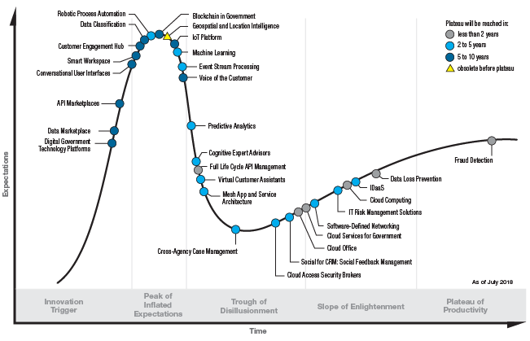
GARTNER HYPE CYCLE FOR DIGITAL GOVERNMENT TECHNOLOGY, 2018
HYPE OF REALITY?
When you’re fundraising, it’s AI. When you’re hiring, it’s ML. When you’re implementing, it’s logistic regression.
– everyone on Twitter ever*
Source: www.gartner.com/smarterwithgartner/top-trends-from-gartner-hype-cycle-for-digital-government-technology-2018.
*https://towardsdatascience.com/no-machine-learning-is-not-just-glorified-statistics-26d3952234e3

Slide 20



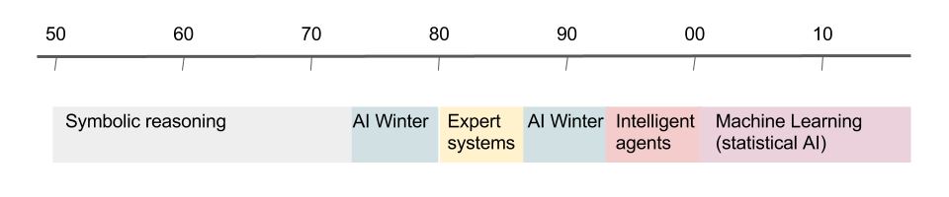
HYPE, FAKE NEWS OR SCARY REALITY?
“We tend to overestimate the effect of a technology in the short run and underestimate the effect in the long run.” (Roy Amara)
How can you tell the difference?
Sometimes it is impossible to impossible know which signal is the correct one, what is fad and what is fiction. In many cases this means exploring options in practise in an experimental way.
AIG EXPERT GROUP MEETING IN PARIS, OECD, 29-05-2019

Slide 21
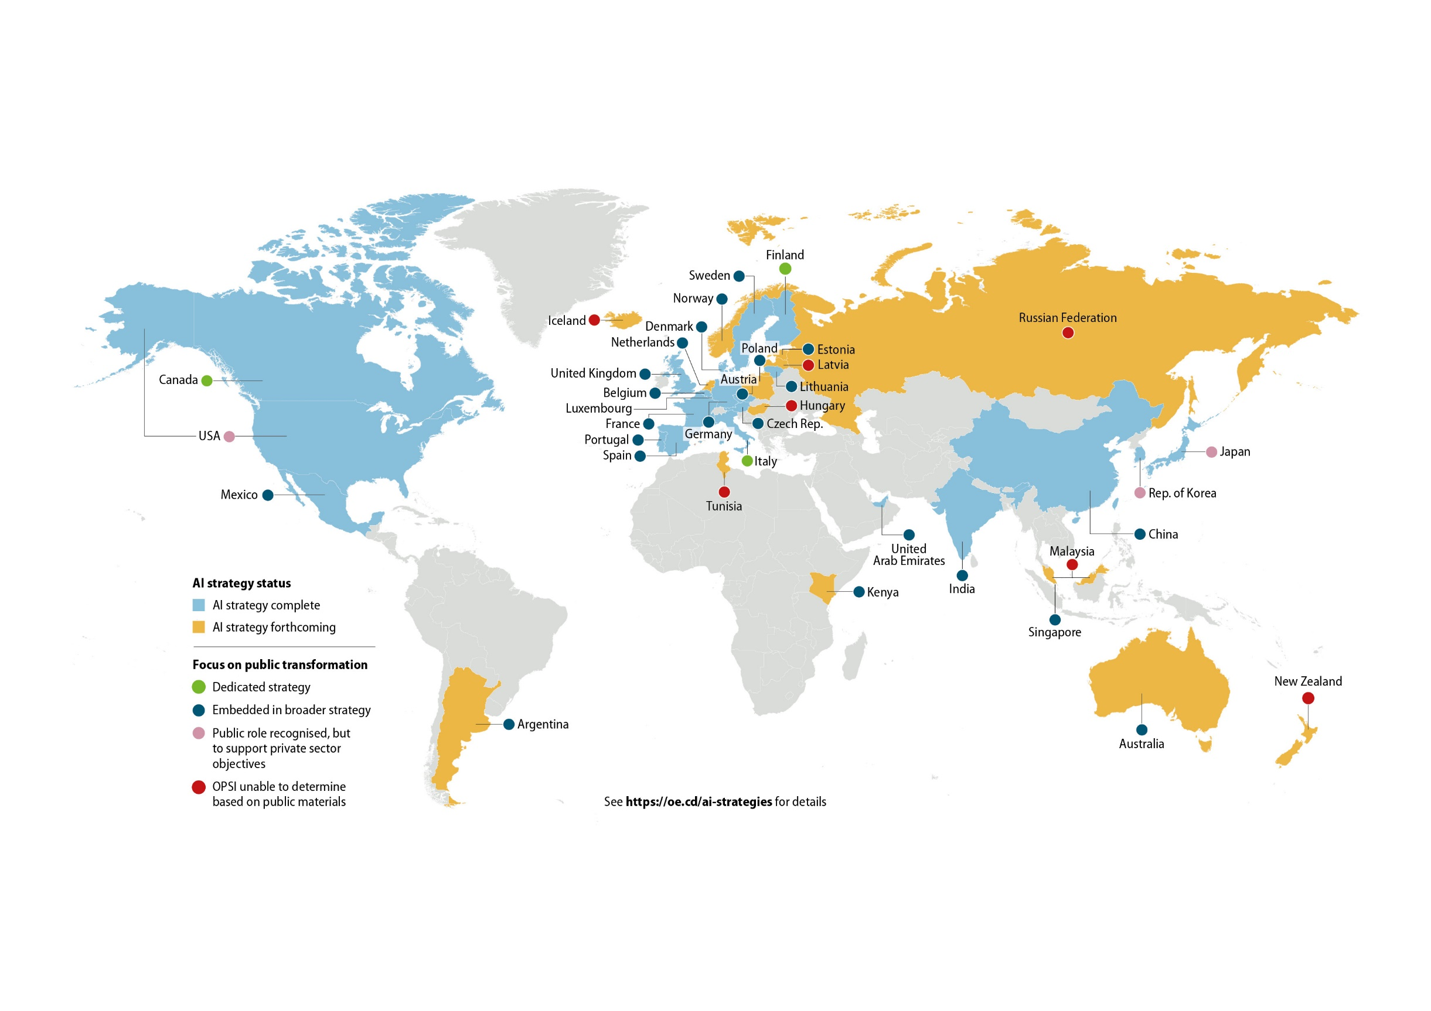
Slide 08
Public sector AI strategies
Notes:
We started with deep case analysis.

Slide 22
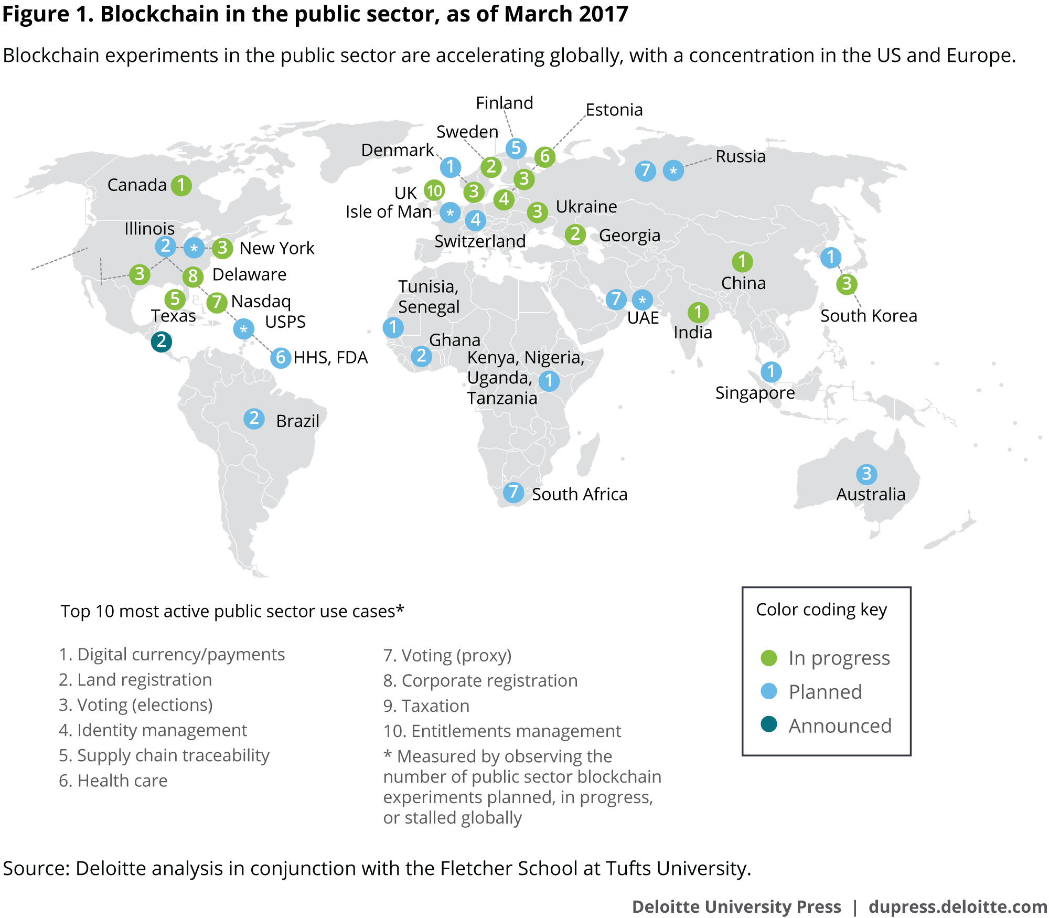
Slide 08
Spread of blockchain - 2017
One year ago: 117 Initiatives in 26 Countries
Source: Deloitte analysis on blockchain in conjunction with the Fletcher School at Tufts University (March 2017)
Notes:
We started with deep case analysis.

Slide 23
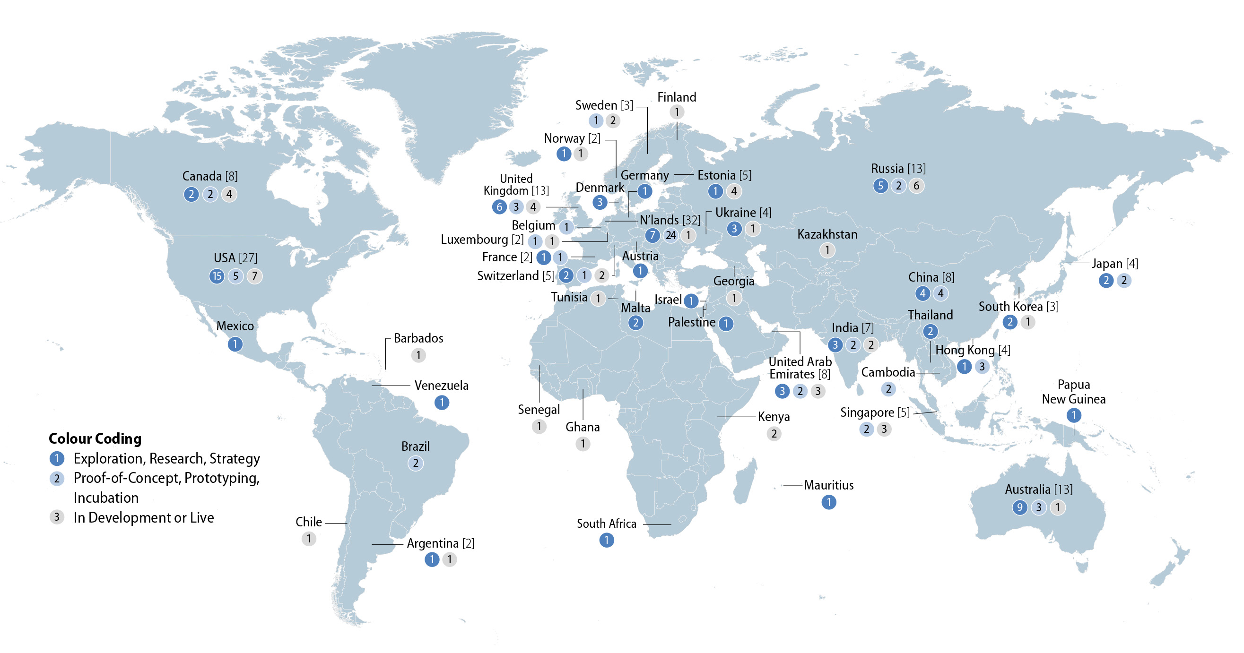
Slide 09
Spread of blockchain - 2018
Today
Source: OECD analysis of data collected by The Illinois Blockchain Initiative (March 2018)
Notes:
We started with deep case analysis.

Slide 24

CURRENT TOOLS AND METHODS AND HOW THEY ARE USED ARE FAILING GOVERNMENTS
Foresight activities tend to be silod and do not translate in actively exploring options
This does not help governments to deal with deal with complex and fast-evolving new technologies. This means that anticipatory innovation governance should blend foresight, engagement and reflexivity into an integrated and systemic approach.
AIG EXPERT GROUP MEETING IN PARIS, OECD, 29-05-2019

Slide 25

Slide 34
#OECDsys
@piret.tonurist
oe.cd/opsi
@OPSIgov
piret.tonurist@oecd.org

