Slide 1
Scientific Advice and Foresight Work in the European Parliament: The case of STOA
Science meets Parliament, Ljubljana, 15.11.2019
Wolfgang Hiller, Director, Impact Assessment and European Added Value

Slide 2
Defining the challenge – bridging the gap
Progress in science and technology requires proactive and forward looking legislative activity
Fake news and mistrust towards science and evidence-based policy making
Legislators are no Scientists, and Scientists no Legislators

Slide 3
The creation of STOA – an institutional response
March 1987, an EP office for scientific and technological option assessment was launched.
Since September 1988: STOA works on a permanent basis, in the service of all committees.
Governance and leadership through the STOA Panel, composed of Members representing 9 committees

Slide 4
Part of a wider parliamentary support network
The Scientific Foresight Unit (STOA) as part of the European Parliamentary Research Service (EPRS), the in-house research service and think tank of the European Parliament
Embedded in inter-institutional cooperation with research services of the other European Institutions
Member of the European Parliamentary Technology Assessment (EPTA)
Contacts and cooperation with the research and science community in Europe and beyond

Slide 5
Empowering Members through knowledge
Provide strategic advice in the fields of science and technology options assessment and scientific foresight
Based on interdisciplinary research
Implementing the´silo and pipe strategy´

Slide 6
A broad range of activities
Precision Agriculture
Publications, studies, blogspots
Workshops and events
Conferences and delegations
Communication

Slide 7
STOA studies
Technology Assessment
Scientific Foresight

Slide 8
Recent STOA publications
How the General Data Protection Regulation changes the rules for scientific research
Polarisation and the use of technology in political campaigns and communication
Regulating disinformation with artificial intelligence
Blockchain
Galileo Satellite Navigation System

Slide 9
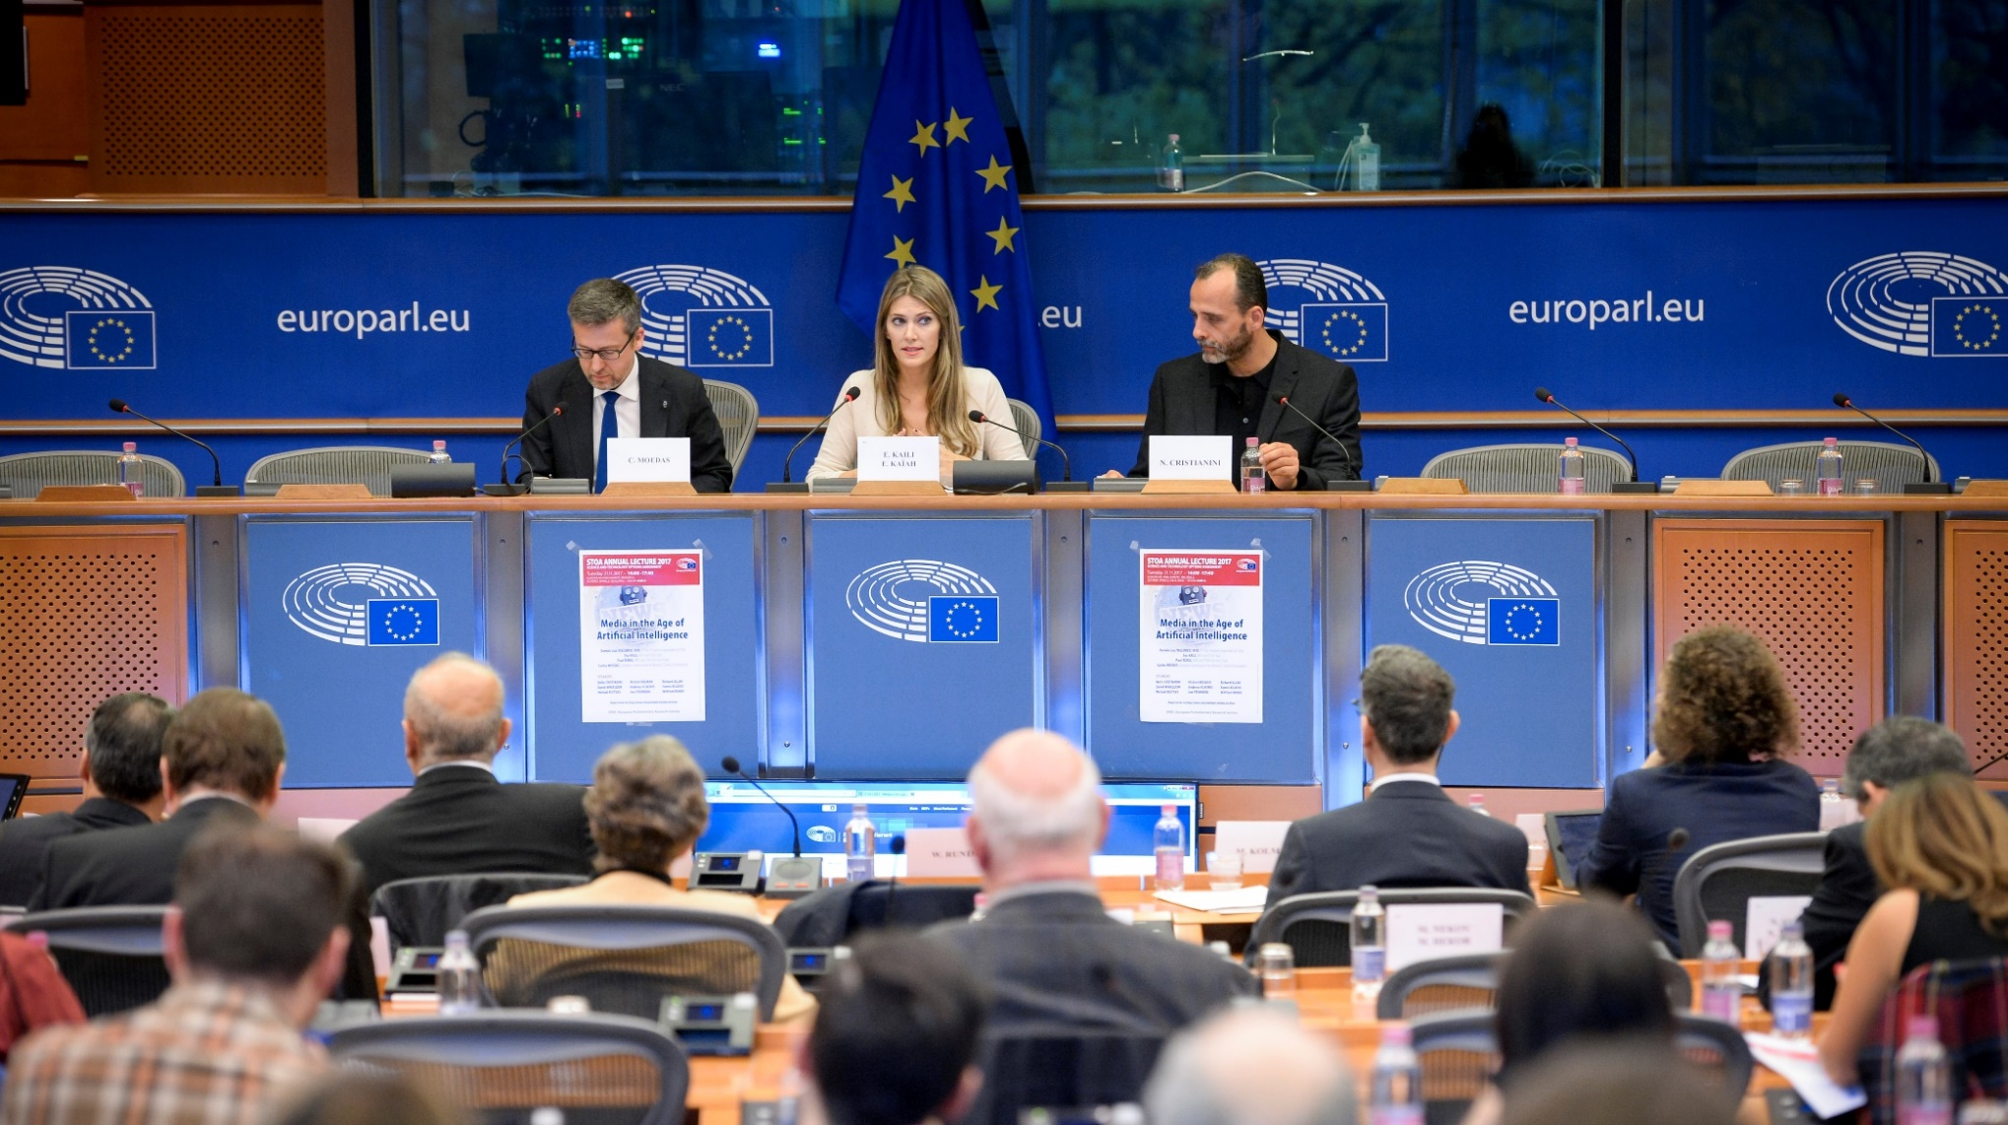
STOA Annual Lecture

Slide 10
Science meets Parliaments

Slide 11
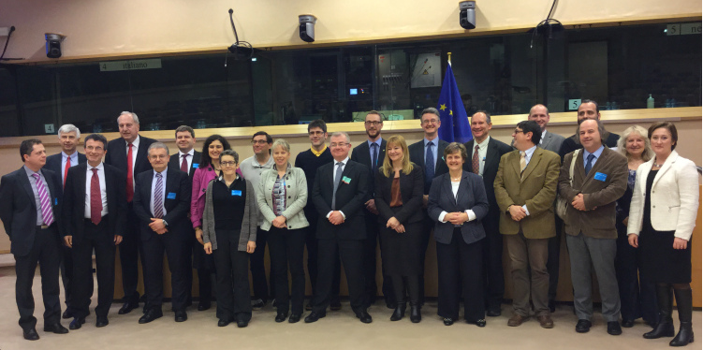
MEP – Scientist Pairing Scheme

Slide 12
Impact and benefits
Building trust between science and politics
Enhancing mutual understanding
Establishing long-term relations and continuing collaboration

Slide 13
European Science Media Hub (ESMH) Linking science, politics, media, citizens
Networking
Knowledge sharing
Media monitoring & intelligence
Training for journalists

Slide 16
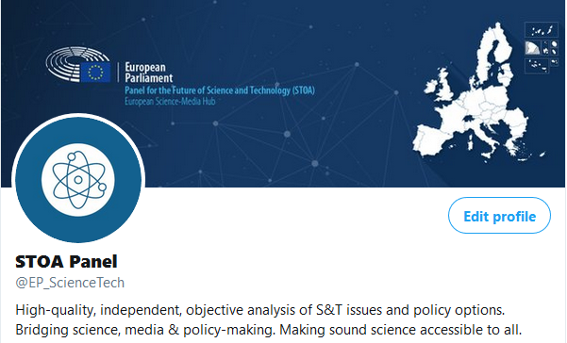
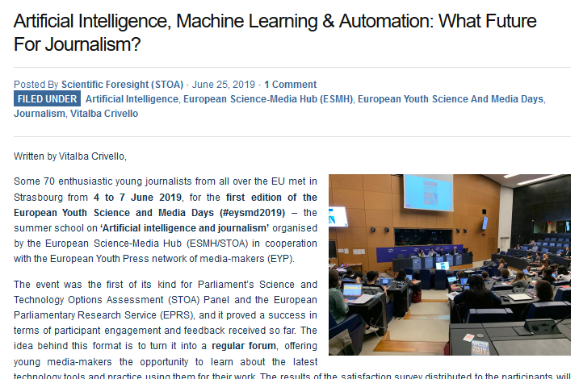
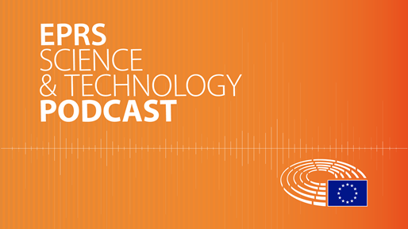
New media

Slide 17
More ways to enhance outreach and mutual understanding
Use `easy to read language`
Experiment with innovative formats
Use modern tools of communication

Slide 18
Modern tools for outreach
STOA website
Videos on Youtube at My STOA
STOA Podcasts
Animated Infographics
Blog

Slide 19
Thank you!

